Slide 1
Bundled Execution of Recurring Traces for Energy-Efficient General Purpose Processing
Shantanu Gupta, Shuguang Feng, Amin Ansari,
Scott Mahlke, and David August
University of Michigan
(Intel, Northrup-Grumman, UIUC, Princeton)
MICRO-44 December 6, 2011

Slide 2
Computational Efficiency Landscape
Energy dilemma
More gates can fit on a die
But power constraints limit their use
To scale performance, need to increase efficiency
AMD 6850
S1070
GTX 295
GTX 280
IBM Cell
Core i7
AMD Opteron
Core 2
Embedded
Processors
Pentium M
2

Slide 3
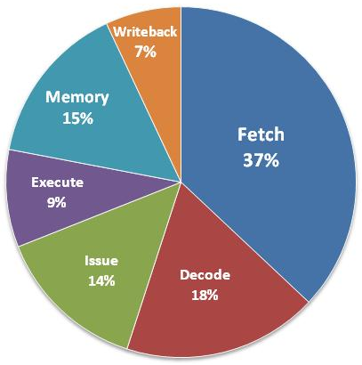
Where Does The Energy Go?
Energy used in a single-issue RISC in-order core
Instruction fetch and
decode energy dominates
Actual execution barely
consumes 10%
Plenty of opportunities to save energy….
[Dally’08]

Slide 4
Increasing Efficiency with Accelerators
Accelerators can give 10 – 50X efficiency
Application regularity defines success:
Small dominant code segments
Little control flow
Narrow application set
Data parallelism
FPGAs
General Purpose Processors
Flexibility
ASIPs
DSPs
SIMD
Loop Accelerators,
ASICs
Efficiency, Performance
Notes:
ASICs, accelerators, conservation cores, loop buffers…all these were used in embedded systems…
Regular codes is suitable…e.g. counted inner-most loops, modulo-schedulable codes, explicit data-parallelism, etc.
Small number of benchmarks…can use specialized hardware…

Slide 5
Utility Factor for Accelerators
What fraction of the code gets accelerated?
Most solutions fail for “irregular” or “general-purpose” code
FPGAs
General Purpose Processors
???
Flexibility
ASIPs
DSPs
SIMD
Loop Accelerators,
ASICs
Efficiency, Performance
Goal: A design to target irregular codes
Notes:
ASICs, accelerators, conservation cores, loop buffers…all these were used in embedded systems…
Regular codes is suitable…e.g. counted inner-most loops, modulo-schedulable codes, explicit data-parallelism, etc.
Small number of benchmarks…can use specialized hardware…

Slide 6
The BERET Architecture
A compute engine for “hot regular regions” in irregular codes
Key insights:
Exploits recurring instructions (traces) to save on redundant fetches and decodes
Uses a bundled execution model to save on redundant register reads/writes
CPU
BERET
Program
CPU
BERET
L1 I$
L1 D$
copy live-ins
Hot
Regions
copy live-outs
BERET: Bundled Execution of REcurring Traces
Notes:
Exclusive to every core. Everything else is according to our vision from the last year!
Works for irregular codes
Applied on recurring sequences of instructions (hot parts of a code)
Runs them using a subgraph execution model
Can be configured for any program segment

Slide 7
Insight 1: Recurring Instructions
How about loops?
Typical loops in irregular codes are large and control intensive!
We leverage such looping traces for savings
Straight-line code → simple hardware
Typically short → easy to buffer
Significant fetch / decode savings for buffered instructions
BB 0
_{Hot basic blocks}
BB 1
85%
15%
BB 1
BB 1
BB 2
BB 5
BB 20
BB 2
BB 3
BB 3 exit?
BB 2
10%
90%
BB 4 exit?
BB 5
BB 4
BB 5
BB 20
50%
50%
BB 6
BB 7
A looping trace
BB 20
Control Flow
Graph (CFG)
Notes:
Show CFG…hot trace..
Side branches trigger an exit to the original control-flow graph
Say that traces help us save redundant instruction fetches and decodes
Show trace coverage in some chosen benchmarks
Traces have been used in the past for dynamic code optimization…we exploit them to find temporal regularity in code sequences
Remember, these can have side exits…and the execution returns to the original Control flow graph

Slide 8
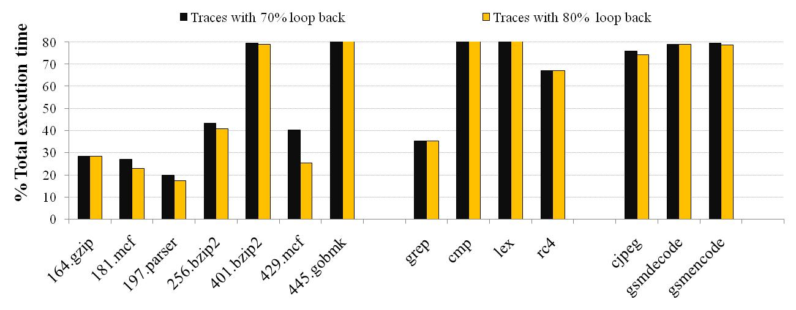
Frequency of Recurring Instructions
Offload stable traces in irregular loops

Slide 9
Insight 2: Bundled Execution
Traditional processors issue and execute instructions in isolation…
Bundled
execution
>>
LD
>>
LD
+
LD
+
LD
+
/
&
+
/
&
ST
>>
<<
ST
>>
<<
ST
ST
11 instrs, 14 reads, 10 writes
3 instrs, 6 reads, 2 writes
Notes:
Subgraph-execution can save register accesses…
Can divide a data flow graph into constituent subgraphs…

Slide 10
Efficiency of Bundled Execution
All results normalized to a bundle length of 1
Bundled execution increases datapath efficiency by more than 2x
10

Slide 11
BERET Hardware Design
Hardware design objectives:
Capable of executing straight-line code in a loop (traces)
Support for bundled execution of trace instructions
Handle trace side-exits, and transfer control to the main processor
D$
I$
Internal
Register File
Store
Buffer
Index bits
MUX
Configuration RAM (CRAM)
Input Latch
SEB 1
SEB 2
SEB N
SEB
config.
ALU
LD
config. bits
Writeback Bus
<<
ALU
Configure
SEB
Execute
SEB
Writeback
Output Latch
1 – 2 cycles
1 – 5 cycles
1 – 2 cycles
SEB: Subgraph Execution Block
Notes:
This is a mini-processor, which is a microcoded CISC engine that can run only straight line code.
Configuration RAM stores the active program trace --- instruction fetch/decode savings..recurring trace storage
Each trace is broken down into bundles of instructions, executed on the SEBs. At a time, only one SEB is active --- SEB gives us bundled executioin…
Energy Savings also result from a simple hardware with a short pipeline, no control handling / speculation, smaller structures, fewer latches…

Slide 12
Compiler Support
1. Trace Detection
2. Mapping traces to SEBs
Data flow
subgraphs
Program
Hot Trace
1
MPY
ADD
SUB
BR
LD
AND
SHIFT
ST
ADD
ADD
OR
BR
×
+
BERET with SEBs
2
1
LD
-
Configuration
SEB 0
Control
exit
&
BR
Assert
Hot Traces
(with high loop
back probability)
2
SEB 1
<<
RF
ST
SEB 2
3
3
+
+
SEB 3
exit
|
BR
Assert
Notes:
These the flow of software support to map program regions to
Once mapped to BERET, run the sequence of SEBs back to back, until a trace exit is found. Control returns to the main processor in that case…

Slide 13
CPU-BERET Execution Flow
RF
RF
Execution
Side
Exit
CPU
BERET
Header
Copy Live-Ins
Copy Live-Outs
Execution Time
Body
Body
…
Body
Assert
Header
Header
Header
Header
RF-0
RF-1
RF-0
RF-1
Registers copied to BERET
Program executes on BERET
Assert discovered, last iteration squashed
Registers copied back to main processor
Program executes on main processor

Slide 14
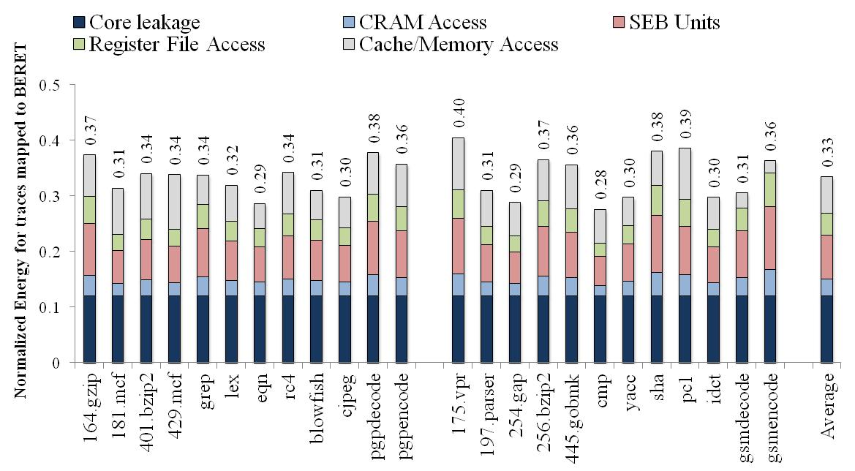
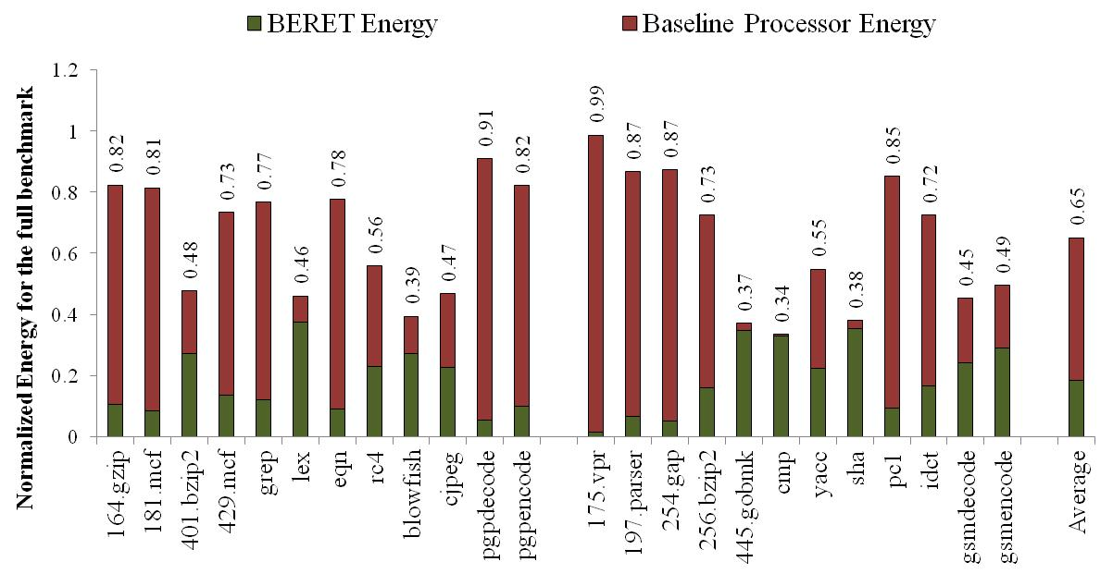
Energy Savings
Training set
Test set
Notes:
Chart 1: Energy consumption (normalized to full core) for the execution traces mapped to BERET hardware
Chart 2: Energy consumption for the entire program, parts of which run on BERET, and the rest runs on default core.
Energy savings against an ARM 1176 core : single-issue in-order
Performance comparison against the same design.
Training set is the set of workloads used to determine the collection of SEBs. The test set was a new set of benchmarks to measure the quality of identified SEBs.

Slide 15
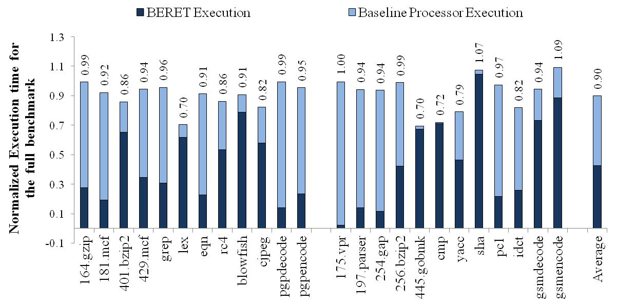
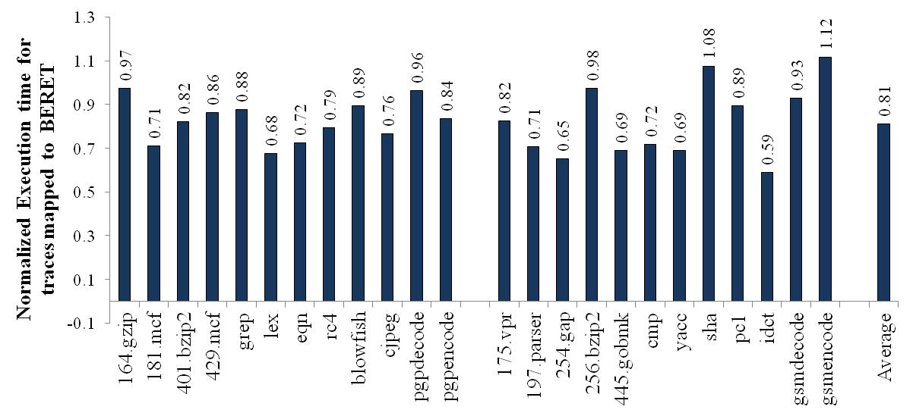
Performance Impact
Notes:
Performance changes from running on the BERET engine. Overall, there is a 10% performance improvement. This speedup is a result of exploiting ILP in SEBs that execute instructions in parallel. This behavior is very similar to the subgraph level accelerators (CCA, Nate Clark et. al.).

Slide 16
Concluding Remarks
Scaling program performance in energy-constrained environment requires improving computational efficiency
Most accelerators exploit program regularity for savings
BERET is a configurable engine that saves energy by:
Exploiting hot traces to avoid redundant fetches and decodes
Using a bundled execution model to reduce temporary variable reads and writes
Energy Saving
~35%
Performance Enhancement
~10%
Area Overhead
20%

Slide 17
Questions
For more
See http://cccp.eecs.umich.edu

Slide 18
Fine Grain Program Phase Behavior
Traditional phases too coarse-grained to match accelerator
Traditional phases
Fine-grain
0M
Accelerate the pink portions
10M
Hypothesis of This Work
Irregular programs are composed of fine-grain periods of high degrees of regularity. We can identify these periods and run them on an accelerator customized for “simple” execution.
18

