Slide 1
Erasing Core Boundaries for Robust and Configurable Performance
43rd International Symposium on Microarchitecture
Shantanu Gupta Shuguang Feng Amin Ansari Scott Mahlke
University of Michigan, Ann Arbor
December 7, 2010

Slide 2
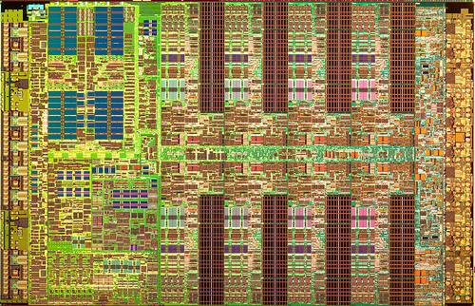
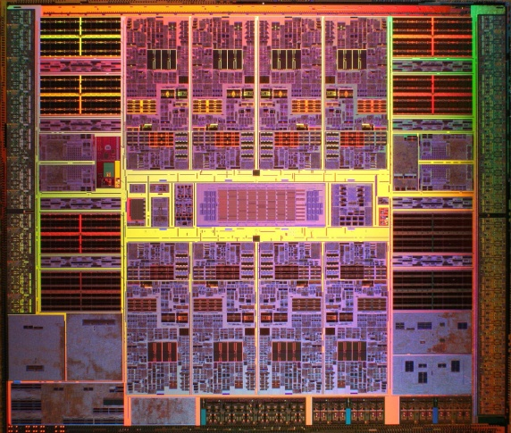
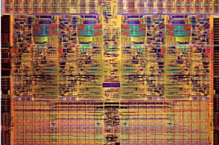
Multicore Architectures
Industry wide move to multicores
  2 – 16 cores on a single die
Multiple challenges confront them:
  Single-thread performance
  Reliability
  Power density
  Memory bandwidth
  ….
Our hypothesis: A highly configurable architecture can handle these issues in a unified manner.
IBM Cell
Sun Niagara 2
Intel 4 Core Nehalem
Notes:
Multicore trend driven by
Power density concerns
Diminishing returns on single core complexity
But, the trend to use simpler cores...
Stagnates single-thread performance
Provides little to no inherent redundancy
Is not enough to combat the power density

Slide 3
Multicore Performance Challenge
1. Good throughput / parallel
performance with more cores
2. Stagnating sequential performance
Core
Core
Core
Core
Core i7
Core Duo
Core 2 Quad
Core
Core
Core
Core
Pentium 4
CPU Performance (log scale)
Pentium III
Need flexibility to provide both
Parallel and Sequential performance
Pentium II
Core
Core
Core
Core
Pentium
486
Core
Core
Core
Core
Power wall
Parallel workloads
(scientific computing, newer
web browsers, video decoding)
Sequential workloads
(legacy workloads, most
mobile/desktop apps)
Spectrum of Applications

Slide 4
Solution: Configurable Performance
Assign resources where they are needed…
In an N core chip:
  Use all N cores for best Parallel Performance
  Group M cores together for Serial Performance (M < N)
Core Fusion, ISCA’07; Composable Lighweight Processors, MICRO’07
Parallel / Throughput
Serial / Sequential
Source: Mark D. Hill

Slide 5
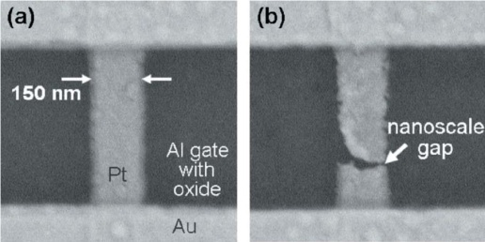
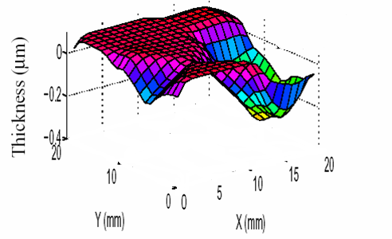
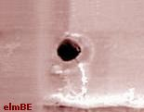
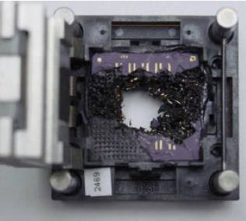
Multicore Reliability Challenge
Parametric
Variability
Electromigration (EM)
Intra-die variations in ILD thickness
Need mechanisms for
in-field silicon failures
Hard
Faults
[Todd Austin, GSRC Sep 08]
Increased Heating
Thermal
Runaway
Oxide breakdown (OBD)
Higher
Power
Dissipation
Higher
Transistor
Leakage
Manufacturing Defects That Escape Testing
(Inefficient Burn-in Testing)
Negative Bias Threshold Inversion

Slide 6
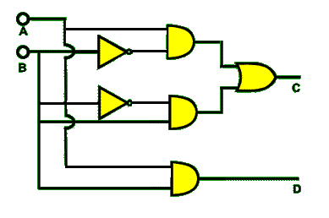
Solution: Isolate Broken Resources
CORE level
MODULE level
ElastIC, DT’ 06
Configurable Isolation, ISCA’07
Online Diagnosis of Hard Faults, MICRO’ 05
Ultra Low-Cost Defect Protection, ASPLOS’ 06
STAGE level
Stage1
Stage2
Stage3
StageN
Stage1
Stage2
Stage3
StageN
Stage1
Stage2
Stage3
StageN
StageNet, MICRO 08
Core Cannibalization, PACT 08
StageNet decouples the pipeline stages
Regular fabric, no global interconnections
Any set of stages can be connected to form a pipeline

Slide 7
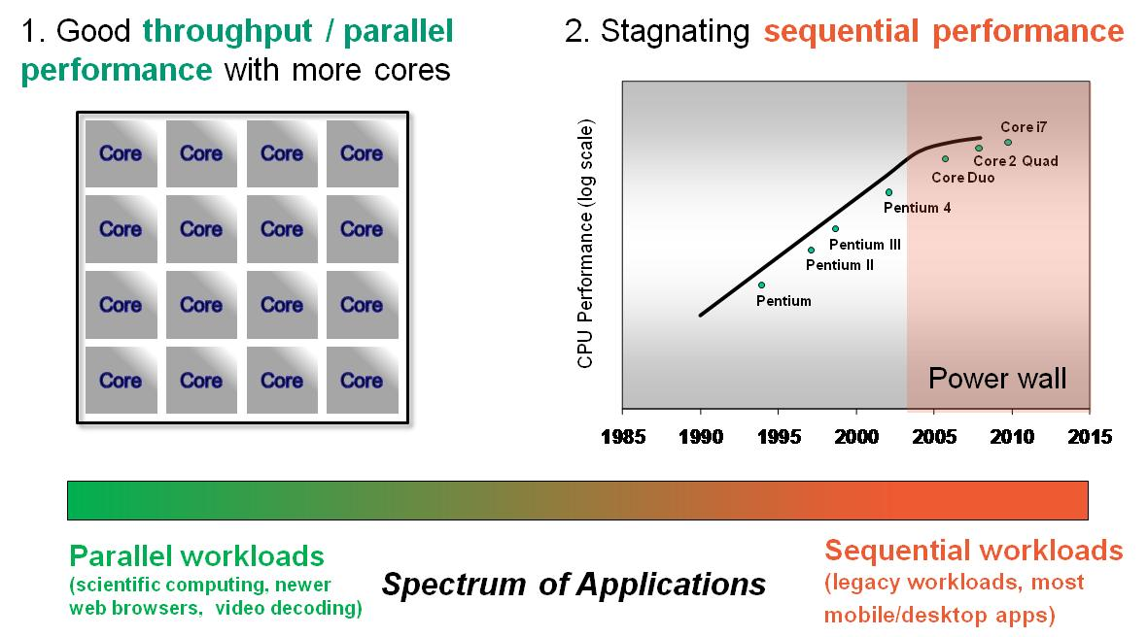
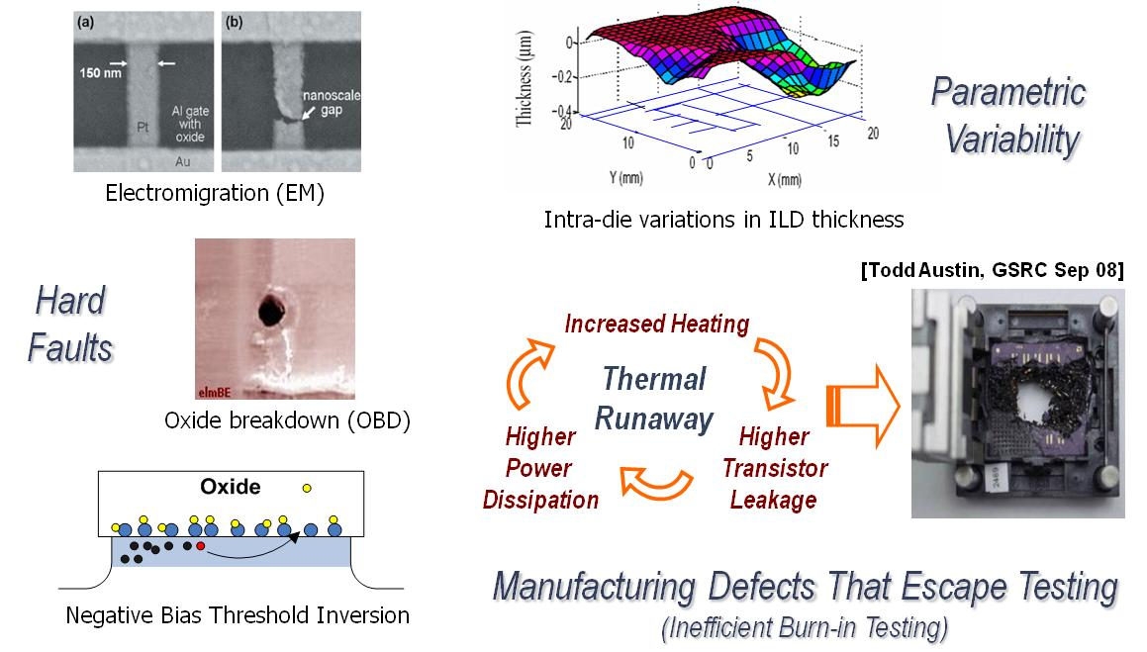
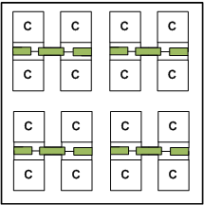
Point Solutions: Summary and Limitations
Configurable Performance
Reliability
Stage1
Stage2
Stage3
StageN
Fuse cores for
higher single-thread
performance
Stage1
Stage2
Stage3
StageN
Stage1
Stage2
Stage3
StageN
Stage level isolation

Slide 8
Point Solutions: Summary and Limitations
Solve only one challenge at a time
Incur additive overheads, no resource overlap
Are incompatible with one another
Our Goal:
Design an architectural solution, which
  Simultaneously targets configurable performance and reliability
  Overlaps hardware changes, and
  Resolves any conflicting requirements
Stage1
Stage2
Stage3
StageN
Fuse cores for
higher single-thread
performance
Stage1
Stage2
Stage3
StageN
Stage1
Stage2
Stage3
StageN
Stage level isolation
Tightly coupled resources
Centralized structures for data
and control management
Decoupled resources
Distributed data and control
management
Notes:
----- Conclude with limitations of prior schemes -------
+ Independent efforts, they solve one problem at a time
+ Mutually incompatible
+ Additive overheads, no sharing
..Our goal is to design a unified multicore solution that can seamlessly provide reliability and performance....

Slide 9
The CoreGenesis (CG) Architecture
Crossbar Switch
Fetch
Decode
Issue
Ex/Mem
Fetch
Decode
Issue
Ex/Mem
Distributed
Structures
Fetch
Decode
Issue
Ex/Mem
Fetch
Decode
Issue
Ex/Mem
Regular grid of pipeline stages. No explicit core boundary.
Stages interconnected by full crossbars
Distributed structures for data and control management
1. Throughput
Notes:
Erase boundaries, and share resources across cores for reliability and performance
a) We salvage stage resources across cores
b) Design new mechanisms for decentralized fusion of pipelines for a higher issue width
Show a grand picture of CoreGenesis architecture, and highlight pieces of importance.
+ Explain the general architecture and its benefits
+ Completely regular
+ Decoupled pipeline
+ Decentralized design, no single point of control for issue and data forwarding

Slide 10
The CoreGenesis (CG) Architecture
Single pipeline processor
Advantages:
Unified performance / reliability solution
Overlaps hardware overheads
Regular fabric
No centralized resources for fetch, issue, operand copying
Fetch
Decode
Issue
Ex/Mem
Fetch
Decode
Issue
Ex/Mem
Fetch
Decode
Issue
Ex/Mem
Fetch
Decode
Issue
Ex/Mem
Conjoined pipelines processor
1. Throughput
2. Reliability
3. Configurable Performance
Notes:
Erase boundaries, and share resources across cores for reliability and performance
a) We salvage stage resources across cores
b) Design new mechanisms for decentralized fusion of pipelines for a higher issue width
Show a grand picture of CoreGenesis architecture, and highlight pieces of importance.
+ Explain the general architecture and its benefits
+ Completely regular
+ Decoupled pipeline
+ Decentralized design, no single point of control for issue and data forwarding

Slide 11

CG – Microarchitectural Hurdles
 | Control Flow | Register Data Flow | Memory Data Flow | Instruction Issue
Single Pipeline | ? | ? | N/A | N/A
Conjoined Pipelines | ? | ? | ? | ?
Control Flow
Instruction sequence needs to be managed across fetch stages
Register and Memory Data Flow
Detection of cross pipeline register and memory data flow violations
Recovery to a consistent architectural state
Single Pipeline: Solved by the StageNet design, MICRO’08
  Stream Identification bits for Control Flow
  Bypass cache (inside EXEC. stage) for Register Data Flow
Instruction Issue
Segregate data flow chains between pipelines
Notes:
We want to achieve all this without having any centralized structures. This is what makes it very hard.

Slide 12
CG – Overview
Conjoined pipelines processor
Detection of data
flow violations
In-order
Writeback
(broadcasted)
Distributed
fetch
Distributed
decode
Decentralized
Instruction issue
Fetch
Decode
Issue
Ex/Mem
Fetch
Decode
Issue
Ex/Mem
1. Control Flow
2. Register Data
Flow tracking
3. Memory Data
Flow tracking
4. Replay
Mechanism
5. Instruction Issue

Slide 13
CG – Control Flow
Distributed Fetch.
Pipelines fetch alternate instructions
Branch predictors are kept in sync.
Advantages
Evenly splits the work (fetch, decode, issue) between two pipelines
No explicit communication required for control decisions
Consistent control decisions due to mirrored branch predictors
9..7..5..3..1
Fetch
Decode
10..8..6..4..2
Fetch
Decode
Notes:
-> Highlight the mechanisms to make decentralized fusion work: contributions in this paper.
Fetch management
Distributed issue
Register data handling + rollback
Memory data handling + rollback
-> We will focus on two mechanisms: (2) decentralized issue and (4) data forwarding + rollback
Other mechanisms discussed in the paper

Slide 14
CG – Data Flow
Across pipeline dependencies are tricky….
Register Data Flow
  Issue stages locally maintain a table of source registers
  Issue stages monitor write-backs, and detect if any other pipeline updates a source for an outstanding instruction
  Missed dependency → initiate a light-weight replay
Compare notes
at commit time
Replay if any
dependency
was violated
Instruction
stream
Split instruction
stream
Local decisions
and execution
Notes:
Within pipeline dependencies (producer and consumer on same pipeline) are handled by the StageNet’s Bypass$

Slide 15
CG – Register Data Flow: Example
Scenario A
… = R1
R1 = ….
… = R2
R1 = ….
… = R1
… = R2
R1 = ….
R1 = ….
R1 = ….
R2 = ….
… = R1
4. … = R2
3, 1
Issue
Execute
R1
R2
R1
R1
R2
R2
R2 = ….
R2 = ….
… = R2
… = R2
… = R2
… = R2
R2 = ….
R2 = ….
4, 2
Issue
Execute
R2
R2
Scenario B
R1 = ….
R2 = ….
… = R2
… = R2
Data flow violation!
Pipeline 1 used a stale value of R2
How can we avoid these violations?

Slide 16
CG – Instruction Issue
Instructions can be:
  Straight steered
  Cross steered
Objective: match producers and consumers
Mismatch → Data Flow violation → Replay
Solution: Use static compiler analysis to generate steering hints
Issue
straight
Ex/Mem
cross
Issue
Ex/Mem
Notes:
Discuss one mechanism in detail

Slide 17
CG – Instruction Issue: Example
10..8..6..4..2
Issue
straight
Ex/Mem
6
Fetch
order
cross
9..7..5..3..1
Issue
Ex/Mem
9
1
10
4
Always straight steering
Ignores data dependencies
Number of replays = 5
5
2
7
3
Compiler orchestrated steering
Use clustering algorithms
Accounts for dependencies and
communication delays
Number of replays = 0
8
Critical cross
dependency

Slide 18
CG – Design Summary
Fetch
Decode
Issue
Ex/Mem
Fetch
Decode
Issue
Ex/Mem
Control Flow
Pipelines fetch alternate
instructions
Branch predictors kept
in sync
2. Register Data Flow
Maintain local data flow
information
Check the decisions at
writeback
5. Instruction Issue
- Steer consumers to
producers
Leverage static
compiler analysis
3. Memory Data Flow tracking
4. Replay Mechanism

Slide 19
Evaluation Methodology
Liberty Simulation Infrastructure
  For cycle accurate simulations
Trimaran Compilation System
  For instruction steering hints
Experiments:
  Single-thread performance gain from conjoining
  Throughput improvement from conjoining (at low utilizations)
  Throughput sustainability (in face of failures)
Microarchitectural Paramenters
Branch predictor | Global, 16-bit, gshare predictor
Level 1 I/D cache | 4-way, 16KB, 1 cycle latency
Level 2 unified cache | 8-way, 64KB, 5 cycle latency

Slide 20
Sequential Performance

Slide 21
Throughput at varying utilization

Slide 22
Throughput Sustainability (Reliability)

Slide 23
Conclusions
Architectural flexibility can tackle multiple multicore challenges
CoreGenesis is our attempt at a unified performance and reliability solution
  Decentralized instruction flow management to combine resources for higher single-thread performance
  Decoupled pipeline architecture to allow stage level reconfiguration
Results:
  Combining two single issue pipelines gives 40% speedup
  Sustains the same throughput for up to 70% longer
  Overheads: 20% area, 17% power

Slide 24

Thank you
Erasing Core Boundaries for Robust and Configurable Performance
http://cccp.eecs.umich.edu

Slide 25
Back up slides

Slide 26
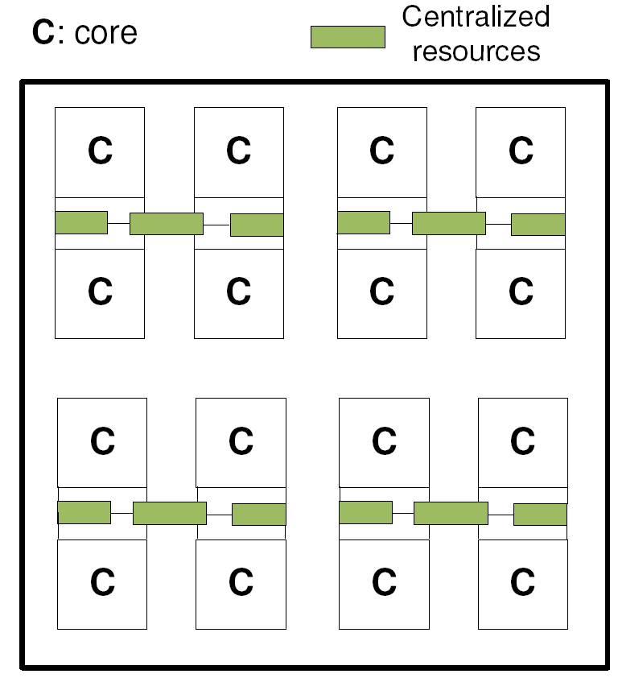
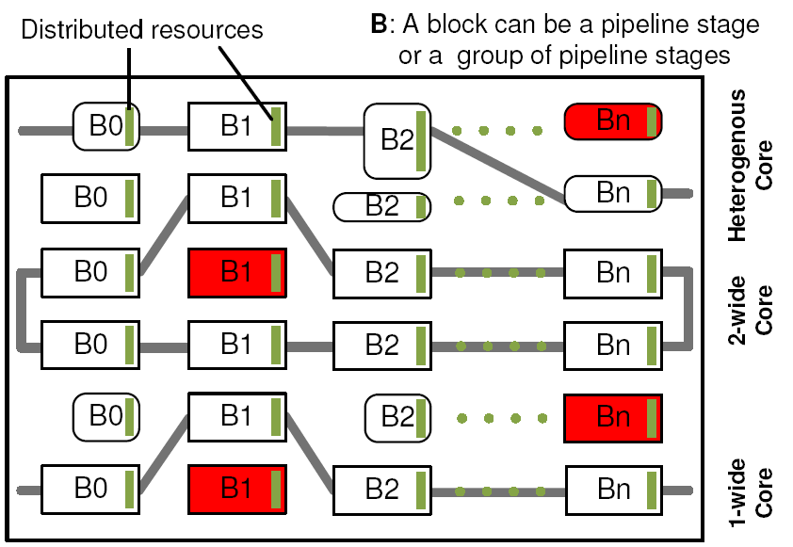
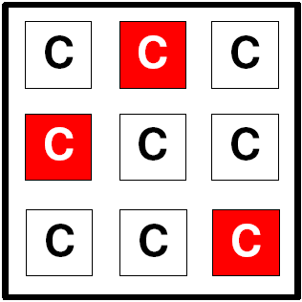
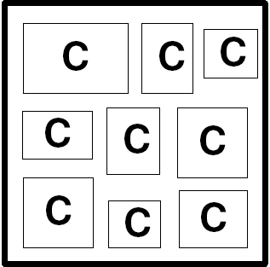
Traditional Solutions and CoreGenesis (CG)
(B) Core Disabling. Isolates broken
cores (red). Sustains throughput
only in low failure rates.
Throughput
Sequential
The architecture is composed of a sea of building blocks (B).
These blocks can be configured for:
Throughput computing: By forming single-issue pipelines
Single-thread performance: By forming wider-issue pipelines
Fault-tolerance: By decommissioning broken blocks.
Customized processing: Heterogeneous building blocks can
be introduced in the fabric to form customized pipelines.
CoreGenesis Vision
Dynamic Multicore. Cores can fuse
together when sequential performance
is needed.
(C) Heterogeneous CMP. Maintains
a variety of cores to offer power-
proportional computing.
Traditional point solutions

Slide 27
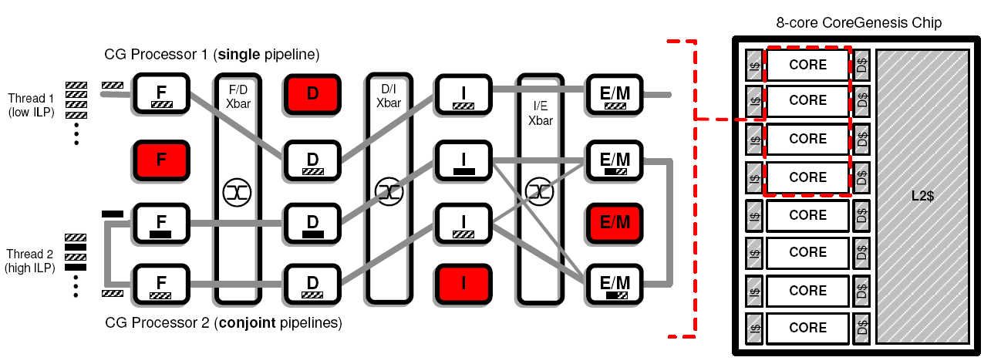
CG Instance: A Unified Performance-Reliability Solution
Provides..
Configurable Performance:
By merging varying number of stages
Reliability:
By isolating broken stages
Summary of Challenges
 | Single Pipeline | Conjoint Pipelines
Control Flow
Register Data Flow
Memory Data Flow
Instruction Steering
Design Characteristics
Elementary pipeline stages form the
building blocks
Stages interconnected using full crossbars.
No global flush, stall or forwarding signals.
No modifications to the cache hierarchy

Slide 28
Decoupling Stages in a Pipeline [MICRO’08]
Fetch
Decode
Issue
Ex/Mem
Gen
PC
Branch
Predictor
Macro-op
Generator
Register File
Bypass $
buffer
buffer
buffer
buffer
buffer
buffer
buffer
SID
SID
double
double
double
double
double
double
double
1. Control Flow
2. Data Flow
3. Transmission Delays
Stream ID (SID)
Control flow handling
Eliminates flush signals
_{Bypass $}
Stores previous results
Fully associative structure
Emulates data forwarding
Macro-Ops
Send instruction
bundles
Amortizes transfer
delay
Increases system
utilization
>>
LD
+
LD
+
/
&
0
1
ST
>>
<<
ST

Slide 29
Replays

Slide 30
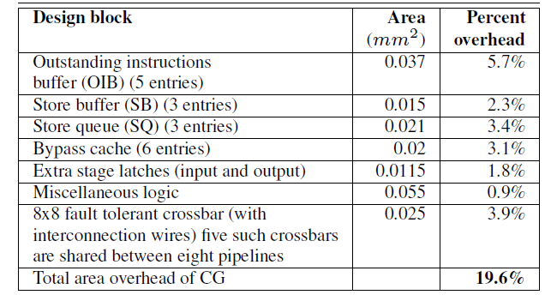
Area

Slide 31
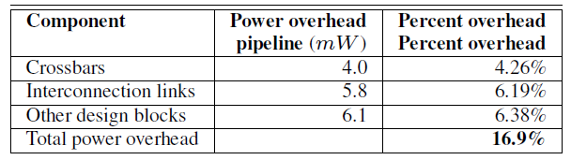
Power

