Slide 1
PolygraphMR: Enhancing the Reliability and Dependability of CNNs
Salar Latifi, Babak Zamirai, Scott Mahlke University of Michigan
Notes:
15-17 mins

Slide 2
Problem Statement
CNNs are emerging in mission-critical applications.
Network accuracy by itself is not assuring the reliability.
CNNs are like black boxes.
Pedestrian
Truck
Input
CNN
Output

Slide 3
Problem Statement
Need to know when the prediction is unreliable.
Input
CNN
Output
Pedestrian
Truck
Unreliable
Reliable
Quality Inspector

Slide 4
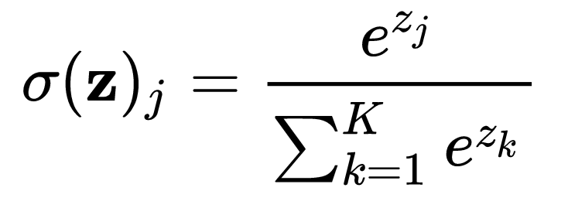
Softmax Prediction Probability as Baseline
Softmax Probabilities
Confidence Check: Put a threshold on softmax probability outputs for accepting a reliable prediction ^{[1, 2]}.
Airplane
0.05
Bicycle
0.05
CNN
Softmax
Car
0.70
Ship
0.05
Truck
0.15
Softmax
5
for j = 1 to 5.
[1] He et al. "Recognition confidence analysis of handwritten Chinese character with CNN." ICDAR 2015
[2] Hendrycks et al. “A Baseline for Detecting Misclassified and Out-of-Distribution Examples in Neural Networks”, ICLR 2017

Slide 5
Unreliability of Softmax Probabilities
Mispredictions and softmax probabilities are profiled on ImageNet dataset.
Undesirable trend of increasing high confidence mispredictions with CNN accuracy.
Notes:
Approximately 10% of the total answers are wrong with high or very high confidence for all the networks.
For having less than 5% wrong answer, TPs also fall. For AlexNet -> from 57% to 43%.

Slide 6
Overview of the PolygraphMR System
Pool of Preprocessors
Heterogeneous Modular Redundancy (MR)
Decision Engine
Our Goals:
Detect mispredictions.
Keep the correct predictions untouched.
Layer 1
Layer 2
Layer 3
Provide Diversity.
Same topology as original network.
Opportunity to detect irregularities.
Generate Outputs:
Label
Reliability
Tunable by user requirements.

Slide 7
Layer 2: Heterogeneous Modular Redundancy
Traditional image classification:
Input Image
Outputs_1
Modular redundant image classification:
PP_1
Outputs_1
Input Image
PP_2
Outputs_2
PP_n
Outputs_n

Slide 8
Layer 1: Pool of Preprocessors
Goal: Inject more diversity in the predictions of the MR CNNs.
A number of examples for more beneficial preprocessors:
ConNorm
FlipX
FlipY
Hist
Gamma
AdHist
ImAdj

Slide 9
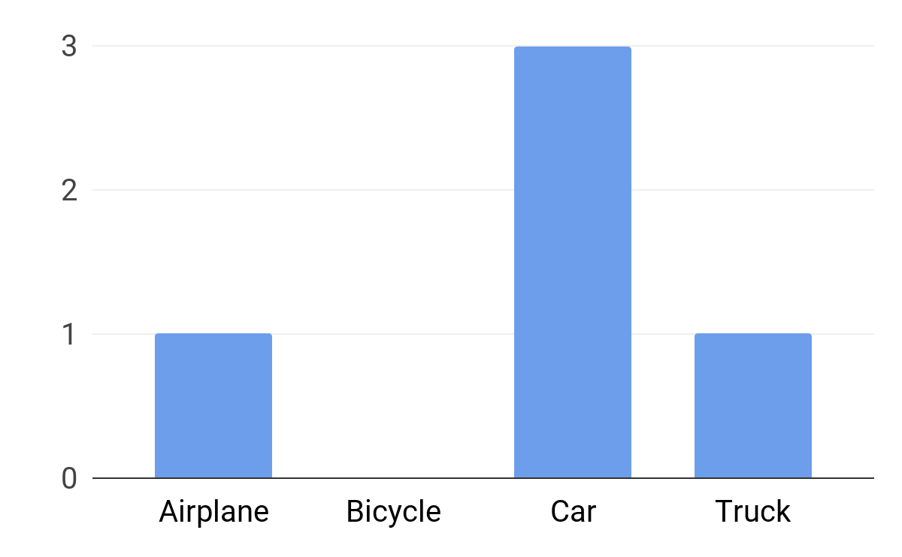
Layer 3: Decision Engine
Thr_Conf: Confidence threshold for filtering low confidence predictions.
User Requirements
Thr_Freq: Frequency threshold for minimum frequency of a reliable answer.
CNN_1
Thr_Freq
CNN_2
CNN_3
Histogram
Thr_Conf

Slide 10
Reducing the Performance Overhead
Resource-aware Modular Redundancy (RAMR):
Precision of individual CNNs is reduced for lower performance footprint ^{[1, 2]}.
MR system is more resilient against precision reduction.
Resource-aware Decision Engine (RADE):
Speculatively reduce the number of initial active CNNs.
For majority of inputs, CNNs are generating the uniform outputs.
RAMR
RADE
[1] Judd et al. "Proteus: Exploiting numerical precision variability in deep neural networks." ICS 2016
[2] Hill et al. “Deftnn: Addressing bottlenecks for dnn execution on gpus via synapse vector elimination and near-compute data fission”, MICRO 2017

Slide 11
Evaluation Setup
Benchmarks:
6 benchmarks across three different image classification datasets:
MNIST
CIFAR-10
ImageNet
Evaluation Metrics:
# of undetected mispredictions at 100% of baseline accuracy
Frameworks:
Image Preprocessing: OpenCV, MATLAB
CNN Training and Inference: Caffe

Slide 12
Reliability Results
Comparisons:
ORG: Original baseline network with confidence threshold.
N_MR: Traditional MR system with N networks and majority voting.
N_PGMR: PolygraphMR system with N networks.
On average, 4_PGMR can detect 40.8% of the baseline CNN mispredictions.
4_PGMR offers 16.6% higher detection rate compared to traditional MR.
On average, 6_PGMR can identify 48.2% of the mispredictions.
PGMR
PGMR
Undetected Mispredictions [%]

Slide 13
Energy Optimizations
With RAMR optimizations:
23.5% reduction in energy overhead,
35.4% detection in mispredictions.
With RAMR and RADE optimizations:
Less than 2x energy overhead,
33.5% detection in mispredictions.

Slide 14
Conclusion
Softmax probabilities are failing to assure reliability for mission-critical applications.
Modular redundancy and behavior diversity provided by preprocessing can help to detect mispredictions.
On average, PolygraphMR can detect mispredictions by up to 48.2% while keeping correct predictions untouched.
With RAMR and RADE optimizations, PolygraphMR can still detect 33.5% of the mispredictions with less than 2x performance overhead.

Slide 15
Q&A
Email: salar@umich.edu
Notes:
15-17 mins

Slide 16
Unreliability of Softmax Prediction Probability
Mispredictions and corresponding softmax probabilities are profiled over validation set of ImageNet dataset.
More than 10% of the mispredictions have either high or very high confidence.
Undesirable trend of increasing high confidence mispredictions with CNN accuracy.
Notes:
Approximately 10% of the total answers are wrong with high or very high confidence for all the networks.
For having less than 5% wrong answer, TPs also fall. For AlexNet -> from 57% to 43%.

Slide 17
Our Goals
Have a systematic approach to detect mispredictions made by CNNs.
Keep the correct predictions untouched.
Reduce the performance overhead of the proposed solution.

Slide 18
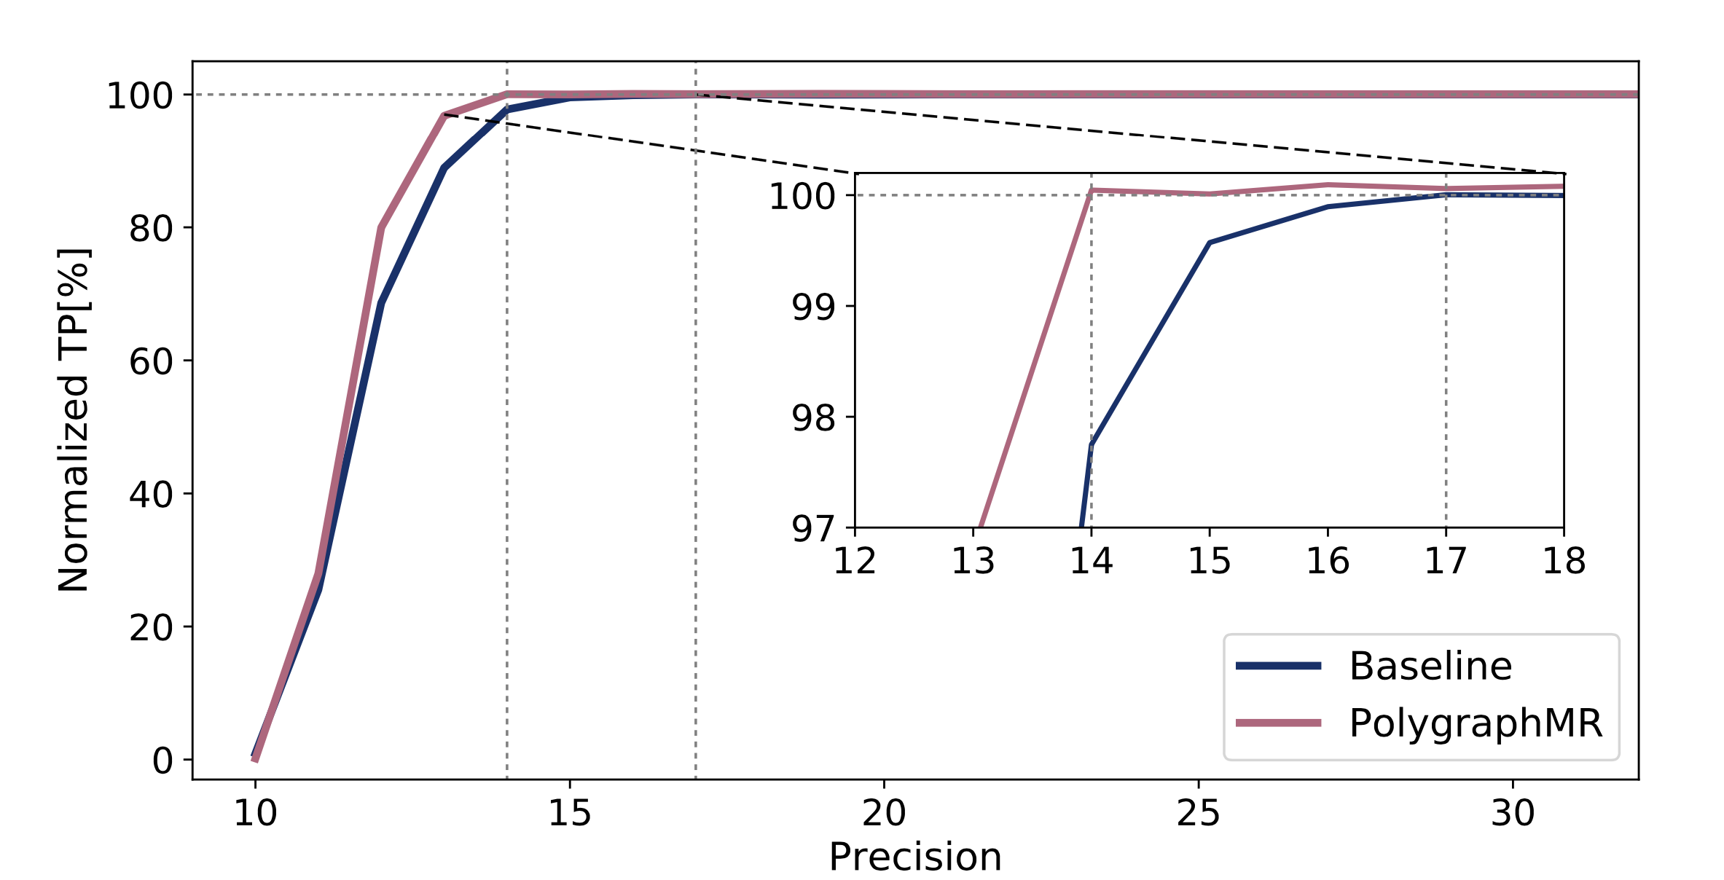
Resource-aware Modular Redundancy (RAMR)
All CNN weights and intermediate values are using narrow-precision representation to reduce the data transfer overhead ^{[1, 2]}.
The redundancy in PolygraphMR allows to further reduce the precision compared to the baseline single CNN.
Normalized Accuracy [%]
Effect of precision reduction on original and PolygraphMR system using AlexNet and ImageNet dataset.
[1] Judd et al. "Proteus: Exploiting numerical precision variability in deep neural networks." ICS 2016
[2] Hill et al. “Deftnn: Addressing bottlenecks for dnn execution on gpus via synapse vector elimination and near-compute data fission”, MICRO 2017

Slide 19
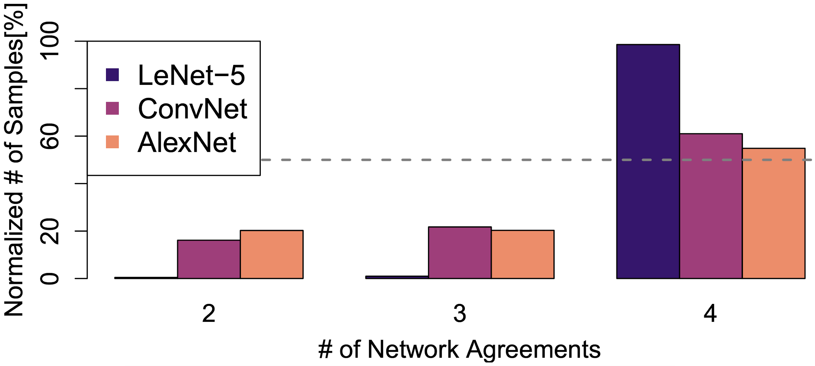
Resource-aware Decision Engine (RADE)
In more than 50% of the predictions, we don’t need to activate all CNNs since their prediction results are in harmony with each other.
Activate CNNs in a staged fashion, and add more CNNs if Thr_Freq criterion is not met by earlier activations.
Histogram of prediction agreements in a system with 4 CNNs, profiled on LeNet-5, ConvNet, and AlexNet.

