Slide 1
TF-Net: Deploying Sub-Byte Deep Neural Networks on Microcontrollers
Jiecao Yu ¹, Andrew Lukefahr ², Reetuparna Das ¹, Scott Mahlke ¹
¹ University of Michigan, ² Indiana University Bloomington
CASES, October 14th, 2019
Notes:
Hi everyone, I am Jiecao Yu from the University of Michigan. Today I am presenting my work TF-Net: Deploying Sub-Byte Deep Neural Networks on Microcontrollers.

Slide 2

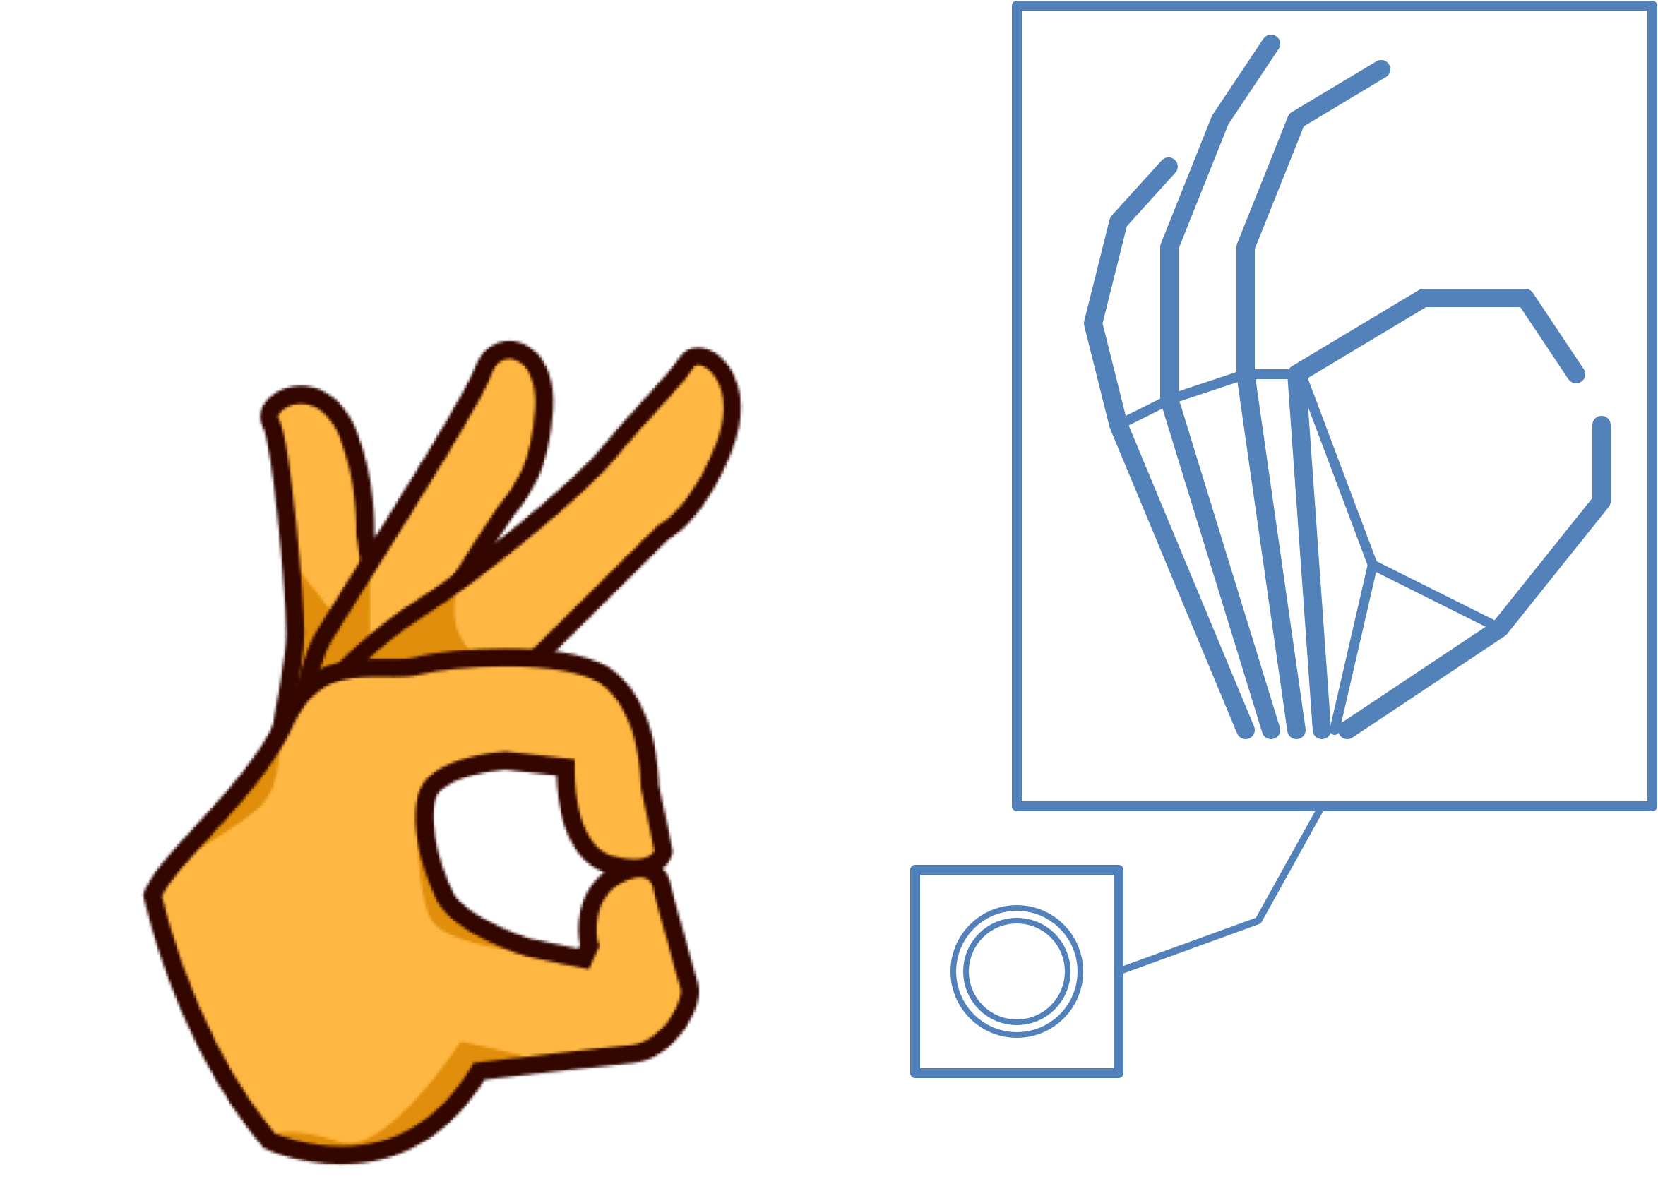
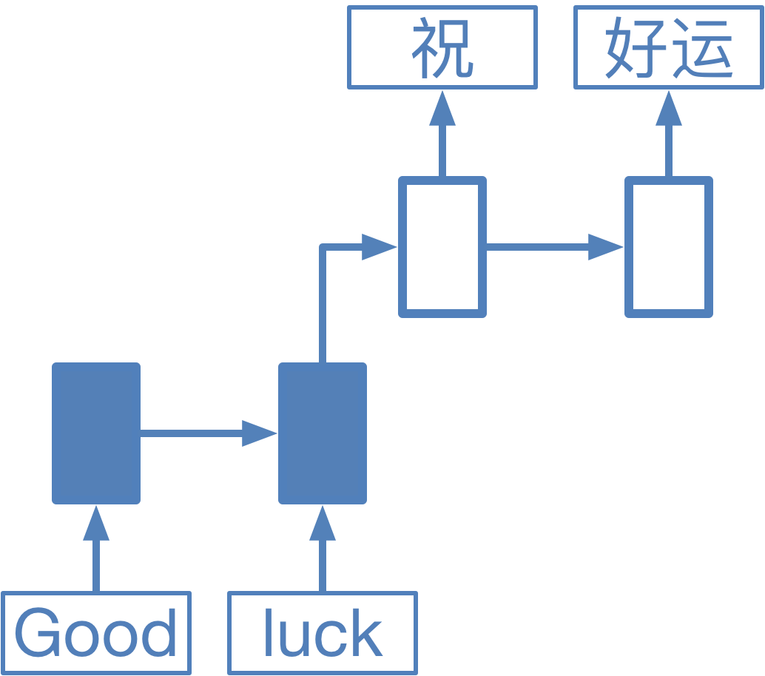
AI Applications
Hand Gesture
Detection
Keyword Spotting
Language
Translation
Notes:
Nowadays, many AI applications are used in our daily life. For example, we use hand gesture detection for better interaction. Keyword spotting is used to wake up the speech assistant without touching the cell phone. And language translation can help us read documents in different languages.

Slide 3
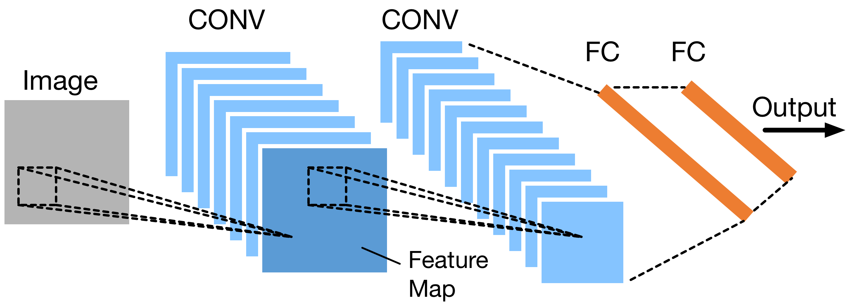
Deep Neural Networks
Fundamental algorithm of AI applications
Convolutional layers
  Extract features
  Convolution operations between weights and input FMs
Fully-connected layers
  Make final predictions
Notes:
For all these applications, deep neural networks have become the fundamental algorithm. This figure shows the basic structure of a DNN model. It includes two convolutional layers and two fully-connected layers. The convolutional layers are used to extract the features from the input image. Each of them consists of a stack of 2D matrices named feature maps. Convolution operations are performed between the weights and input feature maps to generate the output feature maps. With the features extracted by the convolutional layers, fully-connected layers can be used to make the final predictions.

Slide 4
Sensor – Cloud System
DNNs have high computation and storage cost
Cloud-based solution
Cloud
Sensor Node
Power
GPUs
CPUs
Computation offloading
  Unstable network connection
  High data transmission energy
  Data privacy
Micro-controllers
Performance
Notes:
Along with high prediction accuracy, DNN models usually have a high computation and storage cost. In this case, a cloud-based solution is deployed for many AI tasks. The user data is collected by the sensor node and then send to the cloud. The corresponding DNN computation is performed on the cloud to generate reliable predictions. In the cloud data centers, we have high-end CPUs and GPUs. They have high computation performance but also high power consumption. In comparison, on the sensor nodes, we only have extremely low-power microcontrollers which also has a much lower computation performance. Nowadays, people are trying to offload the computation from the cloud to the sensor node due to the unstable connection, the high data transmission energy, and the data privacy problem.

Slide 5
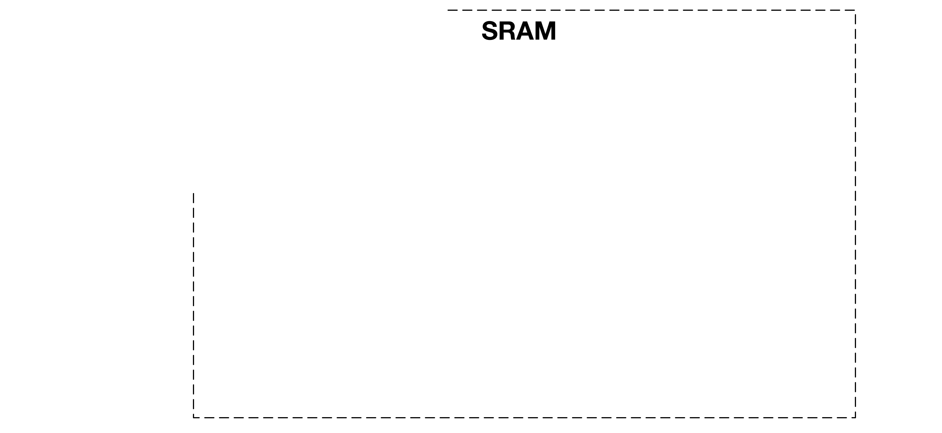
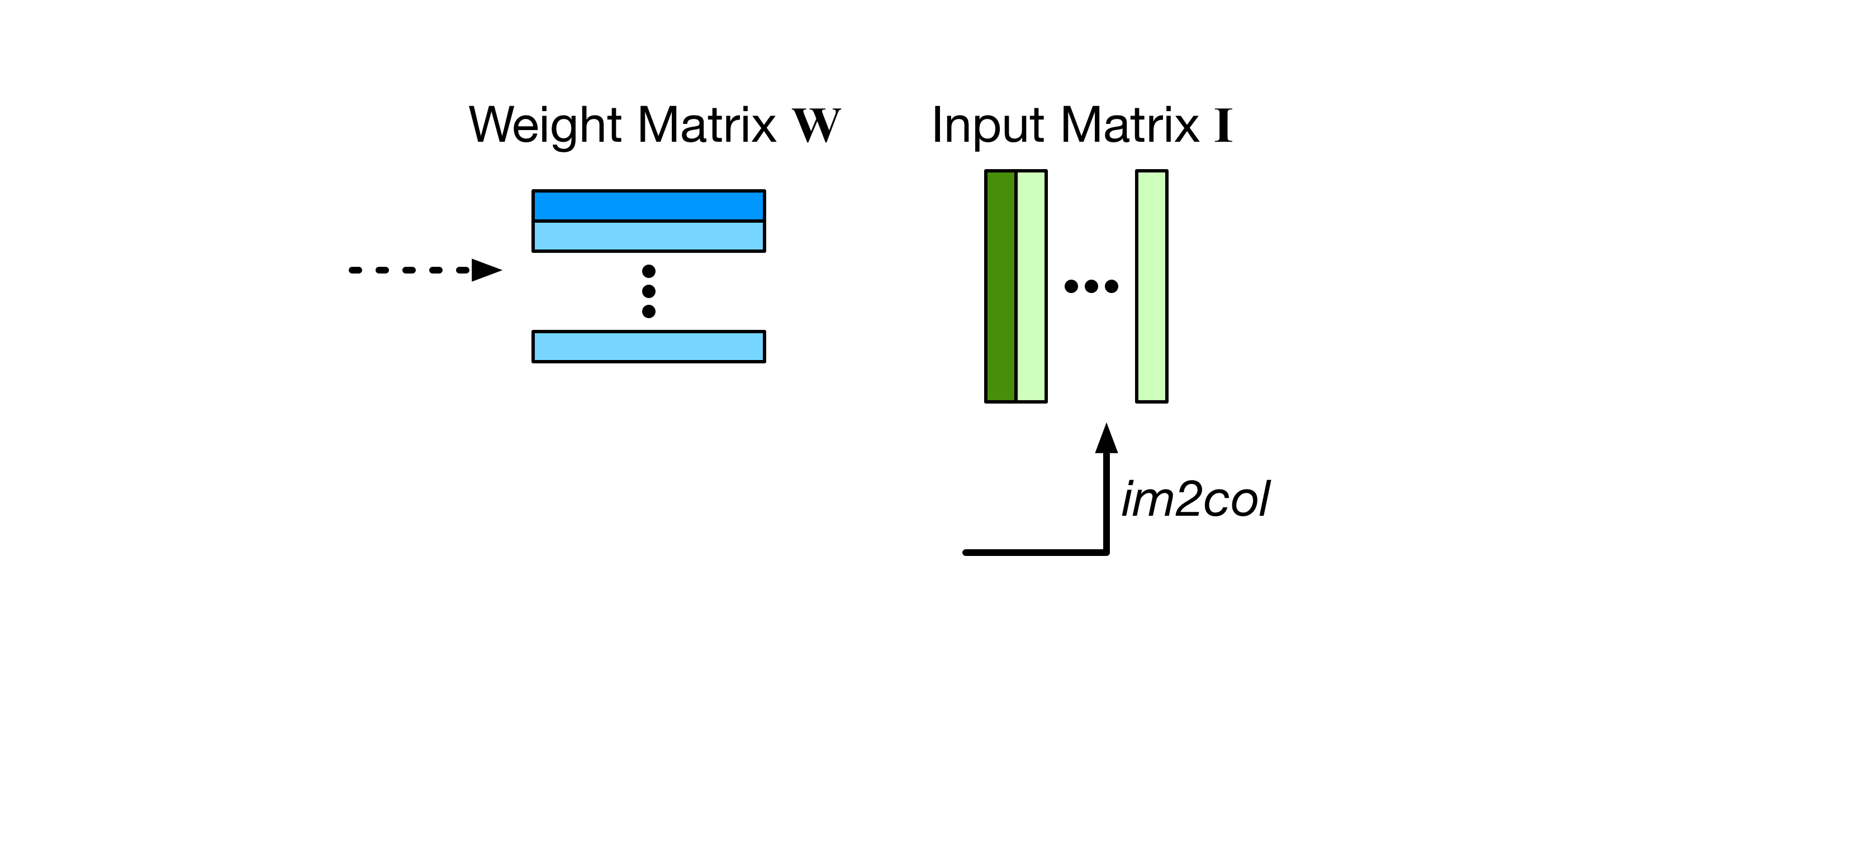
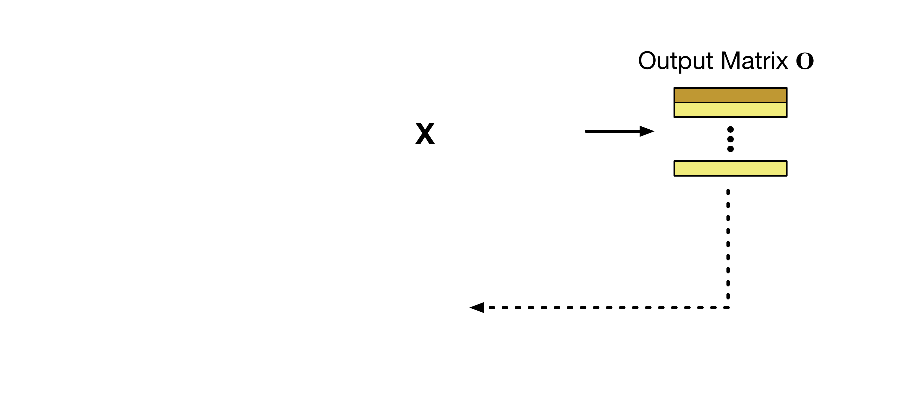
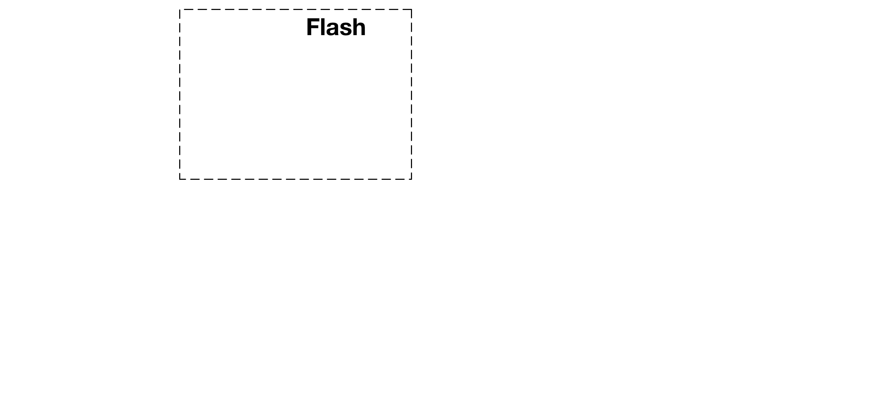
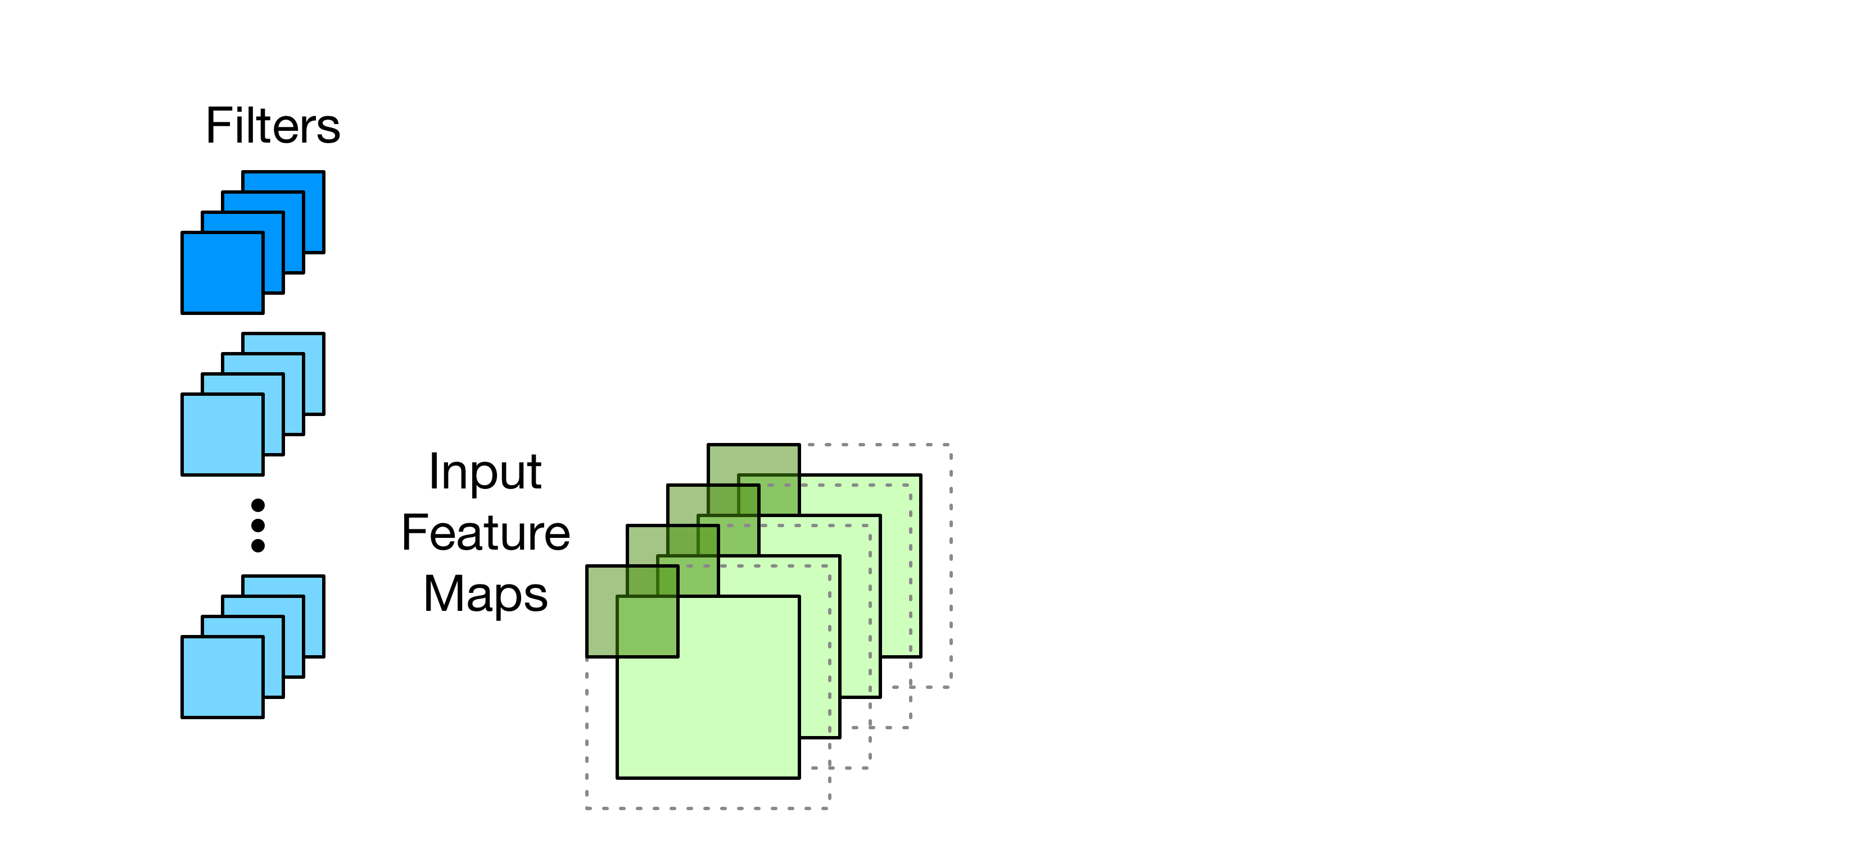
DNN Computation
Difficult to run DNN workloads on microcontrollers
  Extremely limited computation and storage resource
Computation in convolutional layers
Notes:
However, this computation offloading is very difficult for DNN workloads because microcontrollers usually have extremely limited computation and storage resources. For DNN models, most computation is consumed by convolutional layers. Therefore, let’s first take a look at how convolutional layers are usually calculated on microcontrollers. The weight filters and the input feature maps will be put into the weight matrix and input matrix. Then we will perform the matrix multiplication to generate the output matrix. And it will be considered as the input feature maps for the next layer. A typical microcontroller includes two types of storage: flash and SRAM. Flash is considered read-only during runtime so it can only be used to store the weight values. The input values including the input feature maps and input matrix are generated at runtime. Therefore, they need to be put on the SRAM.

Slide 6
Sub-Byte DNN Reduces Computation
Sub-byte (≤8-bit) weights/inputs
  Computation Memory
Accuracy vs. input/weight precision of Network-in-Network (NIN)
Original FP-32
Ternary Weights
5%
Relative Accuracy (%)
FP-32
Ternary weights + 4-bit inputs
Notes:
A typical method to reduce such computation of convolutional layers is using sub-byte weights and inputs. Here "sub-byte" refers to precision lower than or equals to 8-bit. Using sub-byte weights and inputs can reduce both the computation requirement and memory cost. Here we test how accuracy changes with input and weight precisions. We use the Network-in-Network model as an example, and this figure gives the results. The x-axis is the input precision and the y-axis is the relative accuracy. The black line shows the original accuracy using floating-point numbers for both inputs and weights. If we quantize the weights into ternary values, the accuracy only drops by less than 1%. If we also quantize the input values, the blue line shows how accuracy changes. When we use binary values for inputs, the accuracy has a large drop of 5%. In this case, a higher input precision is required for maintaining high prediction accuracy. If we increase the input precision to 4-bit, we can find that the accuracy drop is again limited to only 1%. Therefore, in this work, we try to provide better support for DNN models with ternary weights and 4-bit inputs.

Slide 7
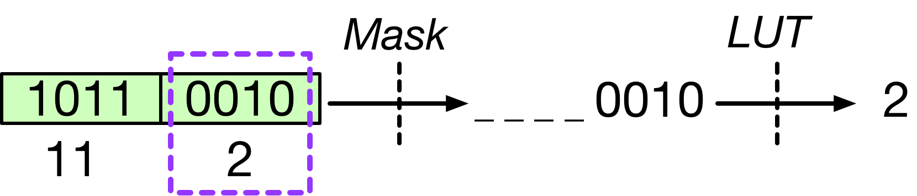
Challenge: Unpacking Overhead
Sub-byte values require unpacking
  Incompatible with byte-addressable memory hierarchy
4-bit values:
NIN / Nucleo-f411re board (Cortex-M4)
7% Acc.
Notes:
However, deploying sub-byte DNN models on microcontrollers is still very challenging. The main challenge is the unpacking overhead. The memory hierarchy of microcontrollers is typically byte-addressable. In this case, the sub-byte values cannot be directly accessed. Instead, they need to be unpacked from bitstreams into regular 16 or 32-bit integers. This figure shows an example of how to unpack 4-bit values. Two values are stored in the same byte. To extract the second value 2, we need to do a mask operation and go through the lookup table. This unpacking process adds much computation overhead. We profile the execution time of network-in-network with different input and weight precision. This figure shows the results. The x-axis is different configurations of input and weight precision. We use 16-bit inputs and weights as the baseline because it can fully utilize the SIMD support and achieve the best performance. As shown in the figure, the execution time is dramatically increased for sub-byte DNN models. The only exception is using binary values for both weights and inputs. However, it will lead to a large accuracy drop of 7%.

Slide 8
TF-Net
Ternary weights + Four-bit inputs
Deploying
Model
Arch.
Training
Framework
Direct Buffer Conv.
Micro-
controllers
Packed MAC
ISA Extension
Notes:
To solve the performance problem due to the unpacking overhead, we propose the TF-Net pipeline. It can help efficiently deploy networks with ternary weights and 4-bit inputs on the microcontrollers. With a given DNN architecture, we first provide a training framework to train the sub-byte DNN models. Then, to efficiently deploy the sub-byte networks, we introduce two algorithms: direct buffer convolution and packed multiply-accumulate. To further accelerate the computation, we also propose an instruction extension for microcontrollers.

Slide 9
TF-Net
Ternary weights + Four-bit inputs
Deploying
Model
Arch.
Training
Framework
Direct Buffer Conv.
Micro-
controllers
Packed MAC
ISA Extension
Notes:
The first part is the training framework.

Slide 10
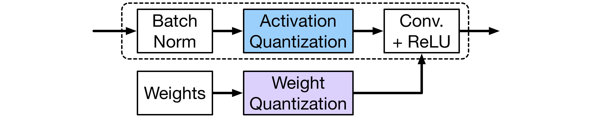
Training Framework
Building block of convolutional layers
1~8-bit inputs
Binary/ternary weights
Step x Unsigned Integer + Lower Bound
Shared inside activations/every weight filter
Multiply-accumulate (MAC) of unsigned integers
Notes:
This figure shows the structure of a basic building block of convolutional layers. The activation values from the previous layers first go through the batch normalization, and then get quantized. The quantized activations are fed into the convolutional layers for computation. For the convolutional layers, the weight values are also quantized. Our training framework supports binary and ternary weights with 1 to 8-bit inputs. For both weights and inputs, they are represented as the step value times with an unsigned integer plus the lower bound. Both the step and lower bound values are floating-point numbers. The same step and lower bound values are shared inside the activations or every weight filter. In this case, the main computation we need to perform in the convolutional layers is multiply-accumulate of unsigned integers.

Slide 11
TF-Net
Ternary weights + Four-bit inputs
Deploying
Model
Arch.
Training
Framework
Direct Buffer Conv.
Micro-
controllers
Packed MAC
ISA Extension
Notes:
After the sub-byte DNN model is trained, we then provide support for deploying the models efficiently.

Slide 12
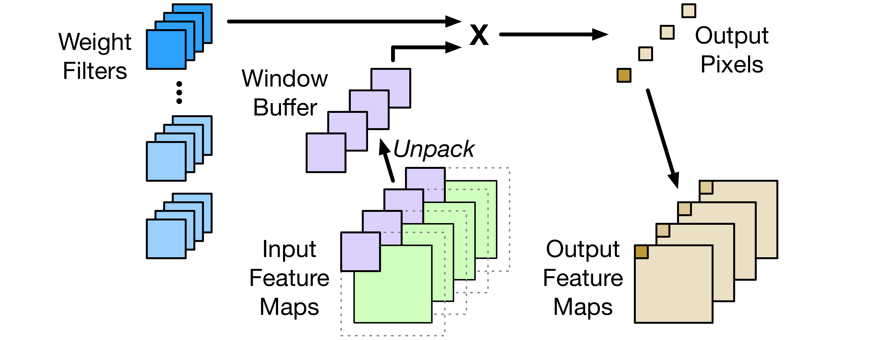
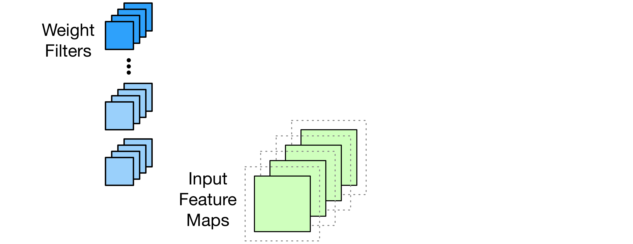
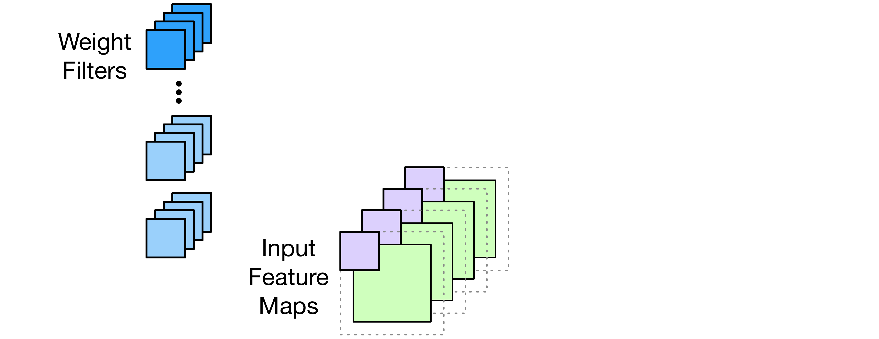
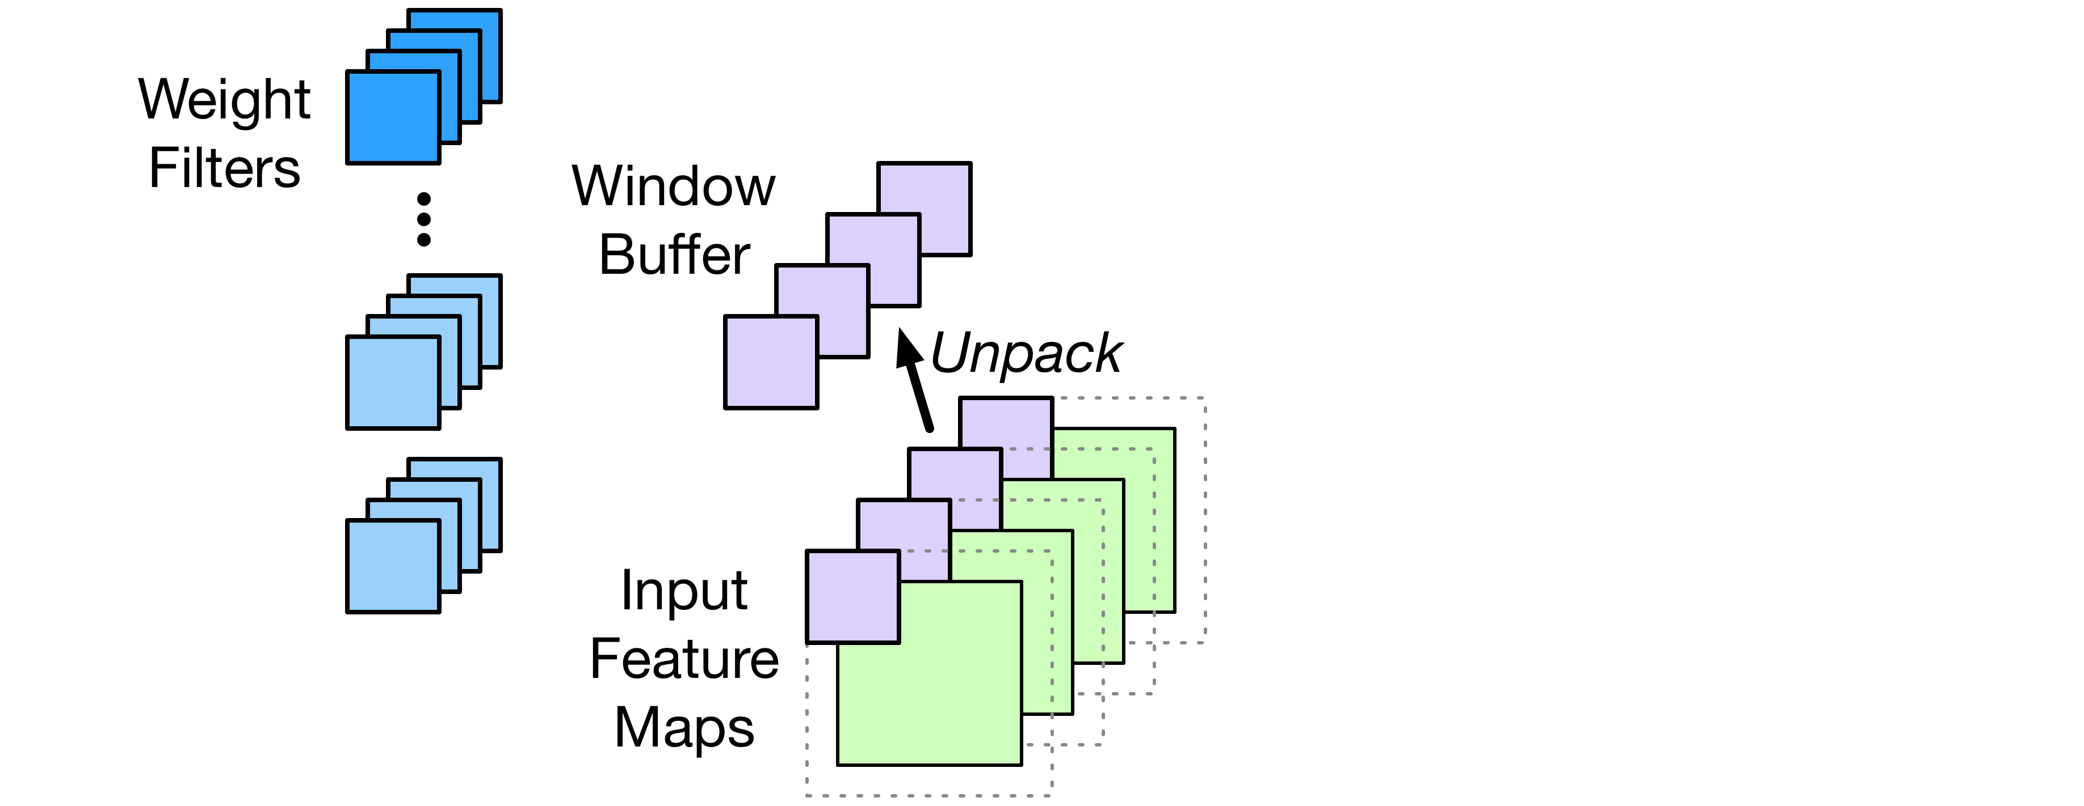
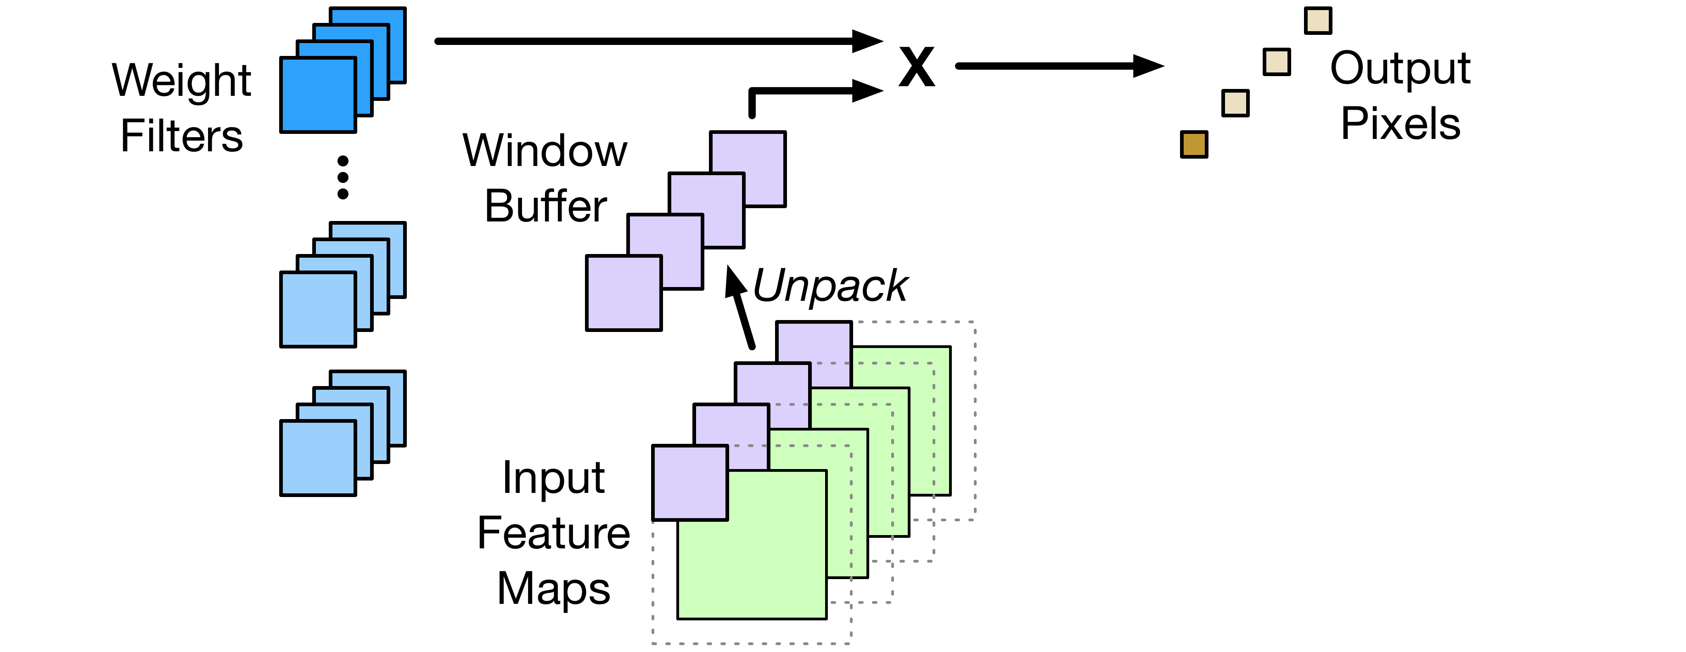
Direct Buffer Convolution
Amortize input unpacking overhead
  Unpacked inputs cached in the window buffer
Reduce SRAM requirement
  Space for input matrix not required
Notes:
The first technique is the direct buffer convolution. Start with the weight filters and input feature maps, we first fetch the input values in the first convolution window. We unpack those input values into 16-bit integers and store the unpacked values in the window buffer. In this case, the input windows will be stored in the window buffer and we don't need to generate the input matrix. After this, we perform multiply-accumulate between the weight filters and the window buffer to generate the output pixels. For the last step, we write the output pixels into the output feature maps. As shown here, direct buffer convolution can help amortize the input unpacking overhead. Each input value is only unpacked once and the unpacked value is cached in the window buffer. At the same time, direct buffer convolution can also help reduce SRAM requirement because we don't need to allocate the space for the input matrix. For conventional convolutional layers, the input matrix costs much more SRAM space than input and output feature maps.

Slide 13
Perf. with Direct Buffer Conv.
NIN on Cortex-M4
0.71x
0.26x
Suffer from weight unpacking overhead
Using 16/32-bit integers wastes computation
✗
✗
Notes:
We then test the performance of NIN with direct buffer convolution. This figure shows the results. We still use 16-bit integers for inputs and weights as the baseline, which is shown as the black bar. The blue bar shows the relative performance with the original unpacking algorithm. Using ternary weights and 4-bit inputs, the performance is reduced to only 0.26x. Now with the direct buffer convolution, the relative performance is significantly increased to 0.71x. However, with the direct buffer convolution, the relative performance is still much lower than the baseline because of two reasons. For the first reason, although the input unpacking overhead is amortized, the current computation still suffers from the weight unpacking overhead. For the second reason, we still need to use 16-bit or 32-bit integers when we do the multiply-accumulate operations. But the inputs and weights we use are only sub-byte values, which means much computation is actually wasted.

Slide 14
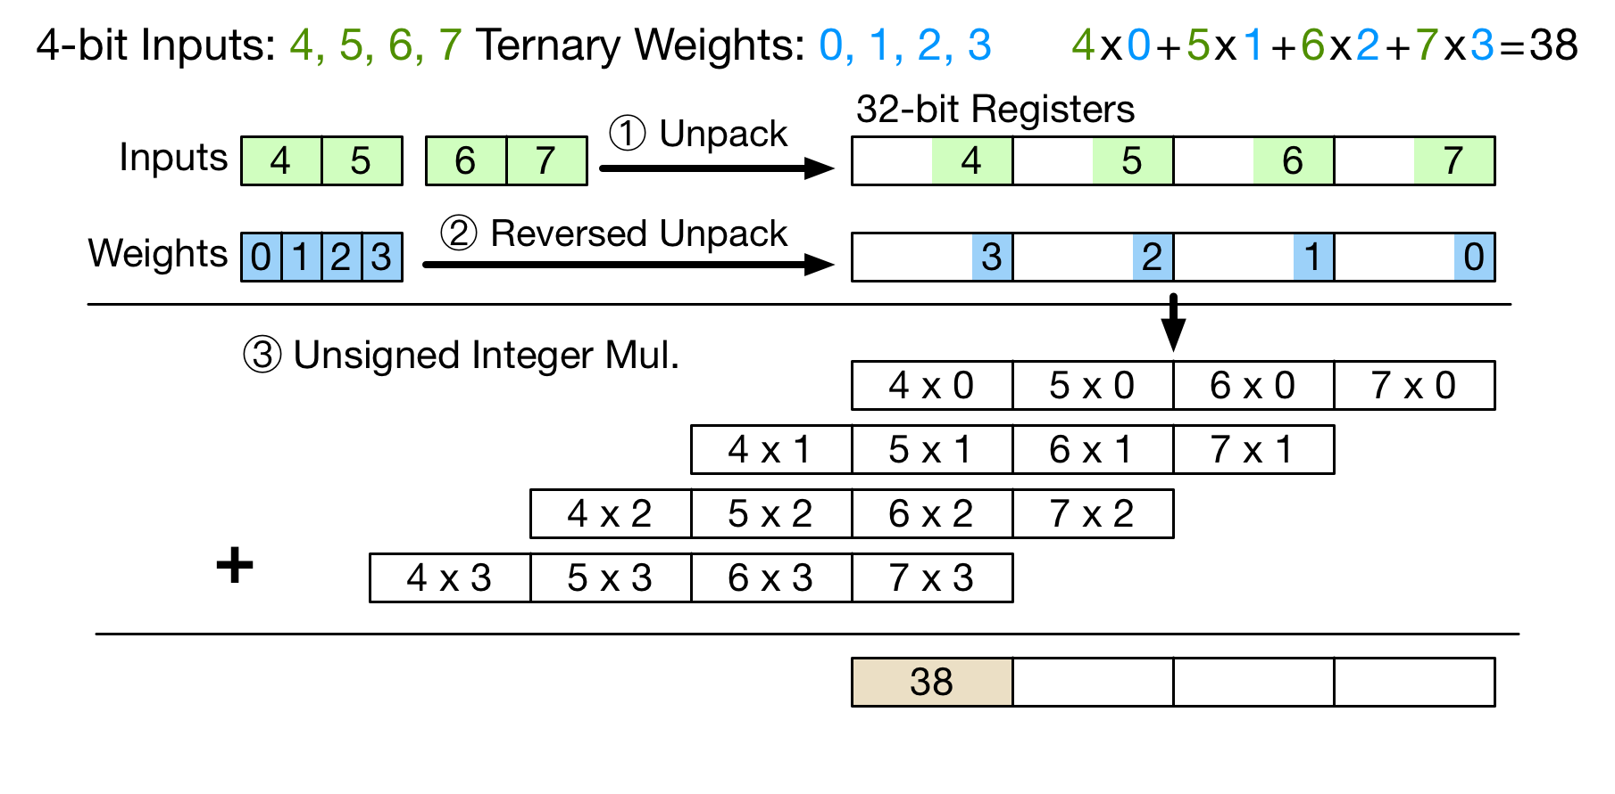
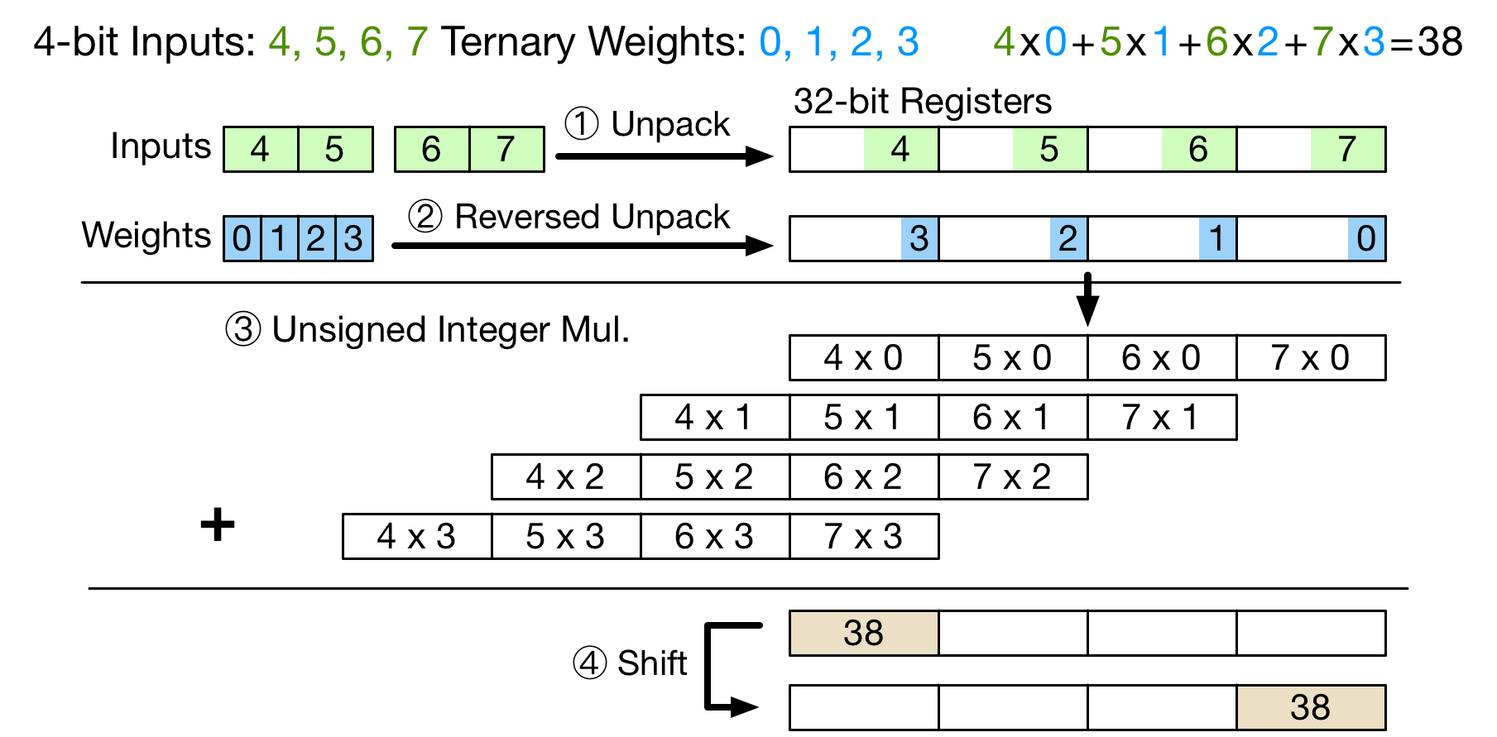
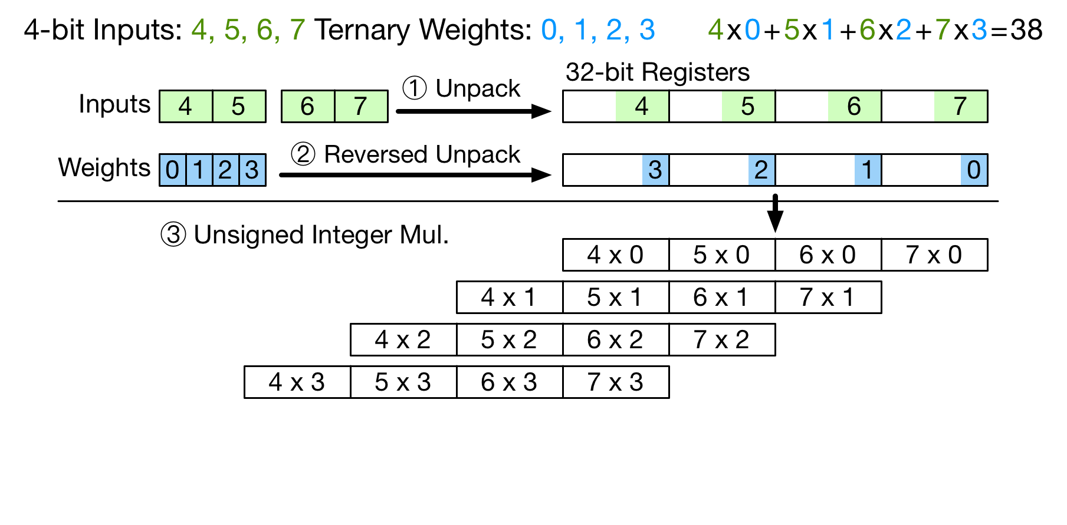
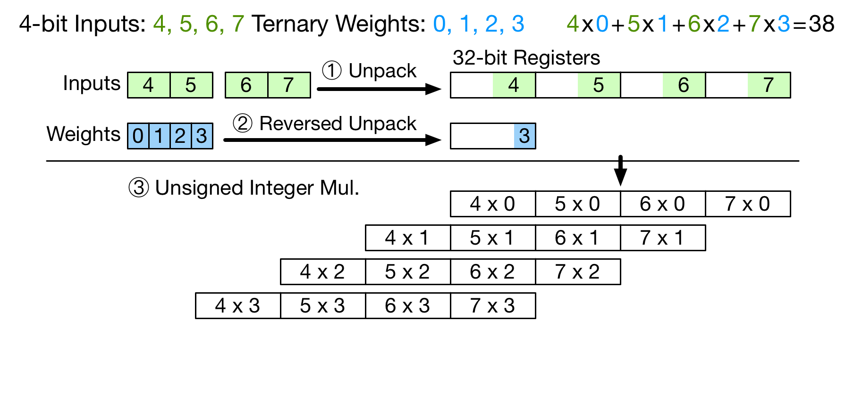
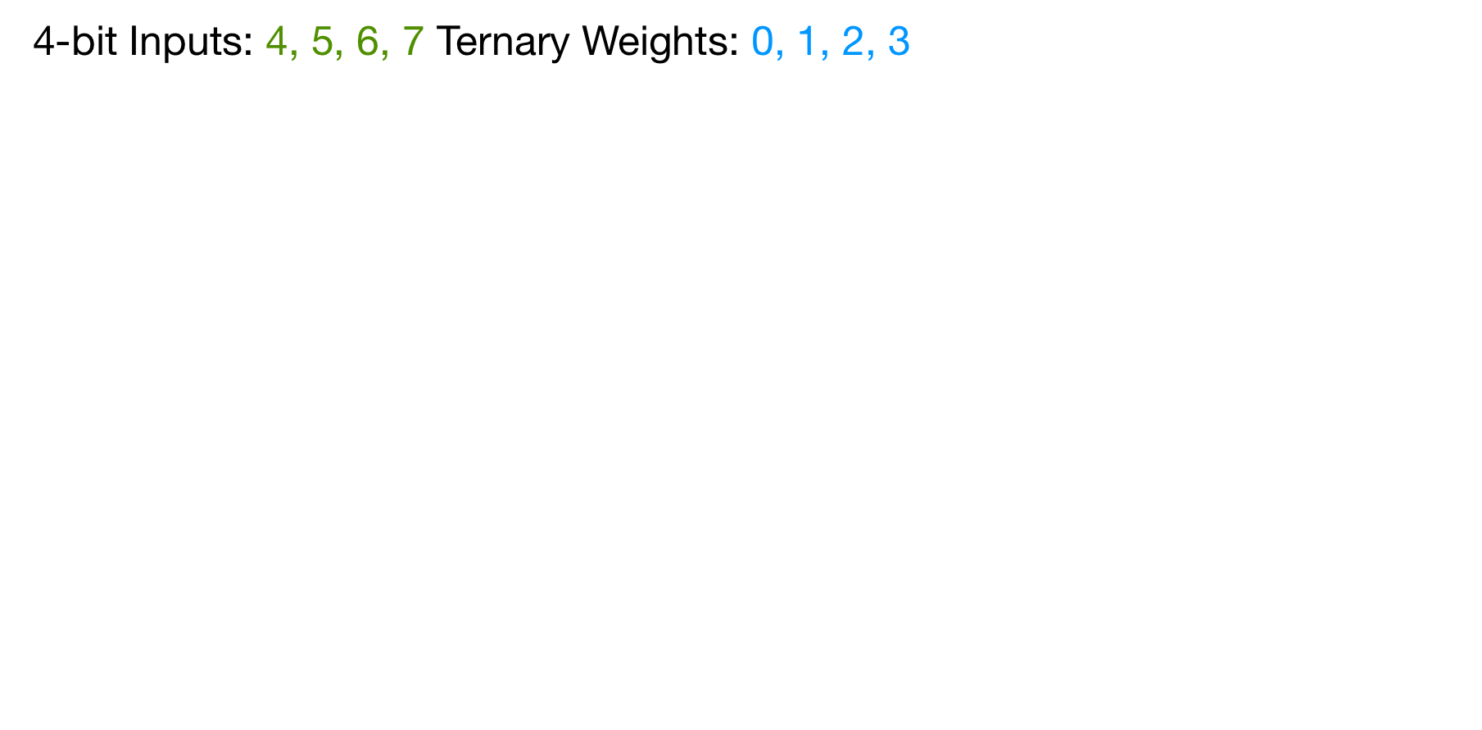
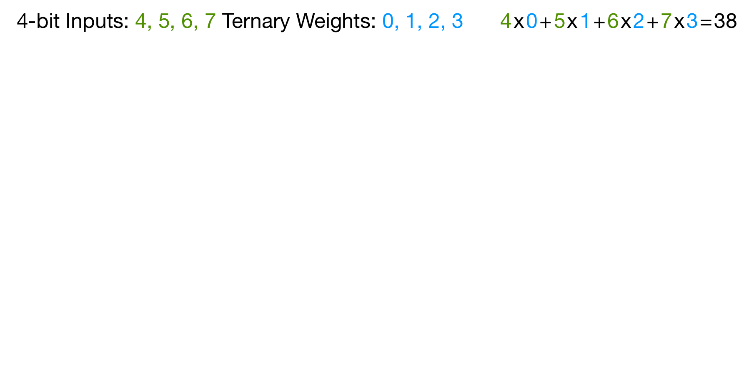
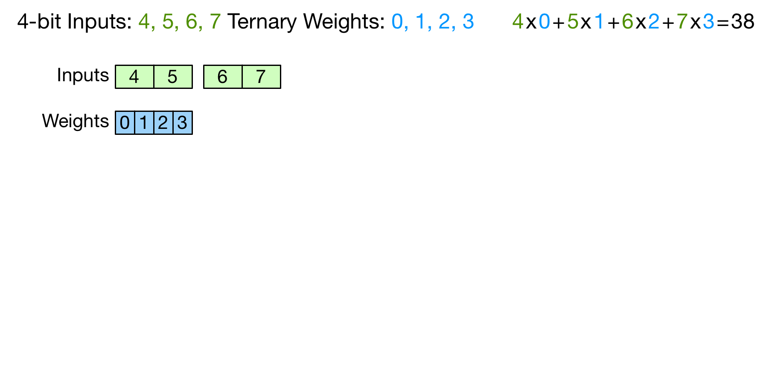
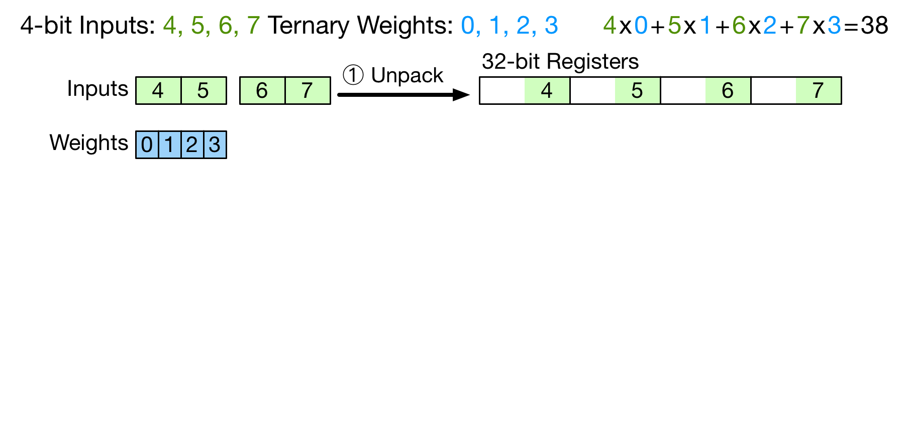
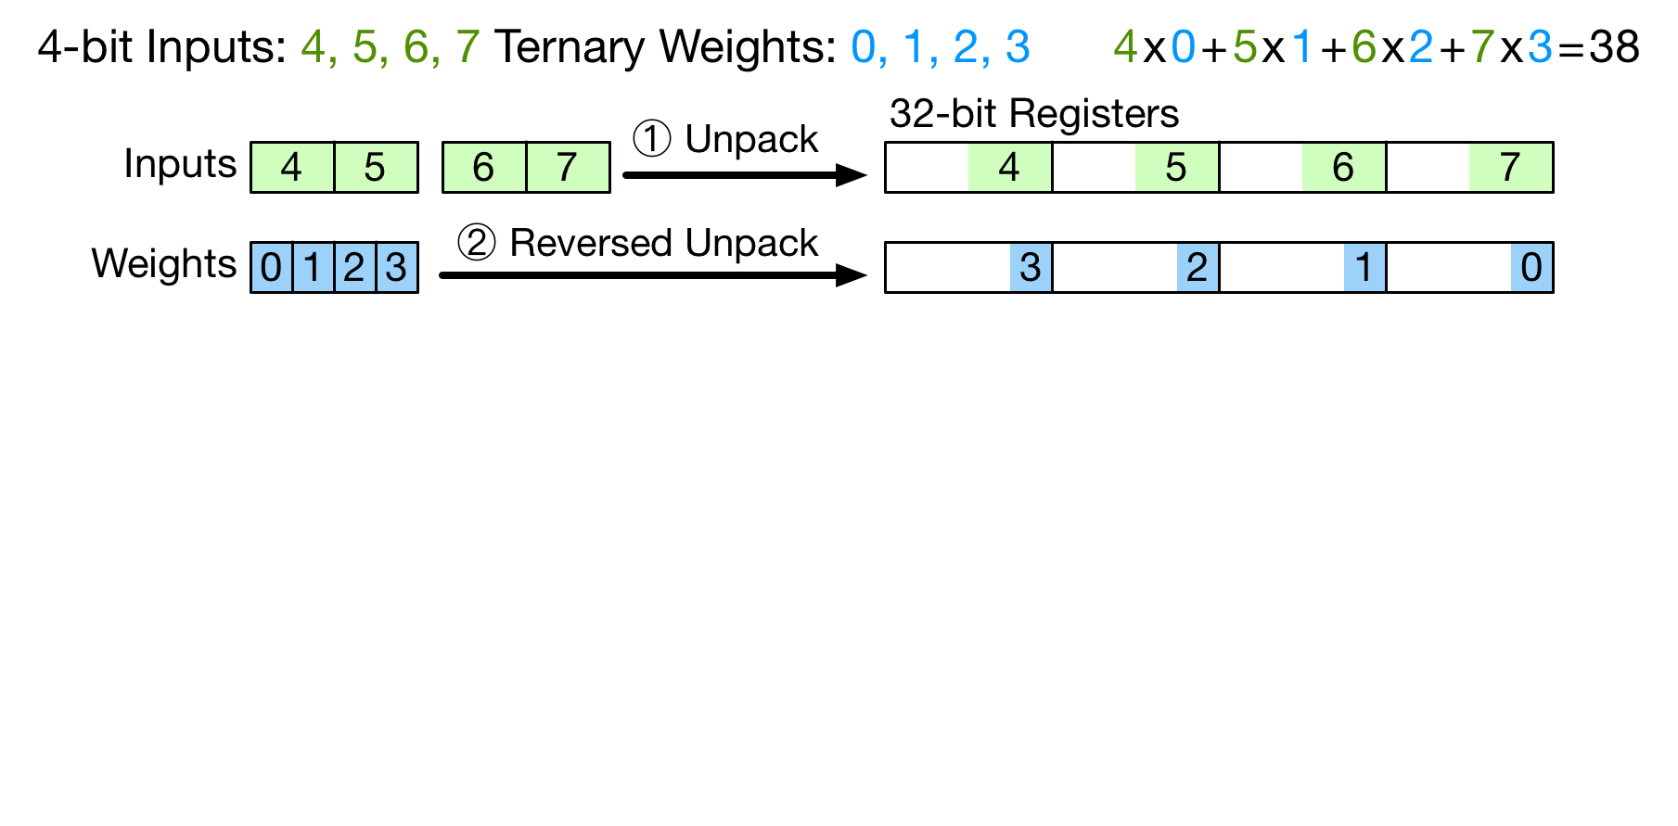
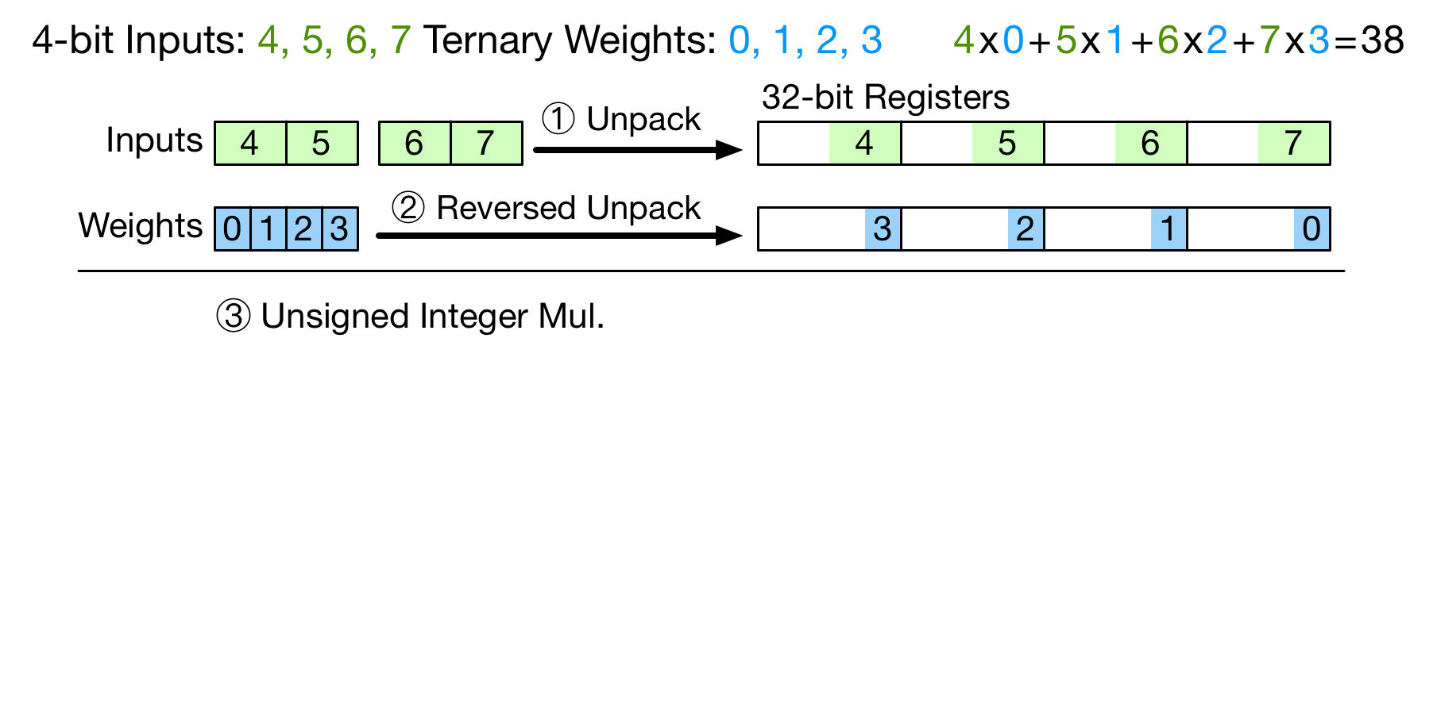
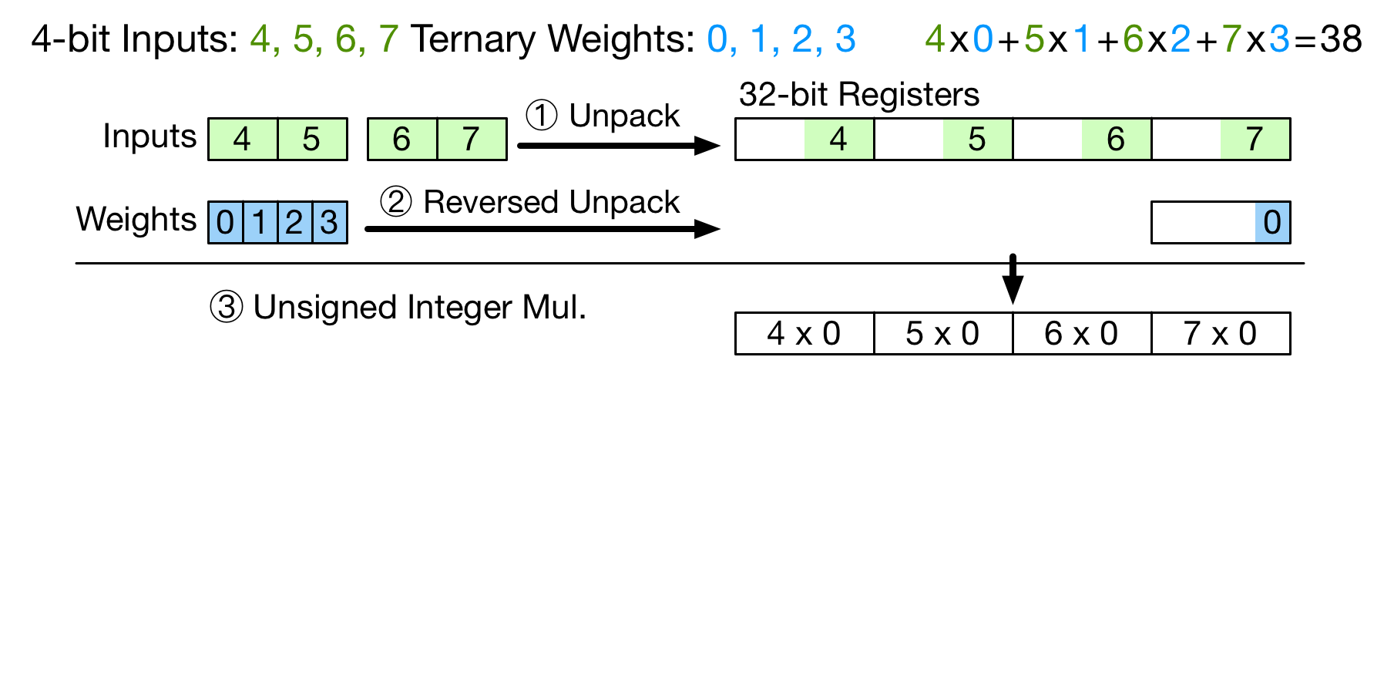
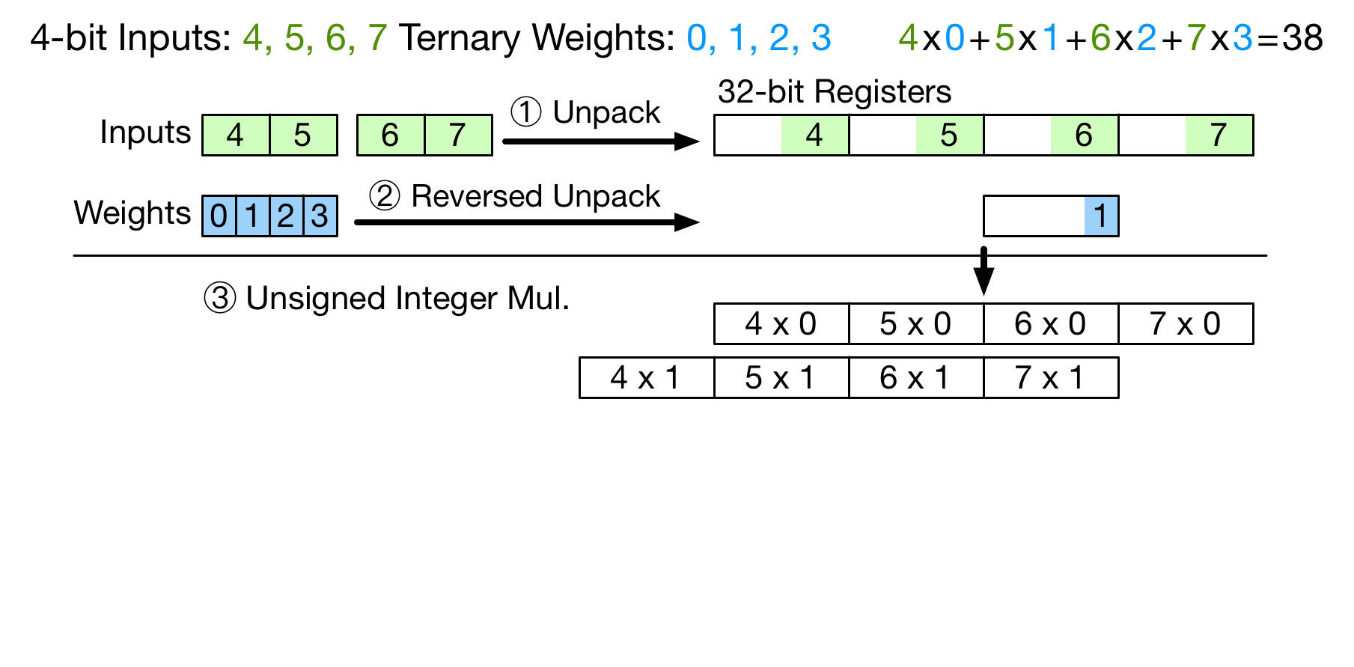
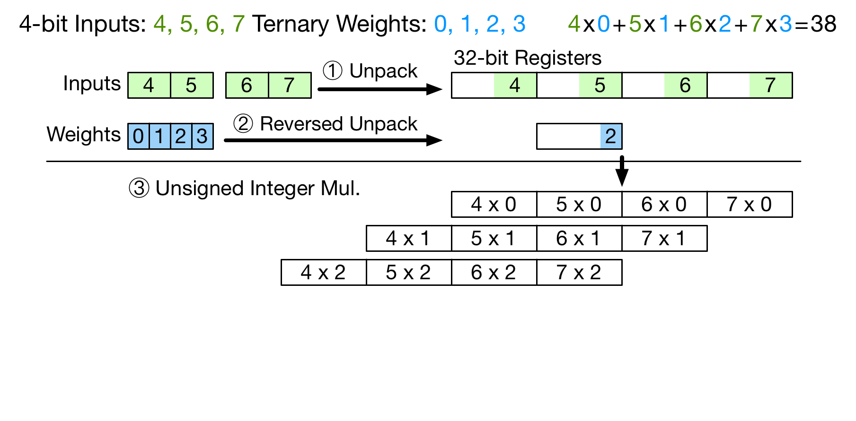
Packed Multiply-Accumulate (MAC)
Perform MAC for 4x (input, weight) in parallel
No overflow
Notes:
To fully utilize the precision reduction, we propose a new computation algorithm called packed multiply-accumulate. It can help perform the MAC operation for four pairs of inputs and weights in parallel. Assume we now have 4 inputs and 4 weights. Inputs are 4-bit and weights are ternary. The multiply-accumulate result equals to 38. On microcontrollers, the inputs are stored in two bytes and the weights can be stored in one byte. For the first step, we unpack the inputs into a 32-bit register. The unpacked inputs are cached in the window buffer. For the second step, we unpack the weight values into another 32-bit register. But here the weights are unpacked in the reversed order. For the third step, we need to perform the unsigned integer multiplication between these two unpacked registers. This multiplication process can be shown as a vertical method. For weight 0, each input is timed with 0. Then for weight 1, each input is timed with 1 but the result values move left by 8 bits. For the remaining weights 2 and 3, we can do the same thing. Now we have completed the multiplication for each 8 bits of the weight register. To finish the integer multiplication, we need to sum up the results. In this case, the highest 8 bits of the output will be the multiply-accumulate result we need. For the last step, we can right shift the output register by 24 bits to get the final output. Because we are using 2-bit weights and 4-bit inputs, there will be no overflow in the lowest 24 bits and the higher 8 bits, which ensures the correctness of the packed MAC.

Slide 15
Perf. with Packed MAC
Higher computation parallelism
  Lower weight unpacking overhead
  Less input access
NIN on Cortex-M4
1.36x
0.71x
Support input precision + weight precision ≤ 6-bit
Notes:
Using packed MAC can help improve the computation performance because it can achieve a higher computation parallelism. Four MAC operations are performed in parallel. Because we are unpacking four weights at the same time, the weight unpacking overhead can be reduced. Also, because four input values are stored in the same register, the input access is reduced. We test the computation performance the packed MAC, and this figure shows the result. The black bar and the blue bar are the results for the 16-bit baseline and the original unpacking algorithm. The orange bar is for the direct buffer convolution. The relative performance is improved to 0.71x. Now with the packed MAC, we can further improve the computation performance to 1.36x, which is shown as the gray bar. Here, to use the direct buffer convolution and packed MAC, the only requirement we need to meet is that there is no overflow in the lowest 24 bits and higher 8 bits when we do the packed MAC. Therefore, our pipeline can provide support for sub-byte networks with input precision plus weight precision lower than or equal to 6-bit.

Slide 16
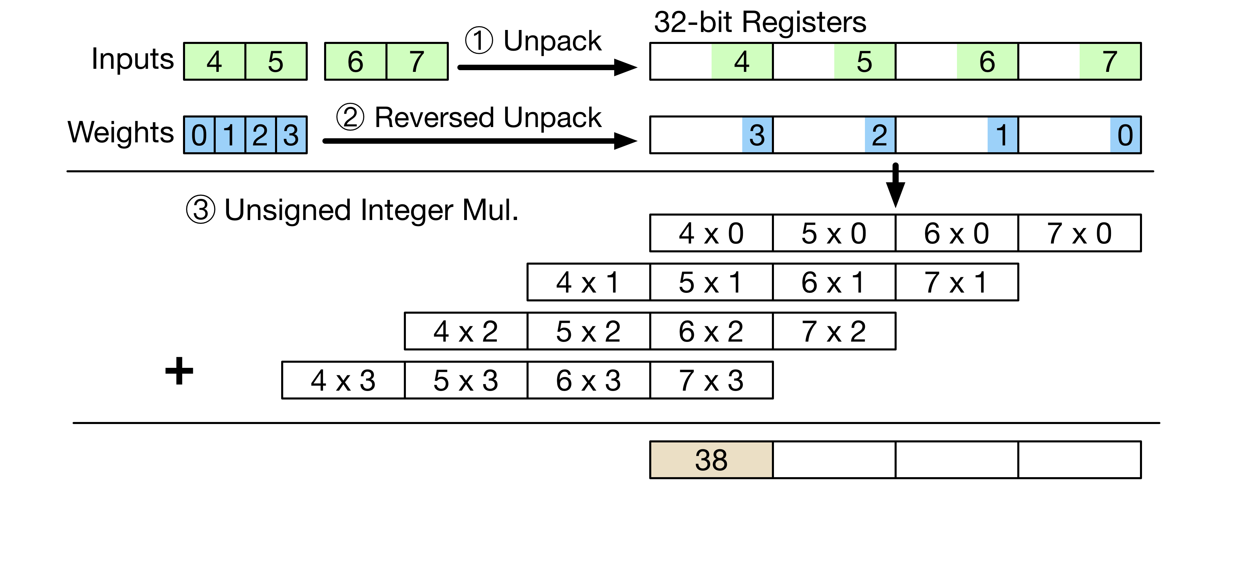
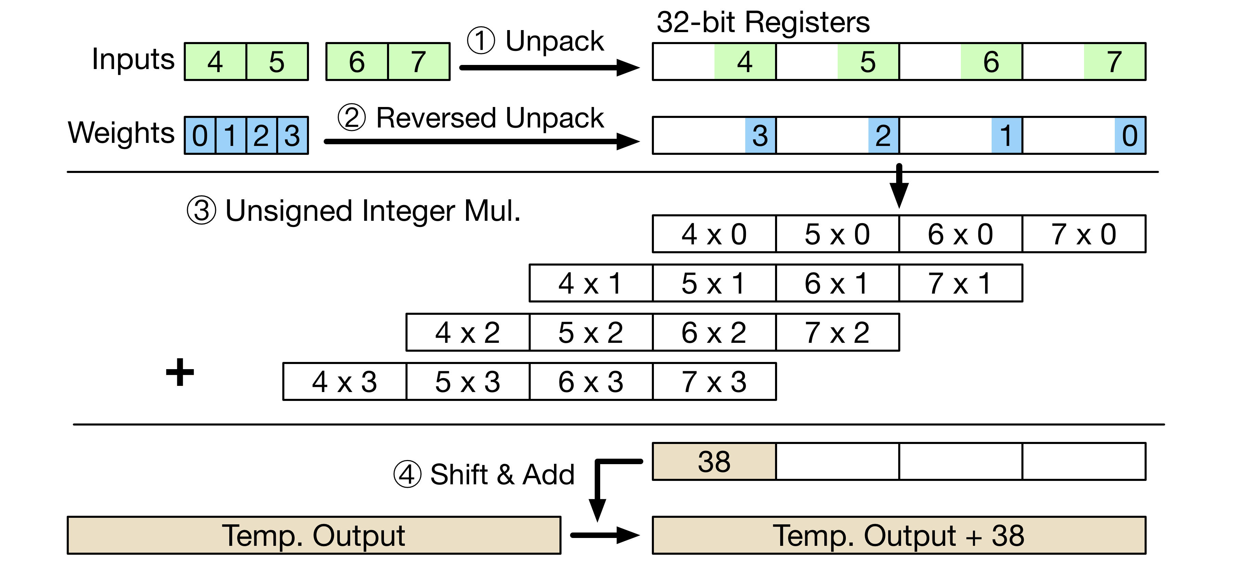
ISA Extension: Mul-Shift-Acc
Improve perf. with lowest hardware overhead
Mul-Shift-Acc instruction
  Low overhead: reusing the 32-bit Mul-Acc module in ALU
Notes:
To further accelerate the computation, we propose to extend the existing ISA of microcontrollers. It can help improve the computation performance with the lowest hardware overhead. If we look at the packed MAC, for the last step, the output register actually need to be shifted and added on to the temporary output value generated from the previous MAC operations. Here the first instruction we propose combines the third and fourth steps. This new instruction is called multiply-shift-accumulate. On conventional microcontrollers, the ALU already contains the circuit module for the 32-bit multiply-accumulate operation. In this case, we only need to add circuits for the shift operation, which can help minimize the hardware overhead.

Slide 17
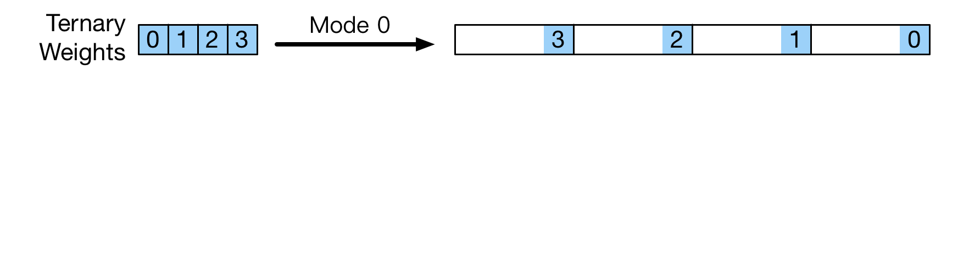
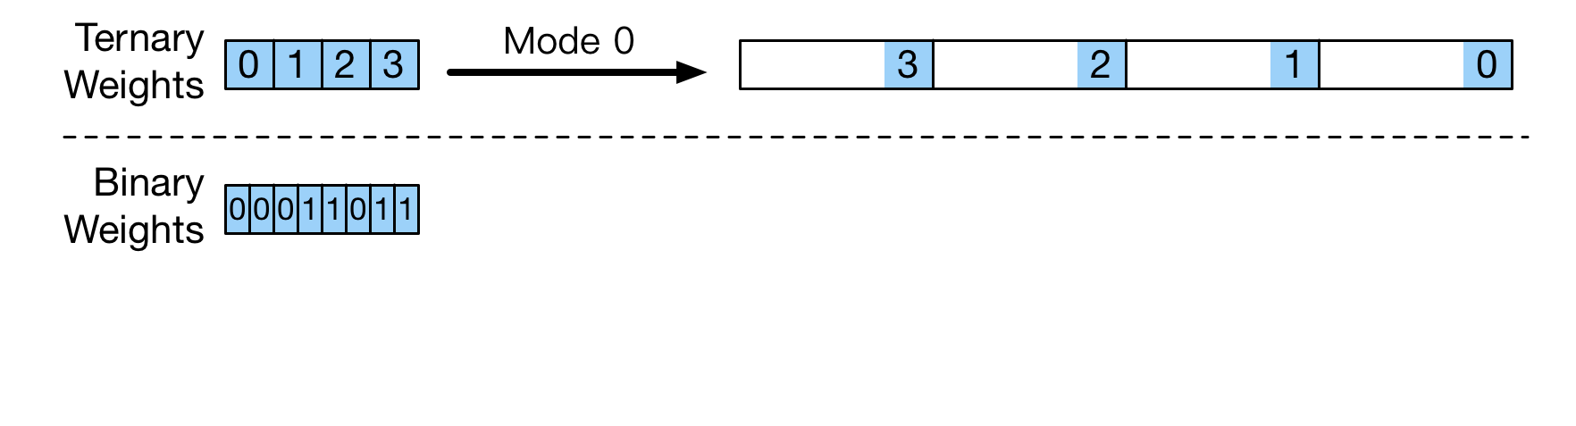
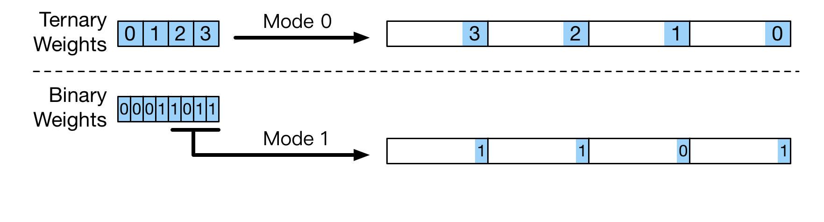
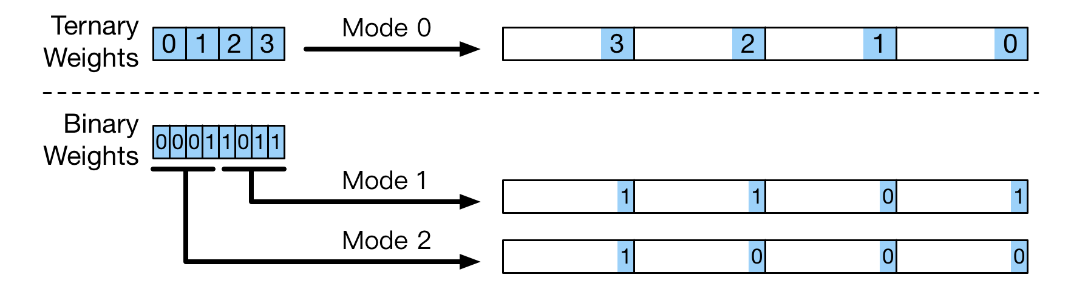
ISA Extension: Unpack
Unpack instruction
  3 modes: configurable with an immediate number
Notes:
Now, for the packed MAC, we already provide hardware support for the third and fourth steps. And the direct buffer convolution can already help reduce the input unpacking overhead, which corresponds to the first step. The only remaining operation which requires acceleration is the second step which is the reversed unpacking. In this case, the second instruction we propose is the unpack instruction. Besides ternary weights, we also provide unpacking support for binary weights. The proposed unpack instruction has 3 modes which can be configured with an immediate number. For mode 0, it can do the reversed unpacking of ternary weights. And for mode 1 and mode 2, the unpack instruction can do the reversed unpacking for the lower 4 bits and the higher 4 bits of the target byte, respectively. With the unpack instruction, we can dramatically reduce the weight unpacking overhead for both ternary and binary weights.

Slide 18
Evaluation Methodology
Network benchmarks on CIFAR-10
Networks | CONV (#layer) | FC (#layer) | Accuracy (FP-32)
NIN | 9 | 0 | 92.57%
VGG-8 | 6 | 3 | 94.04%
ResNet-20 | 19 | 1 | 91.66%
Nucleo-f411re board
  Cortex-M4 (100MHz freq.) / 128KB SRAM/ 512KB flash
Energy: STM32 Power Shield board
ISA extension
  Performance: existing instructions hold consumed cycles
  Energy: synthesis with IBM 45nm SC12 library
Notes:
For evaluation, we test three networks on the CIFAR-10 dataset. We use the test board with a Cortex-m4 microcontroller running at 100MHz. To measure power consumption, we use the Power Shield board. For the DNN computation with the ISA extension, to measure the performance, we can use the existing instructions to hold the cycles consumed by the proposed instructions and perform the necessary memory access. For the energy numbers, we synthesize the hardware modules added for the proposed instructions, then use the results to adjust the power numbers we get from the power shield board.

Slide 19
Accuracy Loss
1.6% accuracy loss with ternary weights/4-bit inputs on average
Notes:
For the first step, we test the accuracy loss when using sub-byte values for inputs and weights. This figure gives the results. The y-axis is the accuracy loss in percentage. The blue bars are the accuracy loss when using binary values for both inputs and weights. The accuracy is decreased by up to 15%. The orange bars show the results with ternary weights and four-bit inputs. The accuracy loss is reduced significantly. On average, the accuracy loss can be reduced to only 1.6%. Therefore, with TF-Net, we can limit the accuracy loss to a small level when using sub-byte values for inputs and weights.

Slide 20
Performance and Hardware Overhead
1.83x
ISA extension incurs 1.4% area overhead
  Mul-Shift-Acc: 1.26%
  Unpack: 0.14%
Notes:
For the next step, we test the computation performance and this figure shows the results. The y-axis is the relative performance. Higher is better. Here we still use 16-bit integers for both inputs and weights as the baseline, which are the blue bars. The orange bars are the results with the original unpacking algorithm. On average, the performance is reduced to only 0.26x. Then the gray bars are the results with direct buffer convolution and the packed MAC. The performance can be dramatically increased to 1.40x. After this, with the ISA extension, the performance can be further improved to 1.83x. We also measure the area overhead of the new instructions. The multiply-shift-accumulate instruction has an area overhead of 1.26% compared with the microcontroller excluding the SRAM and DSP unit. The unpack instruction leads to a 0.14% overhead. In total, the new instructions only require 1.4% area overhead.

Slide 21
Energy Efficiency
Energy efficiency = # images processed per Joule
2.28x
Higher improvement than in performance
  Lower execution time
  Lower dynamic power: less memory access
Notes:
After this, we also test the energy efficiency. Here we define the energy efficiency to be the number of images processed per joule. This figure shows the results. The y-axis is the relative energy efficiency. With the original unpacking algorithm, the energy efficiency is reduced to only 0.33x. Then, with the TF-Net, the energy efficiency can be improved to 2.28x. Here, the improvement in energy efficiency is higher than that in computation performance. There are two reasons. First, the execution time of DNN models is reduced. Second, using sub-byte values can help reduce the memory access and, therefore, the dynamic power consumption also becomes lower.

Slide 22
Improvement with Lower Clock Frequency
Low clock frequency: 24 MHz
  Wait states for flash fetching decreases from 3 to 0
Computation performance: 1.83x 1.72x
  Lower performance benefit from flash access reduction
Energy efficiency: 2.28x 2.41x
  Flash access cost relatively more energy
  Higher energy benefit from flash access reduction
Lower frequency:
  Same computation performance in cycles
  Higher energy efficiency improvement
Notes:
We also test TF-Net on microcontrollers with lower clock frequency. We reduce the clock frequency from 100MHz to 40MHz. In this case, the wait states for flash fetching decreases from 3 to 0. It means the flash read now only takes 1 cycle. For the computation performance, the improvement decreases from 1.83x to 1.72x. This is because some performance benefit of TF-Net comes from the reduction of the flash access but, with a lower frequency, the flash access costs fewer cycles. In comparison, for energy efficiency, the improvement from TF-Net increases from 2.28x to 2.41x. With a lower frequency, the energy consumption for the CPU decreases a lot but the flash access still requires similar energy. The relative energy consumed by flash access will increase. In this case, TF-Net can reduce flash access and the improvement in energy efficiency becomes higher. Because of the same reasons, if we further decrease the clock frequency, the computation performance in cycles will keep the same because the wait states for flash fetching cannot be negative. But the improvement in energy efficiency will become even higher.

Slide 23
SRAM Requirement
1584
2560
NIN
VGG-8
ResNet-20
Input Bits
Notes:
For the last step, we test the SRAM requirements of different models. The y-axis is the SRAM requirement in KB. The blue bars show the SRAM cost with 16-bit inputs, and the orange bars are for the original unpacking algorithm. Now, with the direct buffer convolution, the SRAM requirement is dramatically reduced. For ResNet-20, the SRAM requirement does decrease much with lower input precisions. This is because we use 16-bit inputs for the skip connections.

Slide 24
Conclusion
Unpacking overhead for sub-byte DNN models
TF-Net pipeline
  Training framework for sub-byte DNN
  Direct buffer conv. + packed MAC
  ISA extension
Computation performance: 1.83x
Energy efficiency: 2.28x
Notes:
In conclusion, we show that running sub-byte DNN models on microcontrollers suffers from the unpacking overhead. To accelerate the computation, we introduce the TF-Net pipeline. We first provide a training framework for sub-byte DNN models. Then we propose the direct buffer convolution and packed MAC to reduce the input and weight unpacking overhead. As the last part, we introduce an extension to the existing ISA of microcontrollers to further improve the computation performance. With ternary weights and four-bit inputs, we can improve computation performance by 1.83x and the energy efficiency by 2.28x.

Slide 25
Thanks!
Q & A
Notes:
In conclusion, we show that running sub-byte DNN models on microcontrollers suffers from the unpacking overhead. To accelerate the computation, we introduce the TF-Net pipeline. We first provide a training framework for sub-byte DNN models. Then we propose the direct buffer convolution and packed MAC to reduce the input and weight unpacking overhead. As the last part, we introduce an extension to the existing ISA to further improve the computation performance. With ternary weights and four-bit inputs, we can improve computation performance by 1.83x and the energy efficiency by 2.28x.

Slide 26
TF-Net: Deploying Sub-Byte Deep Neural Networks on Microcontrollers
Jiecao Yu ¹, Andrew Lukefahr ², Reetuparna Das ¹, Scott Mahlke ¹
¹ University of Michigan, ² Indiana University Bloomington
CASES, October 14th, 2019
Notes:
Hi everyone, I am Jiecao Yu from the University of Michigan working with Prof. Scott Mahlke. Today I am presenting my work TF-Net: Deploying Sub-Byte Deep Neural Networks on Microcontrollers.

Slide 27
Accuracy Loss: 2-bit weights/4-bit inputs
Based on LQ-Net but using uniform steps instead
No average accuracy loss with 2-bit weights/4-bit inputs

