Slide 1
A Bypass First Policy for Energy-Efficient Last Level Caches
Jason Jong Kyu Park¹, Yongjun Park², and Scott Mahlke¹
¹University of Michigan, Ann Arbor
²Hongik University

Slide 2
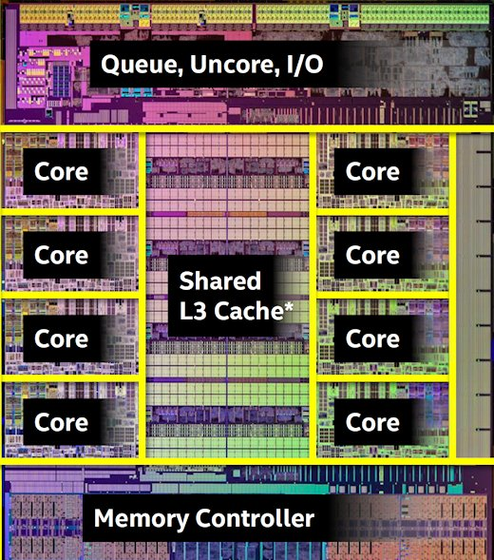
Last Level Cache (LLC)
Large portion of the chip area
About 20% in i7-5960X (Cores ≈ 30%)
Has large impacts on:
Performance
Energy consumption
[Intel Core i7-5960X]

Slide 3
Trends in LLC
Increasing in size

Slide 4
LLC Characteristic
Large number of never-rereferenced blocks
Bypasses: RRIP [Jaleel’10], PDP [Duong’12], DSB [Gao’10]
Still large number of never-rereferenced blocks!

Slide 5
Cache First Policy
Common traits
Inserts into the LLC before identifying characteristics
Conservative in decisions
LLC
Unnecessary writes of never-rereferenced blocks!
Upper Level Caches

Slide 6
Objective of This Work
Design of a Bypass First Policy (BFP)
Defaults to bypassing
Removes unnecessary writes of never-rereferenced blocks
Energy saving
Design Challenges
How do we know when to insert?
Can we implement BFP such that it also improves performance?

Slide 7
Locality in the LLC
Many cache blocks are reused in the upper level
BFP will handle majority of cache blocks

Slide 8
Observation 1: Temporal Locality
When a block is reused,
The same block is likely to be reused

Slide 9
Observation 2: Spatial Locality
When a block is reused,
Blocks within the same memory region are likely to be reused
Locality exists once a reuse has been observed!

Slide 10
BFP Overview
LLC
Shadow Directory
Set 0
…
Set 1
Set 2
…
Width
Set N
Valid
Tag
Spatial Locality Predictor (SLP)
…
Depth
Valid
Tag
Confidence

Slide 11
BFP Design: Insert Decision
Bypassed blocks store tags in shadow directory or SLP
Hit
Miss
Hit
Shadow Directory
LLC
…
Miss
Bypass!
Insert!
Spatial Locality Predictor (SLP)
…
Miss
Hit

Slide 12
BFP Design: Management
Round-robin replacement
Hit
Shadow Directory
…
Bypassed Block
Spatial Locality Predictor (SLP)
…

Slide 13
Determining Parameters
Experimentally sweep to find the parameters
e.g.) Number of bits for tag

Slide 14
BFP and Inclusion Property
Bypass breaks inclusion property
Bypass buffer [Gupta’13]
Bypass buffer
LLC
Energy consumption
LLC >>> Bypass buffer

Slide 15
Experimental Setup
CMP$im
A pin-based trace-driven simulator
Desktop-class CPU for SPEC2006
4-way out-of-order, 128-entry ROB, three-level caches
Mobile CPU for Mediabench
4-way out-of-order, 128-entry ROB, two-level caches
Baseline: LRU
CACTI
Models power for cache structures
22nm technology LSTP (Low Standby Power) process

Slide 16
Energy Saving
5.4%
41.1%
41.1%
57.1%

Slide 17
Performance Comparison
4.8%
4.0%
5.8%
5.7%

Slide 18
Hardware Overhead
 | RRIP | PDP* | DSB | BFP
Per line | 2 bit | 2 bit | 5 bit | 1 bit
Per set |  |  | 22 bit | 31 bit
Per sampled set |  | 515 bit | 748 bit
Extra | 10 bit | 10K gates 0.13kB | 51 bit | 27 bit
Total | 8.0kB | 10.14kB + 10K gates | 31.3kB | 11.75kB
*PDP requires logic to compute PD, which is 10K gates

Slide 19
Summary
Bypass First Policy vs. Cache First Policy
A large number of never-rereferenced blocks even for the optimal replacement
BFP
Apply temporal locality and spatial locality when a reuse has been observed
Shadow directory
Spatial locality predictor
57.1% energy saving for entire SPEC2006
5.7% performance improvement for entire SPEC2006

Slide 20
Questions

