Slide 1
Flextream: Adaptive Compilation of Streaming Applications for Heterogeneous Architectures
Amir Hormati¹, Yoonseo Choi¹, Manjunath Kudlur³, Rodric Rabbah², Trevor Mudge¹, and Scott Mahlke¹
1 | University of Michigan
2 | IBM T.J. Watson Research Lab.
3 | NVIDIA Corp.

Slide 2
Cores are the New Gates
(Shekhar Borkar, Intel)
512
Stream Programming
Unicore
PicoChip
256
AMBRIC
Homogeneous Multicore
128
Heterogeneous Multicore
CISCO CSR1
NVIDIA G80
CUDA
Courtesy: Gordon’06
Courtesy: Gordon’06
Larrabee
64
X10
Peakstream
32
C/C++/Java
RAZA
XLR
Fortress
# cores/chip
Cavium
16
RAW
Accelerator
8
Niagara
Cell
Ct
4
BCM 1480
Opteron 4P
C T M
AMD Fusion
Xeon
Core2Quad
Xbox 360
Power6
Rstream
Power4
PA8800
4004
8008
8080
PA8800
2
4004
8008
8080
Opteron
CoreDuo
Rapidmind
8086
286
386
486
Pentium
P2
P3
P4
Core2Duo
1
Core
Athlon
Itanium
Itanium2
1975
1980
1985
1990
1995
2000
2005
2010
Notes:
Unicore processors worked well for 30 years, primarily because of shrinking transistors and increased operating frequency.
Around 2000, the industry hit what can be collectively called the complexity wall (including power, memory, ILP). This is mainly because of large monolithic structures.
In the past few years, processor designers have turned to multicore designs to continue performance scalability.
We are seeing many multicore designs ranging from 2 to 256 cores on a chip.
Some of them are homogeneous. Others are heterogeneous, containing data engines and special accelerators along with GPPs.
Let us see how these processors were programmed.
Uniprocessors were programmed using sequential von Neumann languages. I am just showing C/C++ just because they were the most popular. Language research focused on bringing more productivity to the programmers. Parallel libraries and languages targeted network of workstations and were the mainly used by scientists working on supercomputers.
Now that multicores have become commodity, every company out there is scrambling to figure out how to program multicores. Here is a sampling of what the companies, both small and big are trying to do. All these projects started only in the past 5 years. Some of them are new languages, some of them are extensions, and others use the library approach. They vary widely in their underlying programming model.
One notable programming model is streaming, and the following approaches provide support for streaming in some form.

Slide 3
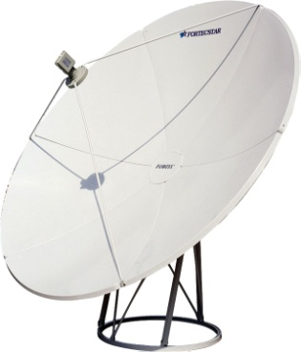
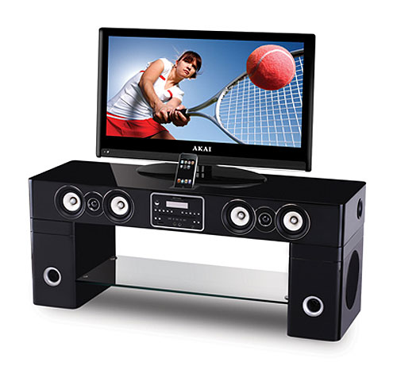
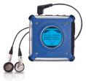
Streaming Computing Is Everywhere!
Prevalent computing domain with applications in embedded systems, desktops and high-end servers
Notes:
Emphasize embedded systems (Cell phones, handhelds, DSPs)
But also extends to desktop and HPS
Performance and power is a major concern in embedded systems
Important to make execution as efficient as possible: optimizations are key
In streaming codes:
Locality: computation and data locality
Easy to extract and exploit both parallelism and locality
Can have a major impact on memory system

Slide 4
StreamIt
Main Constructs:
Filter: Encapsulate computation.
Stateful
Stateless
Pipeline → Expressing pipeline parallelism.
Splitjoin → Expressing task/data-level parallelism.
Exposes different types of parallelism
filter
pipeline
splitjoin

Slide 5
StreamIt Graph Tuning
Parallelism can be tuned in streaming programs
Horizontal Replication
Horizontal Fusion
Vertical Fusion

Slide 6
StreamIt Example
10
A
10
A
10
A
6
Splitter
6
Splitter
43
B1
43
B2
21.5
B1
21.5
B2
21.5
B3
21.5
B4
86
B
6
Joiner
6
Joiner
246
C
246
C
1138
CDE
326
D
326
D
566
E
566
E
10
F
10
F
10
F

Slide 7
What Are We Solving?
A
Core
Memory
Core
Memory
Core
Memory
Core
Splitter
Memory
B1
B2
B3
B4
?
Joiner
C
Performing graph modulo scheduling on a stream graph statically.
What happens in case of dynamic resource changes?
Splitter
D1
D2
Joiner
E
F

Slide 8
Target Architecture
Master processor acts as a controller.
Each slave processor has its own local store and DMA engine.
An interconnect network connects all the components together.
Slave
. . .
Slave
Local Store
Local Store
DMA
DMA
Memory
Interconnect
Master Processor
DMA
. . .
DMA
Local Store
Local Store
Slave
Slave

Slide 9
Overview of Flextream
Streaming Application
Prepass Replication
Adjust the amount of parallelism for the target system by replicating actors.
Static
Find an optimal schedule for a virtualized member of a family of processors.
Work Partitioning
Find optimal modulo schedule for a virtualized member of a family of processors.
Goal: To perform Adaptive Stream Graph Modulo Scheduling.
Partition Refinement
Tunes actor-processor mapping to the real configuration of the underlying hardware. (Load balance)
Dynamic
Stage Assignment
Performs light-weight adaptation of the schedule for the current configuration of the target hardware.
Specifies how actors execute in time in the new actor-processor mapping.
Buffer Allocation
Tries to efficiently allocate the storage requirements of the new schedule into available memory units.
MSL Commands

Slide 10
MSL : Multi-Core Streaming Layer
Instruction set for heterogeneous multi-core systems
A set of high-level commands for :
Actor Commands(Loading/Unloading)
Buffer Commands(Allocating local/global buffers)
Data Transfer Commands(Managing DMAs)
Flextream’s online layer uses these commands to adapt the static schedule

Slide 11
Overall Execution Flow
For every application may see multiple iterations of:
Resource change Request
Resource change Granted

Slide 12
Prepass Replication [static 1]
6
S0
22
10
A
C0
C1
C2
C3
61.5
C1
C2
C
D
A
E0
B
C0
D0
22
C3
86
B
6
J0
6
S1
P1 : 86
P1 : 147.5
P2 : 246
P2 : 184.5
P3 : 326
P3 : 163
P0 : 10
P3 : 163
P0 : 151.5
246
C
22
D0
D1
163
326
D
22
E3
E1
E0
E1
6
J1
E
F
E2
D1
566
E
6
S2
21
E0
E1
E2
E3
141.5
P6 : 283
P7 : 163
P7 : 0
P4 : 566
P7 : 163
P4 : 141.5
P5 : 10
P5 : 151.5
P6 : 0
P4 : 283
P6 : 141.5
10
F
21
6
J2

Slide 13
Work Partitioning [static 2]
Finds optimal actor to processor mapping considering:
Actors’ work estimates
Communication cost
DMA cost
Memory requirements
At the end, each actor is assigned to exactly one processor.

Slide 14
Partition Refinement [dynamic 1]
Available resources at runtime can be more limited than resources in static target architecture.
Partition refinement tunes actor to processor mapping for the active configuration.
A greedy iterative algorithm is used to achieve this goal.

Slide 15
Partition Refinement Example
Pick processors with most number of actors.
Sort the actors
Find processor with max work
Assign min actors until threshold
C0
C1
E2
E3
S2
S1
E0
B
C2
E2
S0
J0
C2
P1 : 141.5
P1 : 283
P2 : 171.5
P3 : 141.5
P0 : 184.5
P3 : 289
J2
J1
A
E1
D1
F
C3
D0
B
C3
C0
C1
S2
J0
S0
J1
J2
S1
P4 : 151.5
P5 : 173
P5 : 183
P4 : 274.5
P5 : 193
P5 : 270.5
P6 : 140
P7 : 159.5
E2
B
C0
C1
C2
C3
S2
S1
J1
J2
S0
J0

Slide 16
Stage Assignment [dynamic 2]
Processor assignment only specifies how actors are overlapped across processors.
Stage assignment finds how actors are overlapped in time.
Relative start time of the actors is based on stage numbers.
DMA operations will have a separate stage.

Slide 17
Stage Assignment Example
A
0
B
2
E3
E0
B
S0
4
E2
C2
6
C0
C1
C2
C3
J2
J1
J0
A
E1
D1
F
C3
D0
S1
8
C0
C1
S2
J0
S0
10
S1
D0
D1
J1
12
S2
E0
E1
E2
E3
14
J2
16
F
18

Slide 18
Buffer Allocation [dynamic 3]
Slave processors have limited local store.
Local store is faster than main memory.
Utilize local stores first and then spill to main memory
In case of spilling, DMAs have to be adjusted

Slide 19
Methodology
StreamIt Compiler
Metis for graph partitioning
32 core heterogeneous distributed memory multi-core system
Each slave core has a DMA engine and 128K local store
System simulator to simulate the interconnect traffic.

Slide 20
Performance Comparison (DES)

Slide 21
Performance Comparison

Slide 22
Dynamic Approach Time Comparison

Slide 23
Overhead Comparison

Slide 24
Conclusion
Static scheduling approaches are promising but not enough.
Dynamic adaptation is necessary for future systems.
Flextream provides a hybrid static/dynamic approach to improve efficiency.

Slide 25
Overhead Comparison

Slide 26
Prepass Replication
6
S0
22
10
A
C0
C1
C2
C3
61.5
22
86
B
6
J0
6
S1
246
C
22
D0
D1
163
326
D
22
6
J1
566
E
6
S2
21
E0
E1
E2
E3
141.5
10
F
21
6
J2

Slide 27
C1
C2
C
D
A
E0
B
C0
D0
C3
P1 : 86
P1 : 147.5
P2 : 246
P2 : 184.5
P3 : 326
P3 : 163
P0 : 10
P3 : 163
P0 : 151.5
E3
E1
E0
E1
F
E2
D1
E
P6 : 283
P7 : 163
P7 : 0
P4 : 566
P7 : 163
P4 : 141.5
P5 : 10
P5 : 151.5
P6 : 0
P4 : 283
P6 : 141.5

Slide 28
Outline
Streaming Background
Flextream’s Approach
Static phase
Dynamic phase
Evaluation
Conclusion

Slide 29
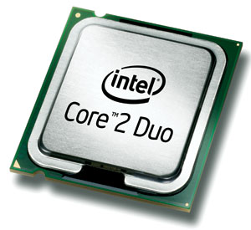
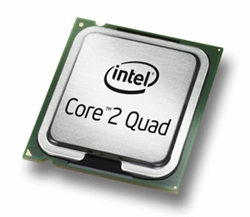
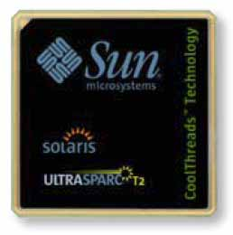
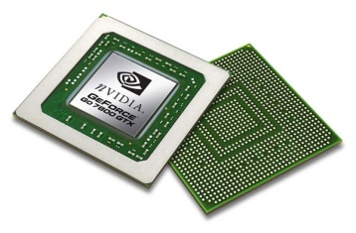
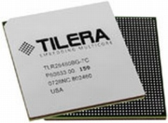
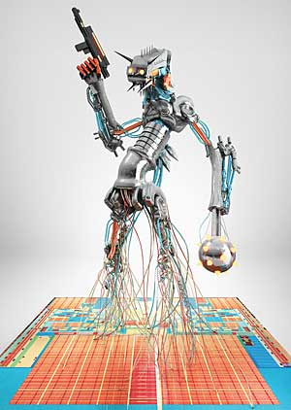
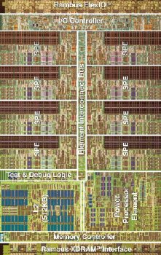
Introduction
Single core performance stopped to scale.
Multi-core and Many-core systems are every where.
These systems have different configurations.
Resource management is a challenging problem.
Cell Processor
Intel Larrabee

