Slide 1
Sponge: Portable Stream Programming on Graphics Engines
Amir Hormati, Mehrzad Samadi, Mark Woh,
Trevor Mudge, and Scott Mahlke

Slide 2
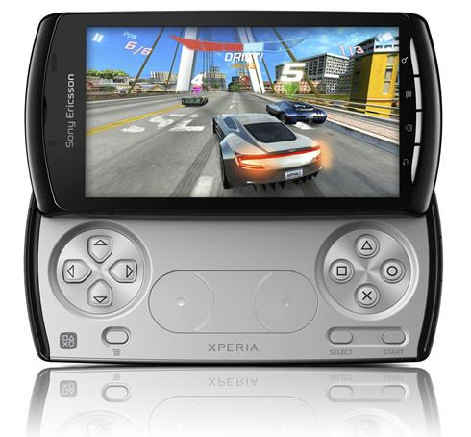
Why GPUs?
Every mobile and desktop system will have one
Affordable and high performance
Over-provisioned
Programmable
Sony PlayStation Phone
Notes:
Higher FLOP per Watt and Higher FLOP per dollar
I7: 0.36 GFLOP/$
GTX 285: 3.54 GFLOP/$
I7: 0.78 GFLOP/W
GTX 285: 5.2 GFLOP/W

Slide 3
GPU Architecture
SM 0
SM 1
SM 29
CPU
_{Shared}
_{Shared}
_{Shared}
₀
₁
₀
₁
₀
₁
_{Shared Memory}
₂
₃
₂
₃
₂
₃
₄
₅
₄
₅
₄
₅
₀
₁
Kernel 1
₆
₇
₆
₇
₆
₇
Time
_{Regs}
_{Regs}
_{Regs}
₂
₃
₄
₅
₆
₇
Interconnection Network
_{Registers}
Kernel 2
Global Memory (Device Memory)

Slide 4
GPU Programming Model
Threads → Blocks → Grid
All the threads run one kernel
Registers private to each thread
Registers spill to local memory
Shared memory shared between threads of a block
Global memory shared between all blocks

Slide 5
GPU Execution Model
SM 0
SM 1
SM 2
SM 3
SM 30
_{Shared}
_{Shared}
_{Shared}
_{Shared}
_{Shared}
₀
₁
₀
₁
₀
₁
₀
₁
₀
₁
₂
₃
₂
₃
₂
₃
₂
₃
₂
₃
₄
₅
₄
₅
₄
₅
₄
₅
₄
₅
₆
₇
₆
₇
₆
₇
₆
₇
₆
₇
_{Regs}
_{Regs}
_{Regs}
_{Regs}
_{Regs}
Grid 1

Slide 6
GPU Execution Model
Block 0
SM0
_{Shared}
ThreadId
0
Warp 0
31
32
Warp 1
₀
₁
63
Block 1
₂
₃
₄
₅
₆
₇
Block 2
_{Registers}
Block 3

Slide 7
GPU Programming Challenges
Data restructuring for complex memory hierarchy efficiently
  Global memory, Shared memory, Registers
Partitioning work between CPU and GPU
Lack of portability between different generations of GPU
  Registers, active warps, size of global memory, size of shared memory
Will vary even more
  Newer high performance cards e.g. NVIDA’s Fermi
  Mobile GPUs with less resources
Optimized for
GeForce 8400 GS
Optimized for
GeForce GTX 285

Slide 8
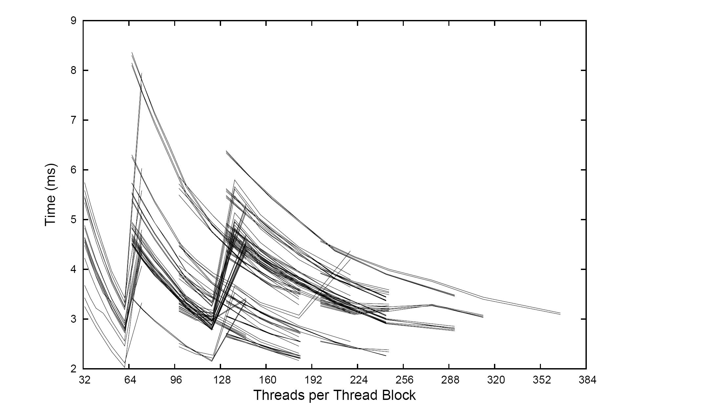
Nonlinear Optimization Space
SAD Optimization Space
908 Configurations
We need higher level of abstraction!
[Ryoo , CGO ’08]

Slide 9
Goals
Write-once parallel software
Free the programmer from low-level details
(C + Pthreads) Shared Memory Processors
Parallel Specification
(C +Intrinsics) SIMD Engines
(Verilog/VHDL) FPGAs
(CUDA/OpenCL) GPUs

Slide 10
Streaming
Higher-level of abstraction
Decoupling computation and memory accesses
Coarse grain exposed parallelism, exposed communication
Programmers can focus on the algorithms instead of low-level details
Streaming actors use buffers to communicate
A lot of recent works on extending portability of streaming applications
Actor 1
Splitter
Actor 2
Actor 3
Actor 4
Actor 5
Joiner
Actor 6
Notes:
Stream programming encourages a style of programming that expresses the parallelism inherent in a program by decoupling computation and memory accesses [11][12]. The explicit parallelism and locality of data in a stream program makes it easier to compile effciently using traditional compiler optimizations.

Slide 11

Sponge
  Generating optimized CUDA for a wide variety of GPU targets
  Perform an array of optimizations
  on stream graphs
  Optimizing and porting to different generations
  Utilize memory hierarchy (registers, shared memory, coallescing)
  Efficiently utilize streaming cores
Reorganization and Classification
Shared/Global Memory
Memory
Layout
Helper Threads
Bank Conflict Resolution
Graph
Restructuring
Register
Optimization
Software Prefetching
Loop Unrolling

Slide 12
GPU Performance Model
- Memory bound Kernels
≈ Memory Time
M 0
M 1
M 2
M 3
M 4
M 5
M 6
M 7
C 0
C 1
C 2
C 3
C 4
C 5
C 6
C 7
- Computation bound Kernels
≈ Computation Time
M 0
M 1
M 2
M 3
M 4
M 5
M 6
M 7
C 0
C1
C 2
C 3
C 4
C 5
C 6
C 7
M
Memory Instructions
C
Computation Instructions

Slide 13
Actor Classification
High Traffic Actors(HiT)
  Large number of memory accesses per actor
  Less number of threads with shared memory
  Using shared memory underutilizes the processors
Low Traffic Actors(LoT)
  Less number of memory accesses per actor
  More number of threads
  Using shared memory increases the performance

Slide 14
Global Memory Accesses
Large access latency
Not access the words in sequence
No coalescing
A[i, j] → Actor A has i pops and j pushes
Global Memory
₀
₃
₇
₁₁
₁₅
₀
₁
₁
₂
₂
₃
₄
₄
₅
₅
₆
₆
₇
₈
₈
₉
₉
₁₀
₁₀
₁₁
₁₂
₁₂
₁₃
₁₃
₁₄
₁₄
₁₅
_{Thread 0}
_{Thread 1}
_{Thread 2}
_{Thread 3}
_{A[4,4]}
_{A[4,4]}
_{A[4,4]}
_{A[4,4]}
Global Memory
₀
₁
₂
₃
₃
₄
₅
₆
₇
₇
₈
₉
₁₀
₁₁
₁₁
₁₂
₁₃
₁₄
₁₅
₀
₁
₂
₄
₅
₆
₈
₉
₁₀
₁₂
₁₃
₁₄
₁₅

Slide 15
Shared Memory
Global Memory
₀
₁
₂
₃
₄
₄
₅
₅
₆
₆
₇
₇
₈
₈
₉
₉
₁₀
₁₀
₁₁
₁₁
₁₂
₁₂
₁₃
₁₃
₁₄
₁₄
₁₅
₀
₁
₂
₃
₁₅
_{Thread 0}
_{Thread 1}
_{Thread 2}
_{Thread 3}
_{Global To Shared}
_{Global To Shared}
_{Global To Shared}
_{Global To Shared}
Shared Memory
₀
₁
₂
₃
₄
₄
₅
₅
₆
₆
₇
₇
₈
₈
₉
₉
₁₀
₁₀
₁₁
₁₁
₁₂
₁₂
₁₃
₁₃
₁₄
₁₄
₁₅
₀
₁
₂
₃
₁₅
_{A[4,4]}
_{A[4,4]}
_{A[4,4]}
_{A[4,4]}
Shared Memory
₀
₄
₅
₆
₇
₈
₉
₁₀
₁₁
₁₂
₁₃
₁₄
₁₅
₀
₁
₁
₂
₂
₃
₃
₄
₅
₆
₇
₈
₉
₁₀
₁₁
₁₂
₁₃
₁₄
₁₅
_{Shared to Global}
_{Shared to Global}
_{Shared to Global}
_{Shared to Global}
Global Memory
₀
₄
₅
₆
₇
₈
₉
₁₀
₁₁
₁₂
₁₃
₁₄
₁₅
₀
₁
₁
₂
₂
₃
₃
₄
₅
₆
₇
₈
₉
₁₀
₁₁
₁₂
₁₃
₁₄
₁₅
First bring the data into shared memory with coalescing
  Each filter brings data for other filters
  Satisfies coalescing constraints
After data is in the shared memory, then each filter accesses its own memory.
Improve bandwidth and performance

Slide 16
Using Shared Memory
Shared memory is 100x faster than global memory
Coalesce all global memory accesses
Number of threads is limited by size of the shared memory.

Slide 17
Helper Threads
Shared memory limits the number of threads.
Underutilized processors can fetch data.
All the helper threads are in one warp. (no control flow divergence)

Slide 18
Data Prefetch
Better register utilization
Data for iteration i+1 is moved to registers
Data for iteration i is moved from register to shared memory
Allows the GPU to overlap instructions

Slide 19
Loop unrolling
Similar to traditional unrolling
Allows the GPU to overlap instructions
Better register utilization
Less loop control overhead
Can also be applied to memory transfer loops

Slide 20
Methodology
Set of benchmarks from the StreamIt Suite
3GHz Intel Core 2 Duo CPU with 6GB RAM
Nvidia Geforce GTX 285
Stream Processors | Processor clock | Memory Configuration | Memory Bandwidth
240 | 1476 MHz | 2GB DDR3 | 159.0 GB/s

Slide 21
Result (Baseline CPU)
24
10

Slide 22
Result (Baseline GPU)
16%
16%
3%
64%

Slide 23
Conclusion
Future systems will be heterogeneous
GPUs are important part of such systems
Programming complexity is a significant challenge
Sponge automatically creates optimized CUDA code for a wide variety of GPU targets
Provide portability by performing an array of optimizations on stream graphs
Notes:
Sequential work on traditional processors
Parallelizable work on specialized computing engines

Slide 24
Questions

Slide 25
Spatial Intermediate Representation
StreamIt
Main Constructs:
  Filter → Encapsulate computation.
  Pipeline → Expressing pipeline parallelism.
  Splitjoin → Expressing task-level parallelism.
  Other constructs not relevant here
Exposes different types of parallelism
  Composable, hierarchical
Stateful and stateless filters
filter
pipeline
splitjoin

Slide 26
Nonlinear Optimization Space
SAD Optimization Space
908 Configurations
[Ryoo , CGO ’08]

Slide 27
Bank Conflict
_{Conflict}
Shared Memory
₀
₁
₂
₈
₉
₁₀
₁
₂
₀
₁
₂
₃
₄
₅
₆
₇
₈
₉
₁₀
₁₁
₁₂
₁₃
₁₄
₁₅
₀
₀
₁
₂
₃
₄
₅
₆
₇
_{Thread 0}
_{Thread 1}
_{Thread 2}
_{A[8,8]}
_{A[8,8]}
_{A[8,8]}
Shared Memory
₀
₁
₂
₉
₁₀
₂
₂
₃
₄
₅
₆
₇
₈
₉
₁₀
₁₁
₁₂
₁₃
₁₄
₁₅
₀
₁
₂
₃
₄
₅
₆
₇
₀
₁
₈
₀
₁
data = buffer[BaseAddress + s * ThreadId]

Slide 28
Removing Bank Conflict
if GCD( # of bank, s) is 1 there will be no bank conflict → s must be odd
Shared Memory
₀
₂
₉
₁₀
₁₁
₄
₀
₁
₁
₂
₃
₄
₅
₆
₇
₈
₉
₁₀
₁₁
₁₂
₁₃
₁₄
₁₅
₀
₁
₂
₂
₃
₃
₄
₅
₆
₇
_{Thread 0}
_{Thread 1}
_{Thread 2}
_{A[8,8]}
_{A[8,8]}
_{A[8,8]}
Shared Memory
₀
₁
₂
₃
₄
₅
₆
₇
₈
₉
₁₀
₁₁
₂
₉
₁₀
₁₁
₁₂
₁₃
₁₄
₁₅
₀
₁
₂
₃
₄
₅
₆
₇
₀
₁
₂
₃
₄
data = buffer[BaseAddress + s * ThreadId]

