Slide 1
Low-Power Scientific Computing
NDCA 2009
Ganesh Dasika,
Ankit Sethia, Trevor Mudge, Scott Mahlke
University of Michigan
Advanced Computer Architecture Laboratory

Slide 2
The Advent of the GPGPU
Growing popularity for scientific computing
Medical Imaging
Astrophysics
Weather Prediction
EDA
Financial instrument pricing
Commodity item
Increasingly programmable
Fermi
ARM/Mali ?
“Larrabee” ?

Slide 3
Disadvantages of GPGPUs
Gap between computation and bandwidth
933 GFLOPS : 142 GB/s bandwidth
(0.15B of data per FLOP, ~26:1 Compute:Mem Ratio)
Very high power consumption
Graphics-specific hardware
Several thread contexts
Large register files and memories
Fully general datapath
Inefficiencies in all
general-purpose architectures

Slide 4
Goals
Architecture for improved power efficiency for high-performance scientific applications
Reduced data center power
Improved portability for mobile devices
100s of GFLOPS for 10-20W
GPU-like structure to exploit SIMD
Domain-specific add-ons
System design for best memory/performance balancing

Slide 5
Performance vs. Compute Power
S1070
GTX 295
GTX 280
IBM Cell
Core i7
Core 2
Cortex
A8
Pentium M

Slide 6
High Throughput at Low Power
Medical domains
Image reconstruction
Communications, signal-processing
Real-time FFT for GPS receivers
Parity-checking for WiMAX and WiFi
Financial applications
Fluctuation analysis for various market indices
SDE or Monte Carlo-based pricing models

Slide 7
Application Analysis
Primarily FP computation
Significant mem usage
(approx 0.9B/instr)
Some complex AG

Slide 8
Performance vs. Computer Power vs. Bandwidth
S1070
GTX 295
GTX 280
IBM Cell
GTX 295
GTX 280
Core i7
Core 2
Bandwidth limited!!
~0.15 B/instr vs
~0.9 B/instr
Cortex
A8
Pentium M

Slide 9
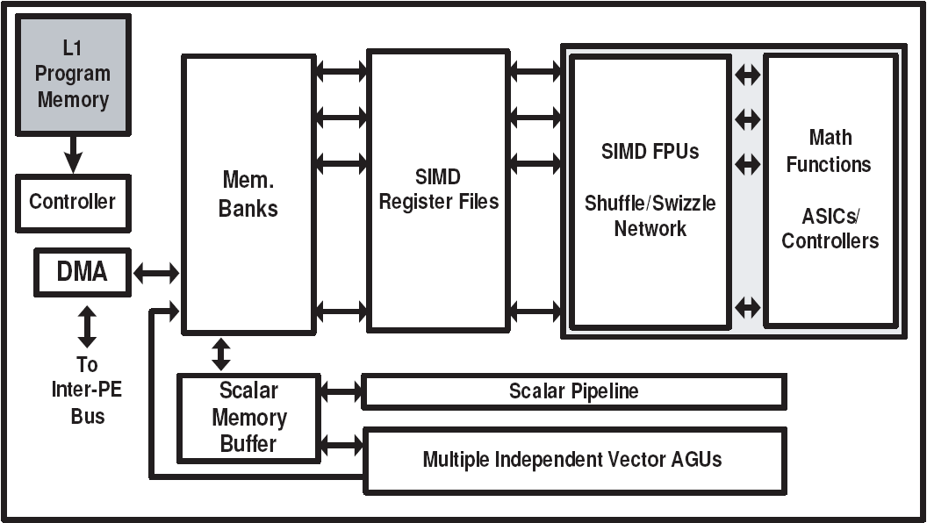
eco-GPGPU
FP MAC pipeline
Shuffle-swizzle networks
Co-processors for math functions
Significantly less power than Nvidia GPUs

Slide 10
Current Architecture
500 MHz @ 65 nm
64-way SIMD
64 GFLOPs
~2.5 W/core
1 TFLOP
@ 16 cores, 40 W

Slide 11
Performance vs. Compute Power
S1070
eco-GPGPU
GTX 295
GTX 280
IBM Cell
Core i7
Core 2
Cortex
A8
Pentium M

Slide 12
Memory System?
Multiple eco-GPGPU will eventually hit memory wall
GPGPUs use 1,000s of thread contexts to hide latency
Too much area
Too much power

Slide 13
Options for Memory System
3D-stacked DRAM?
Increased B/W
Reduced latency
Multi-threading not necessary
Caches?
32-64KB required assuming 200-cycle DRAM latency
Helps when temporal locality required
Pre-fetching, streaming?
Most data accesses are streaming/stride-based
Addresses predictable
Compression?
Sparse-matrix data easily compressible
Somewhat application-specific

Slide 14
Speedup from Streaming

Slide 15
Options for Memory System
3D-stacked DRAM?
Increased B/W
Reduced latency
Multi-threading not necessary
Caches?
32-64KB required assuming 200-cycle DRAM latency
Helps when temporal locality required
Pre-fetching, streaming?
Most data accesses are streaming/stride-based
Addresses predictable
Compression?
Sparse-matrix data easily compressible
Somewhat application-specific

Slide 16
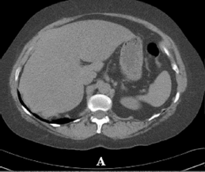
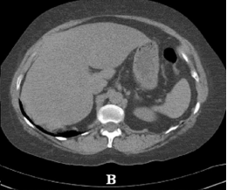
Data Compression in Medical Imaging
Normally for reducing disk space
Use compression to reduce data transfer instead
~10:1 loss-less compression
Re-reconstructed
after 12:1 JPEG lossy compression
of sinogram

Slide 17
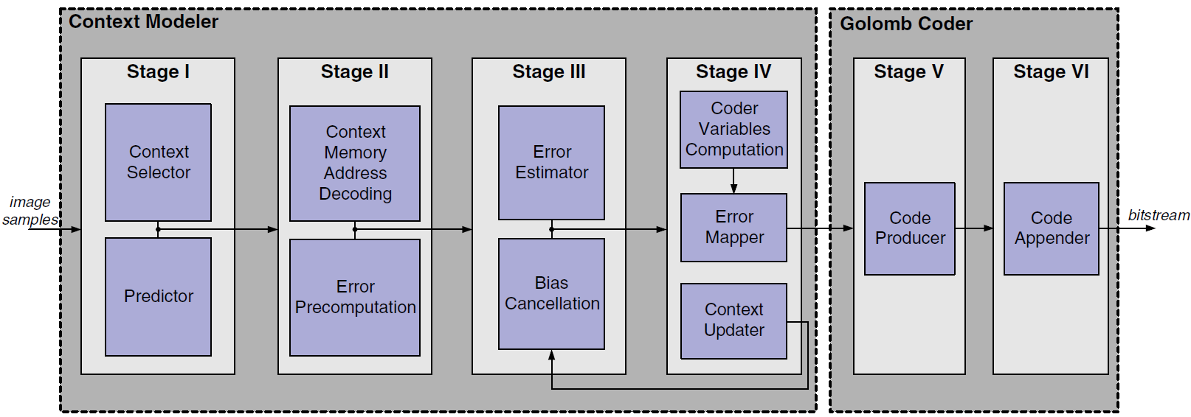
JPEG-LS Compression Hardware
vs
Compression Ratio
Image rows per compression
Low area footprint, compared to FPUs
~0.25mm²
High throughput
~250 Mpixels/sec
Very low power dissipation
~2mW
Compressing more data => Better ratios
[De]Compress data at off-chip mem bus
10X more bandwidth

Slide 18
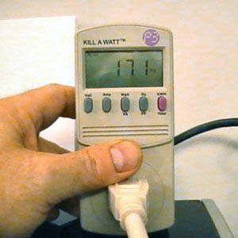
Current/Future Work
Thorough analysis of scientific compute domains
% FP
Mem:Compute ratios
Data access patterns
Improved GPU measurements
CUDA profiler to determine performance
Power measurements
Memory system options

Slide 19
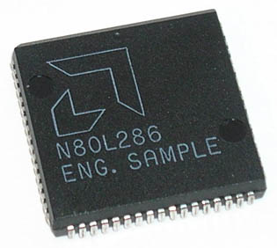
Conclusions
Low-power “supercomputing” an important direction of study in computer architecture
Current solutions either over-designed or far too inefficient
Significant efficiency improvements:
Datapath optimizations
Reduce thread contexts
Improved memory systems

Slide 20
Thank you!
???

