Slide 1
Efficient Soft Error Protection for Commodity Embedded Microprocessors using Profile Information
Daya S Khudia, Griffin Wright and Scott Mahlke
Computer Science and Engineering
University of Michigan
Ann Arbor

Slide 2
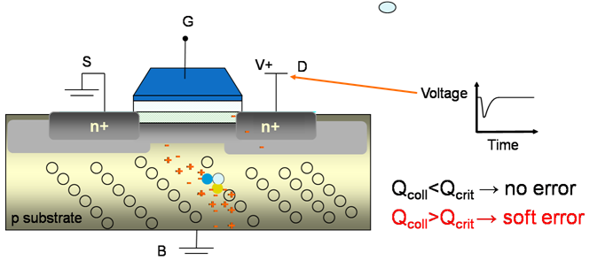
Soft Errors
Soft errors, also called single-event upsets(SEUs)
Occur because of
Neutrons from cosmic rays
Alpha particles from packaging materials
Voltage fluctuations or signal interference
Parameters affecting soft error rates
Technology scaling
Voltage scaling
Image credit: Certichip
Notes:
A critical aspect of any computer system is reliability. One pervasive cause of computer system failure and the focus of this work is soft errors. A soft error or SEU can be induced by high energy particle strike from cosmic radiation and chip packaging material or by electrical noise. Unlike manufacturing or design defects, which are persistent, transient faults as their name suggests, only sporadically influence program execution.
Soft Errors: As the industry moves towards finer process geometries, however the soft error rate may drastically increase.

Slide 3
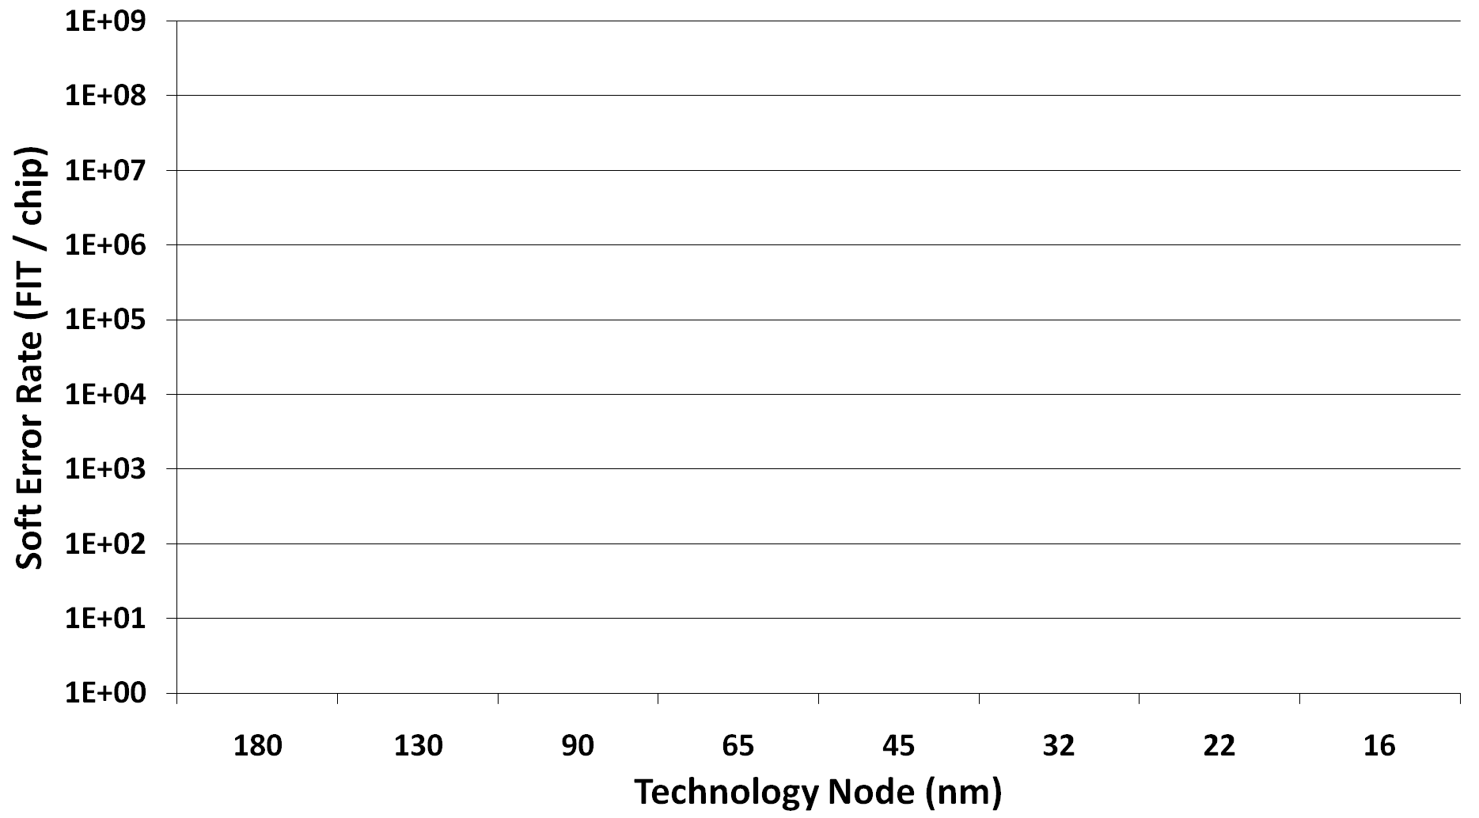
Soft error rate (SER)
One failure per DAY per chip
Past
Present
Future
At high error rates, mainstream systems can experience unacceptable soft errors
There is a need for mainstream solutions
One failure per DAY per 100 chips
Aggressive voltage scaling
(near-threshold computing)
One failure per MONTH per 100 chips
[Feng’10, Shivakumar’02]
Notes:
1 FIT means that the mean time before an error occurs is a billion device hours.
IBM targets 114 FITs. Which would require a mean time before an SEU causes an undetected error of roughly 1000 years.

Slide 4
Traditional Architectural Solutions
n-Modular Redundancy
Invariant Checking
Redundant Multi-threading
Instruction Duplication
Shoestring
Performance Overhead
and
Fault Coverage Target
Symptom-based
Traditional dual/triple – modular redundancy
Run on separate hardware and compare results
Mission-critical reliability w/ high hardware costs
[IBM Z-series, HP NonStop]
Redundant execution in a single-threaded context
compiler interleaves original and redundant instructions
“tunable” coverage
[SWIFT, EDDI]
Utilize multiple threads (temporal) instead of separate hardware (spatial)
Retain high coverage but sacrifice performance costs to save area
[AR-SMT, Reunion]
Bridge the gap between symptom-based schemes and instruction duplication
“reliability for the masses”
sacrifice a little on coverage to maintain very low costs
Relies on anomalous behavior to identify faults
extremely cheap
decent coverage
[RESTORE, SWAT]
Increasing Fault Coverage
Perform selective checking
software invariants
critical μarch structures
[ARGUS, DIVA, Reddy:DSN`08]
Increasing Overheads (area, power, performance, etc.)
Notes:
`Spatial or temporal redundant execution has long been a cornerstone for detecting soft errors,
with hardware DMR (dual-modular redundancy) and TMR (triplemodular redundancy) being the solutions of choice for missioncritical systems.
The basic idea was to use the processor’s extra SMT contexts to run two copies of the same thread, a leading
thread and a trailing thread. The leading thread places its results in a buffer, and the trailing thread veriﬁes these results and commits the executed instructions.
DIVA is less expansive alternative to full duplication utilizing a small checker core to monitor computations performed by a larger core.
Reddy: Simple checks on uarch structures to ensure they are working correctly.

Slide 5
Proposed Solution
Target solution
Provide affordable reliability for commodity systems on
a cheap budget
Exploit cheap symptom-based fault detection
Judiciously apply sw-level instruction duplication to improve coverage
Cache misses
Branch mispredicts
Hardware exceptions
Increasing Fault Coverage
Fault coverage from different sources of masking (75% to 92%)
Target solution
Symptom-based detection
Instruction duplication-based detection
Increasing Overheads (performance)

Slide 6
Contributions
Exploit synergy between symptoms and SW-duplication
A software solution to generate intelligent code to detect soft errors
No user annotations are required
Profile based intelligence in the analysis
Memory profiling and Edge profiling
Some instructions are more important than others
Value profiling for generating more software symptoms
Exploit statistical invariance

Slide 7
Outline
Background
System level overview
Intelligent duplication
Profiling techniques
Experimental evaluation
Conclusions

Slide 8
System Overview
Instrument and get profile data for
edge-profiling
memory profiling for alias analysis
value profiling
Profiling
Compilation
Analyze program structure
Load profile data and perform selective duplication
Intelligent Duplication
Trigger Lightweight recovery based on
selective symptoms (hardware exceptions)
comparison fail in duplicated code
Runtime
Operating System
Physical Hardware
Notes:
One such solution is safetynet.

Slide 9
Compilation
analyses and optimizations
Code analysis and intelligent duplication (IR to IR)
intermediate representation (IR)
Application binary
Code generation
Application source code
Classification
Analysis
Duplication
Code analysis and intelligent duplication
can be used with code written in various languages
Is independent of target machine
For our Low-cost solution, we target an ARM backend

Slide 10
Baseline Classification and Analysis
High value instructions:
Likely to produce corrupted program output if they consume corrupted input
Symptom-generating instructions:
Likely to produce symptom if they consume corrupted inputs
Safe Instructions:
Normally covered by symptom generating instructions
Safe
addr = addr1 + 8
Symp-Gen
ld1
ld1 = load addr
op1
op1 = ld1 + 1
---
High Value
call printf (---, op1, ---)
Refs: Shoestring, EDDI , SWIFT
Notes:
EDDI => 2002
SWIFT => 2005

Slide 11
Instruction Duplication
Recursively duplicate instructions starting from operands of high-value instructions
Stop if
Already duplicated
Safe
No more producers
---
---
High value
original instrs
==
duplicated
cmps and branches
Symptom generating
Recovery or continue execution
Safe

Slide 12
Baseline Coverage and Overhead
Goal: Reduce overhead without affecting fault coverage
90% of fault coverage at 40.50% overhead

Slide 13
Profile Based Duplication
Memory Profiling
Silent stores
Need not be protected because expected to write the same value again
Get load/store alias information
Edge Profiling
Do not protect an infrequently executed instruction by duplicating frequently executing instructions
Value Profiling
Use the statistical invariance to generate more software symptoms
By incorporating dynamic behavior, perform intelligent duplication

Slide 14
Refined Duplication Process
---
---
D_{st1} = D_{incr} + 1
D_{st1}
st1
dt1 = incr + 1
lib calls
original instrs
cmp
duplicated
T
Store dt1, addr
cmps and branches
Dependence through memory
br
F
Trigger recovery
ld1
ld1 = load addr
D_{op1}
D_{op1} = ld1 + 1
Control flow
op1
op1 = ld1 + 1
cmp
Only consider lib calls
Data flow
---
T
F
br
Trigger recovery
call printf (---, op1, ---)
Notes:
Consider lib calls
Dependence through memory
Memory is protected by other means

Slide 15
Memory Profiling: Silent Stores
A store is silent if it writes the already existing value at memory location
A large fraction of silent stores exist and can be exploited for intelligent code duplication

Slide 16
Exploiting Silent Stores
---
---
D_{st1} = D_{incr} + 1
D_{st1}
st1
dt1 = incr + 1
silent store
original instrs
Silent stores are expected to write the same value again soon
cmp
duplicated
T
store dt1, addr
cmps and branches
br
F
Trigger recovery
ld1
ld1 = load addr
D_{op1}
D_{op1} = ld1 + 1
Control flow
op1
op1 = ld1 + 1
cmp
Data flow
---
F
T
Trigger recovery
br
call printf (---, op1, ---)
Notes:
As long as the last store is not wrong, this optimization wouldn’t cause any harm.

Slide 17
Edge Profiling: Recursive Duplication Break
Do not protect a non frequently executed instruction by duplicating a frequently executed instruction
BB0:
Control flow
2000
20
BB1:
Data flow
BB2:
10
10
BB3:
BB4:

Slide 18
Value Profiling
Most of the times, result is 0
Most of the times, result is 71
add
xor
What are the most frequently value produced by an instruction?
If a value is produced more than 99% of the times, use that value for symptom generation

Slide 19
Creating Software Symptoms
If in a chain of instruction, last instruction produces the same value
Insert the comparison with the frequently generated value
---
---
op
Generates the same value very frequently

Slide 20
Software Symptom Generation
original instrs
duplicated
cmps and branches
---
---
---
---
0
Produces 0 more than 99%
cmp
D_{op2} = D_{op3} * D_{op4}
D_{op2}
op2
op2 = op3 * op4
br
F
Trigger recovery
T
D_{op1}
D_{op1} = D_{op2} + 1
op1
op1 = op2 + 1
cmp
---
F
T
call printf (---, op1, ---)
br
Trigger recovery
Notes:
More efficient to check for symptoms.

Slide 21
Evaluation Methodology
Program analysis, Profiling and intelligent duplication
Implemented as compiler pass in the LLVM compiler
Input sensitivity of profiling
train input of SPECINT2K for training
ref input for the actual fault injection runs
Statistical fault injection (SFI) experiments
GEM5 simulator in ARM syscall emulation mode
Random (single) bit flip in physical register file
Simulated entire benchmarks after fault injection
Log files analyzed for results classification
Notes:
Symptoms
Silent stores profiling implemented as an extension of Loop Aware Memory Profiling (LAMP)
Value Profiling implemented as instrumentation pass in LLVM
are unusual behavior. With value profiling, we are providing a mechanism for generating symptoms.

Slide 22
Fault Injection Outcome Classification
Masked
No corruption in the program output
SWDetects
Detected by duplication
Covered by symptoms
Produces a symptom such as page fault in 1000 cycles of fault injection
Failures
Fail status on program termination or program did not terminate in 20 Hrs.
SDCs (Silent Data Corruptions)
Fault injections which results in user visible corruptions
Notes:
SDC are the most catastrophic types of error and will affect the system’s data integrity

Slide 23
Performance Overhead
Over 40% reduction in overhead

Slide 24
Fault Coverage

Slide 25
Conclusions
Proposed software-only low overhead fault detection technique
yields intelligent and efficiently duplicated code
Profile based analysis
Silent stores need not be protected
Don’t protect infrequently executed instructions by duplicating frequently executed instructions
Value profiling can be used to generate software symptoms
Intelligent duplication yields
Over 40% reduction in overhead
Statistical insignificant difference in fault coverage

Slide 26
Thank You! Questions?

