Slide 1
PEPSC : A Power Efficient Computer for Scientific Computing.
Ganesh Dasika¹ Ankit Sethia² Trevor Mudge² Scott Mahlke²
1 – ARM R&D, Austin Tx
2 – ACAL, University of Michigan

Slide 2
The Efficiency of High-Performance Compute
AMD 6850
S1070
GTX 295
To reach 1 Petaflop 200 KiloWatts will be required.
GTX 280
IBM Cell
Target Efficiency
Core i7
Core 2
Cortex
A8
Pentium M
Notes:
The dotted lines show perf/watt.

Slide 3
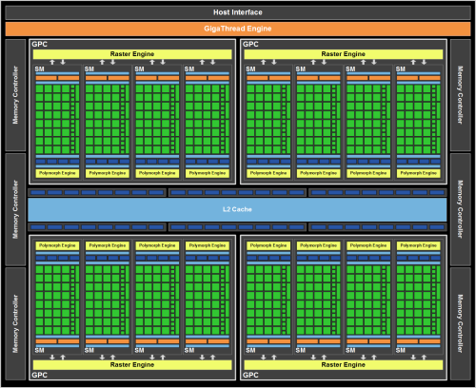
General-Purpose Scientific Computing
Currently, best performance is by GPGPUs
Generalized shader pipelines
Graphics 1st priority, generality 2nd
Power inefficient graphics-specific hardware
Can we improve efficiency by building a processor ground-up?

Slide 4
Important Domains
We mean scientific computing to be:
Dense matrix.
Large datasets.
Floating point computation intensive.
We specifically look at:
Communications, signal processing.
Mathematics.
Financial applications.

Slide 5
Inefficiency Sources
37% 35% 55% 60% 54% 90% 42% 95% 43% 37%
%GPU unutilized
GPU Utiliztion
No single common source, so no panacea.
GPUs unutilized even with thousands of threads.
Need a multi-faceted approach to mitigate inefficiency.

Slide 6
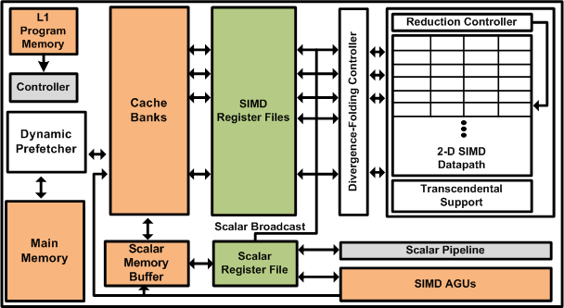
PEPSC
Wide SIMD architecture as a baseline.
Prefetching rather than threading for energy efficiency.
Novel datapath to eliminate datapath and divergence stalls efficiently.

Slide 7
Outline
Data-path stalls.
Memory stalls.
Control stalls.
Experiments and Results.
Conclusion.

Slide 8
Traditional SIMD
Lane 0
Lane 1
Lane 2
Lane 3
L
L
*
*
-
*
-
+
-
-
-
+
+
*
-
*
C[i] = A[i]*B[i]-B[i]-A[i]+x;
-
*
+
-
-
-
WB
WB
WB
WB
-
x
-
Register File
+
+
S
Notes:
Back to back operations feeding into each other.

Slide 9
2D SIMD using FPU Chaining
Register File
Register File
Register File
Register File
L
L
*
ALU0
ALU0
ALU0
*
ALU0
*
-
-
No intermediate values are written back to Register File.
ALU1
ALU1
ALU1
ALU1
-
-
x
-
ALU2
ALU2
ALU2
ALU2
-
+
+
ALU3
ALU3
ALU3
ALU3
+
S
Subgraph
depth?
MUX
MUX
MUX
MUX

Slide 10
2D SIMD using FPU Chaining
Register File
Increased performance
Fewer cycles/operation
Fewer instructions
Reduced power
Fewer intermediate values
=> Fewer RF R/W
Trade-offs:
Increased # RF ports
Increased area
1-Deep FPU
(3 cycle latency)
4-Deep FPU
(9 cycle latency)
F
P
U
0
Arithmetic
Preprocessor
Postprocessor
Register File
Use intermediate,
non-standard values
F
P
U
1
Pre-Proc
Arithmetic
Postprocessor
Arithmetic
Preprocessor
Postprocessor
F
P
U
2
Pre-Proc
Arithmetic
Normalizer
Postprocessor
F
P
U
3
Pre-Proc
Arithmetic
Postprocessor
Normalize at end
Subgraph
depth?
MUX
Normalizer

Slide 11
SIMD Width Efficiency Trade-offs
Chain Length
SIMD Width
Efficiency improves as chain-length and SIMD width increases.
Control flow divergence limits this efficiency.

Slide 12
Dual FPU Chains
Register File
Register File
Targets datapath stalls
Exploit ILP among chains
Requires:
Extra RF-W port
Extra RF-R port
Extra normalizer stage
Arith.
F
P
U
0
Pre.
Post.
Arithmetic
Preprocessor
Postprocessor
Pre.
Arith.
F
P
U
1
Pre-Proc
Post.
Arithmetic
Postprocessor
Pre.
F
P
U
2
Pre-Proc
Arith.
Arithmetic
Post.
Postprocessor
Pre-Proc
F
P
U
3
Pre.
Arithmetic
Arith.
Postprocessor
Post.
Subgraph
depth?
MUX
Normalizer
Normalizer
Normalizer

Slide 13
Dual-FPU Speedup
2-deep
4-deep
5-deep
FPU Chains FPU chain
By exploiting ILP among chains, on an average 18% speedup could be found.

Slide 14
Memory Stalls
GPUs use massive multithreading to hide memory stalls:
Inefficient in terms of static power.
Already several MBs of register file on GPUs
Caches + Prefetching
Reduce # of thread contexts
Works across different memory latencies

Slide 15
Weighted Average Degree
Weighted Average Degree.
Significant variation between benchmarks
Single-stride is insufficient
Significant variation in degree between different loops
Notes:
“Degree” is how many iterations it takes for a load to be ready; how many iterations ahead you need to issue a prefetch

Slide 16
Dynamic Degree Prefetcher
Prefetch Table
Current PC
Load PC | Address | Stride | Confidence | Degree
0x253ad | 0xfcface | 8 | 2 | 2
1
+
Enable
Create entry in PF table
based on last two requests
1
+
>
1
Prefetch Queue
Miss address
Prefetch
Enable
-
=
+
Prefetch Address
On every subsequent
miss, re-check stride
and improve confidence
Increase degree if miss
in the cache is already queued in the PFQ

Slide 17
DDP Results
~2.5X speedup from Degree-1
~3.5X from DDP
80% reduction in D-cache wait latency.

Slide 18
Divergence-Folding
Register File
Register File
Reduce control-flow overhead.
Use dual-FPU chaining to execute opposite sides of branches concurrently.
Support simultaneous dual path execution.
e + f
Arith.
Pre.
Post.
Pre.
+ g
Arith.
Post.
if (cond2)
a = b + c + d;
else
a = e + f + g;
“then”
Pre.
b + c
Arith.
Post.
Vt1 = Vb + Vc [0xFF00]
Va = Vt1 + Vd [0xFF00]
Vt2 = Ve + Vf [0x00FF]
Va = Vt2 + Vg [0x00FF]
“else”
Pre.
+ d
Arith.
Post.
Normalizer
Normalizer

Slide 19
Other Serializing Constructs
Several instances of inner loops aggregating single value
FP adder tree could help mitigate this
log(SIMD width) depth
Minimal area overhead with FPU chaining
Potential for 5-6X speedup of aggregation
Lane0
Lane1
Lane2
Lane3
FPU0
FPU1
FPU2

Slide 20
Evaluation Methodology
Trimaran compiler used to find chains of dependent instructions.
Major components synthesized using Design Compiler. Power measured using Prime Time.
For memory system simulation, we used M5.
L1 : 512B per SIMD Lane, 1 cycle latency.
L2 : 4kB per SIMD Lane, 10 cycle latency.
Memory : 200 cycle latency.

Slide 21
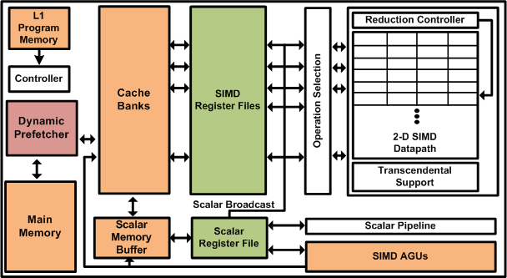
PEPSC Architecture
750MHz @ 45nm
32-way SIMD
120 GFLOPs
~2.1 W/core
1 TFLOP
@ 9 cores, 19 W
Power-Efficient Processor for Scientific Computing

Slide 22
Utilization Improvement on GPU
5%
21%
47%
85%
41%
370%
29%
1340%
67%
33%
%Improvement in utilization.
GPU Utilization
On an average 2x increase in utilization for GPUs with our techniques.

Slide 23
Comparisons
GTX 280 peak
GTX 280 realized
(with enhancements)
PEPSC peak
GTX 280 realized
(without enhancements)
PEPSC realized

Slide 24
Conclusion
GPUs generally energy-inefficient for scientific computing.
PEPSC addresses various reasons of inefficiencies by GPUs.
Chained FPU datapath design.
Dynamic Prefetching reduces memory stalls.
Hardware for handling control divergence.
PEPSC provides a 10x efficiency over modern GPUs.

Slide 25
PEPSC : A Power Efficient Computer for Scientific Computing.
Questions?

