Slide 1
Embracing Heterogeneity with Dynamic Core Boosting
Hyoun Kyu Cho and Scott Mahlke
University of Michigan
May 20, 2014

Slide 2
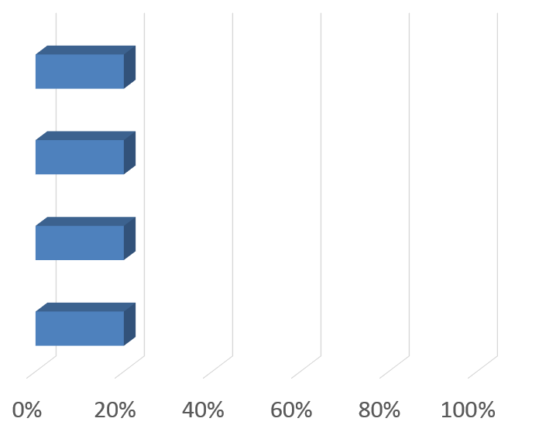
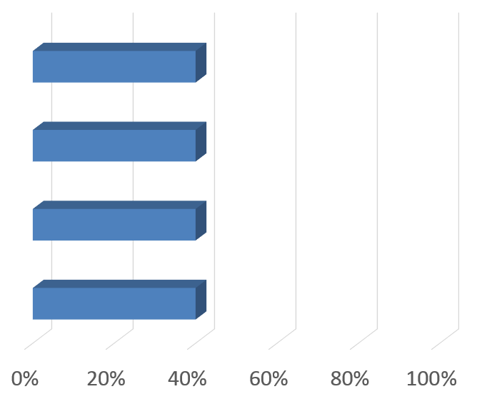
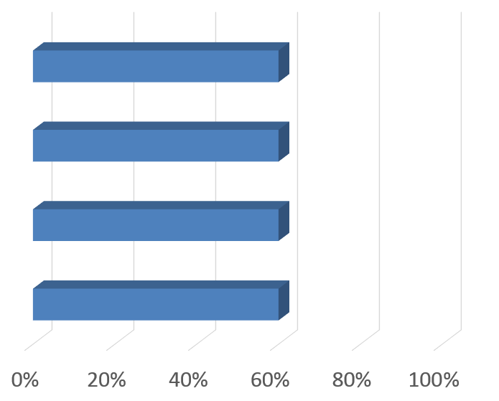
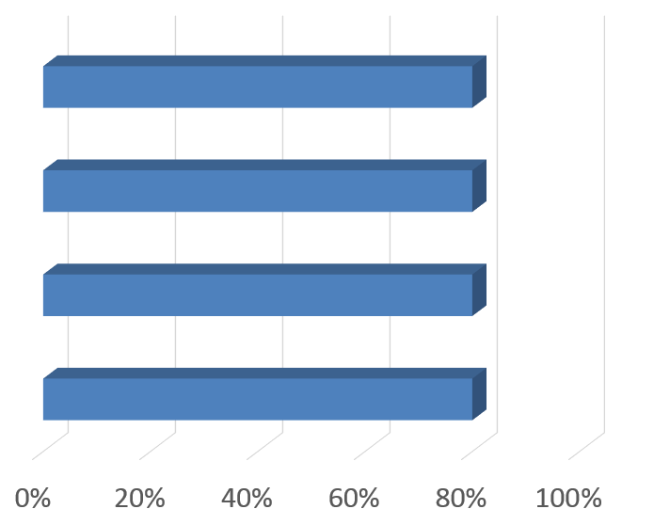
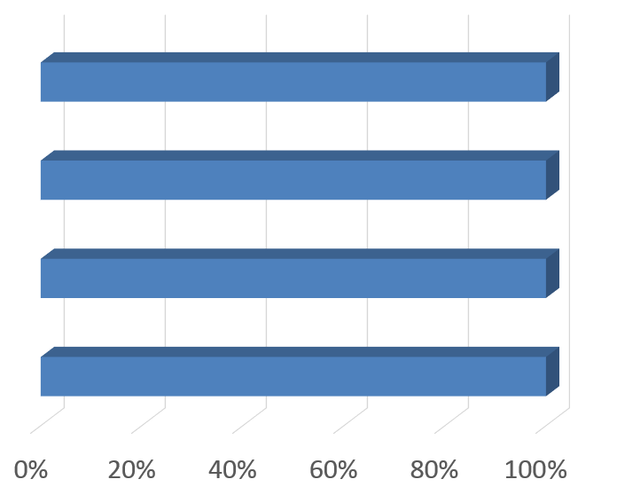
Parallel Programming
Core1
Core2
Workload
Core3
Core4

Slide 3
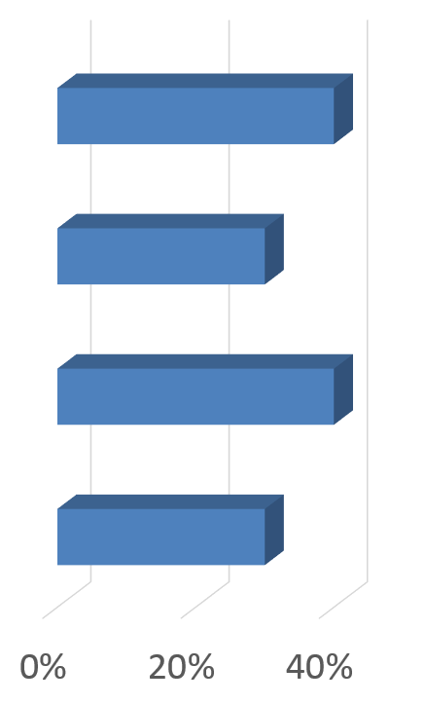
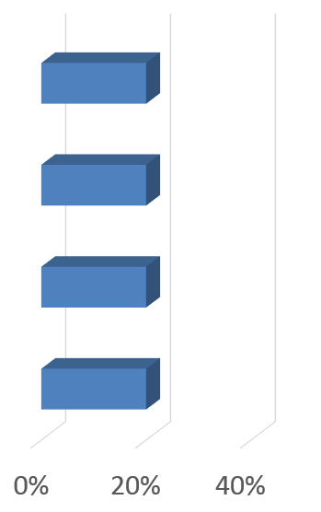
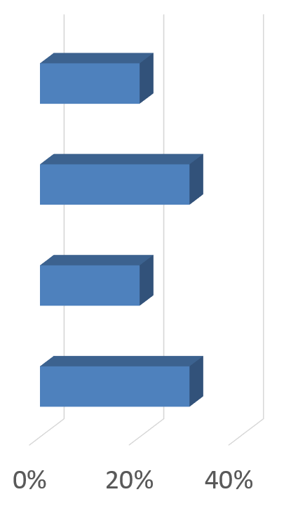
Workload Imbalance Among Threads
Asymmetric S/W
Control flow divergence
Non-deterministic memory latencies
Synchronization operations
Asymmetric H/W
Heterogeneous multicores
Core-to-core process variation

Slide 4
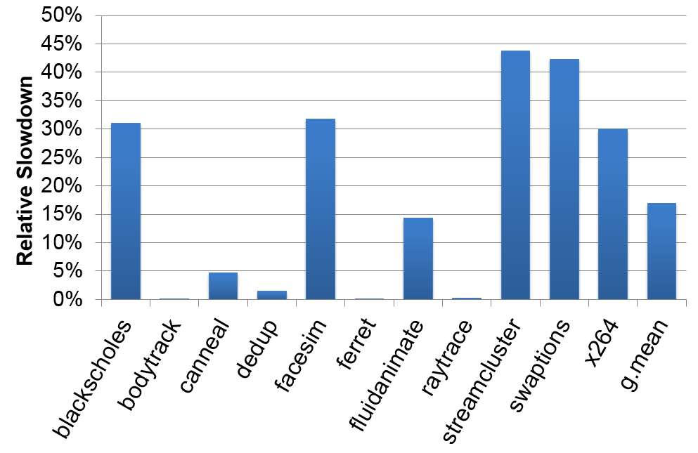
Performance Impact of Asymmetric H/W
Symmetric 8 Cores vs. 8 Cores w/ variations

Slide 5
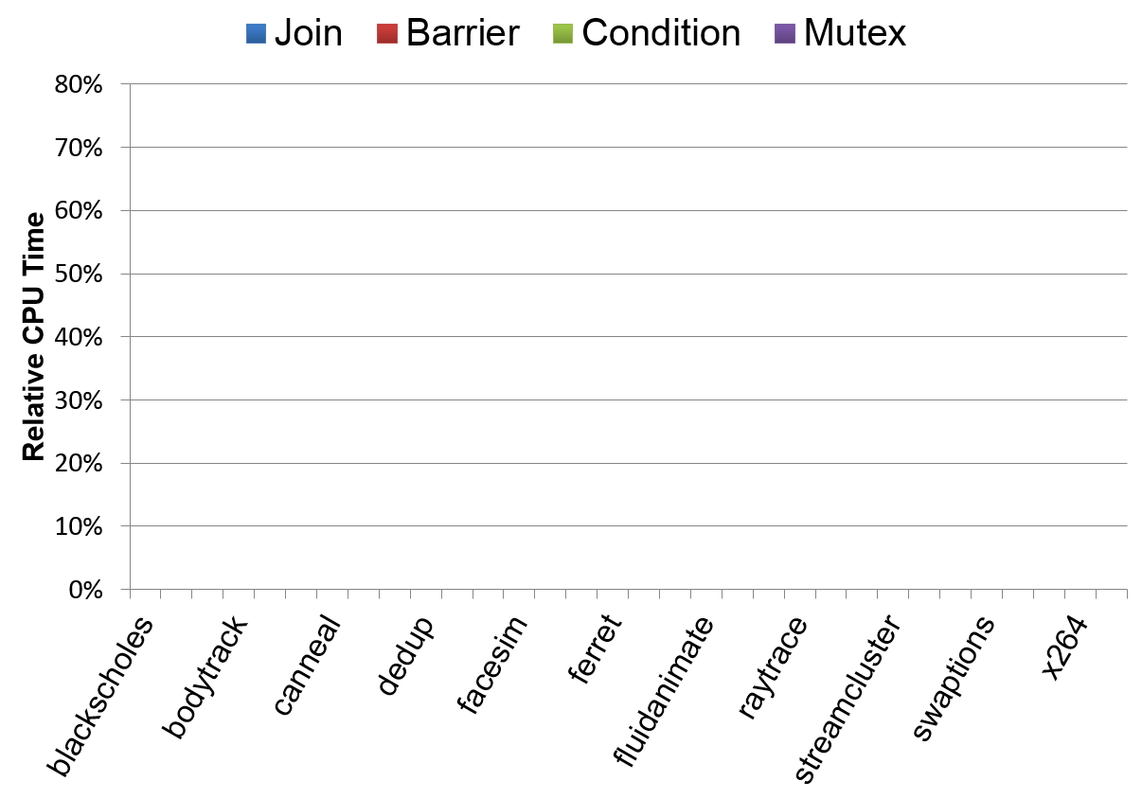
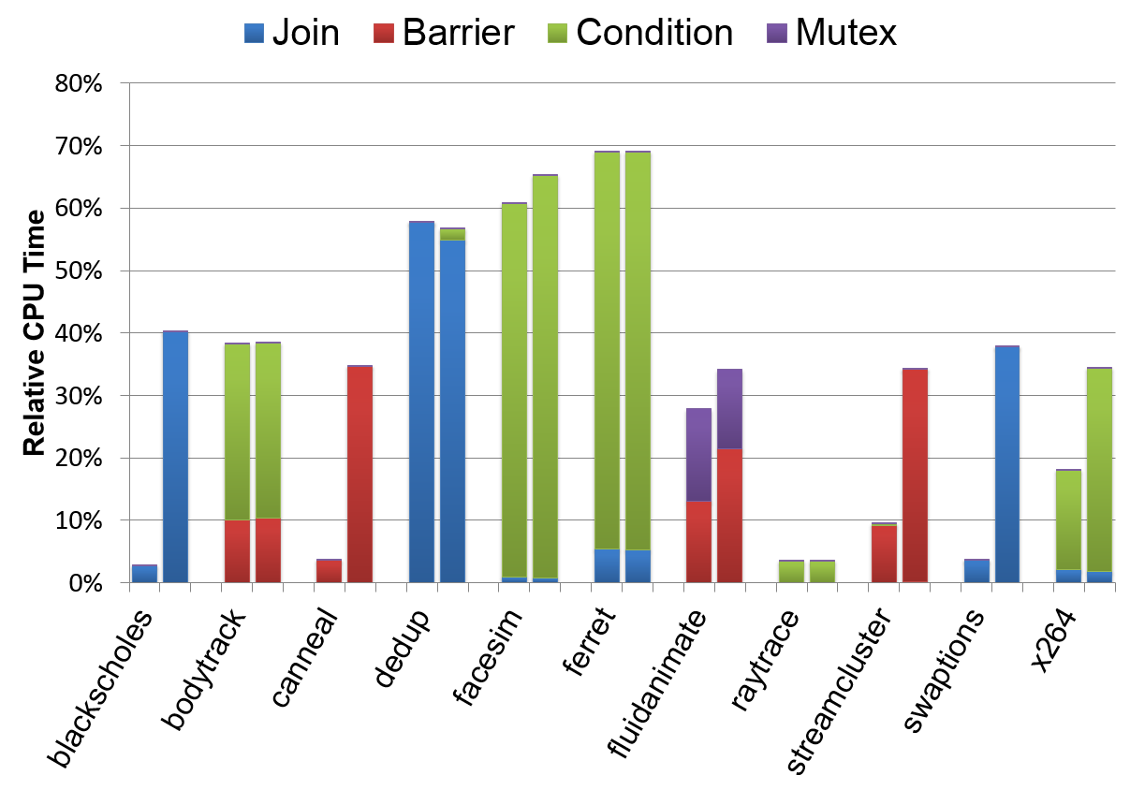
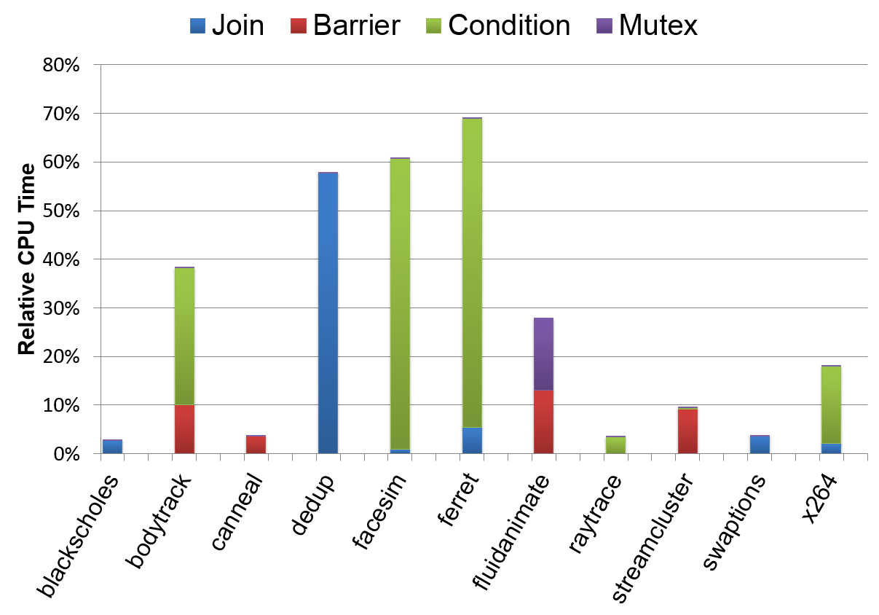
CPU Time Wasted for Synchronization
Homogeneous
Heterogeneous

Slide 6
Thread Criticality due to Workload Imbalance
Barrier
T1
Idle
T2
T3
T4
T5
time
T1
T2
T3
T4
T5
time

Slide 7
Accelerating Critical Path w/ Core Boosting
Barrier
T1
Idle
T2
T3
T4
T5
time
T1
T1
T2
T2
T3
T3
T4
T4
T5
T5
time
time

Slide 8
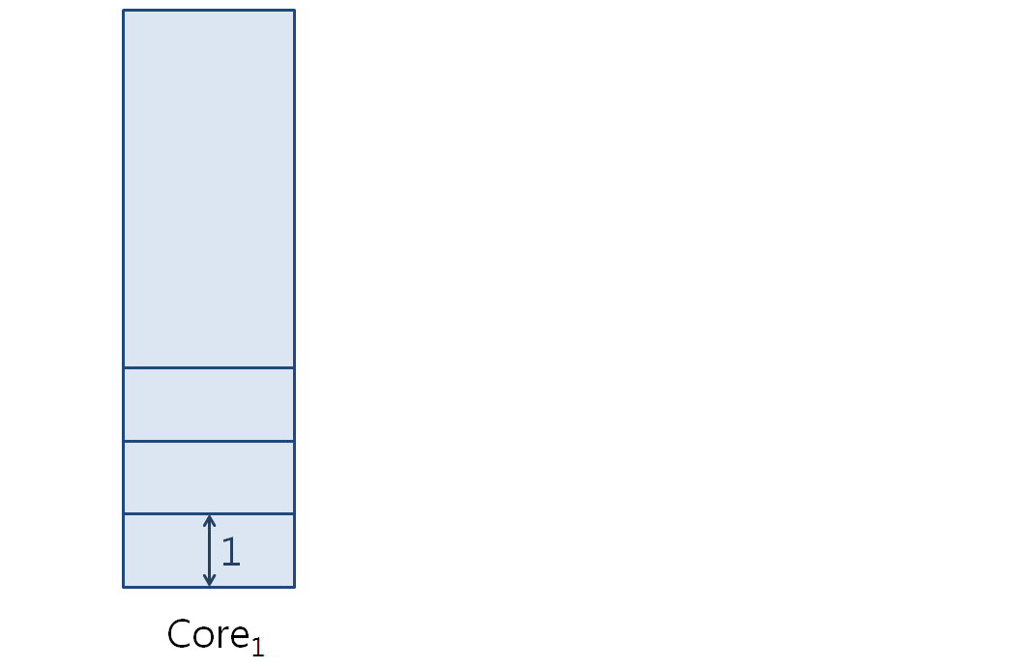
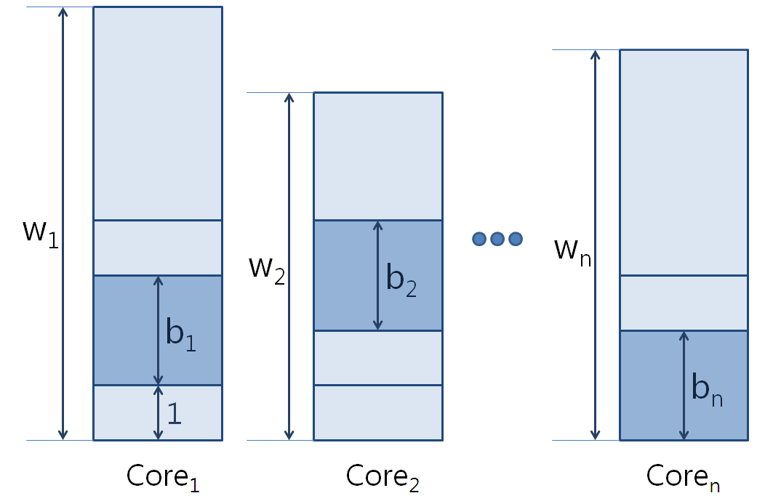
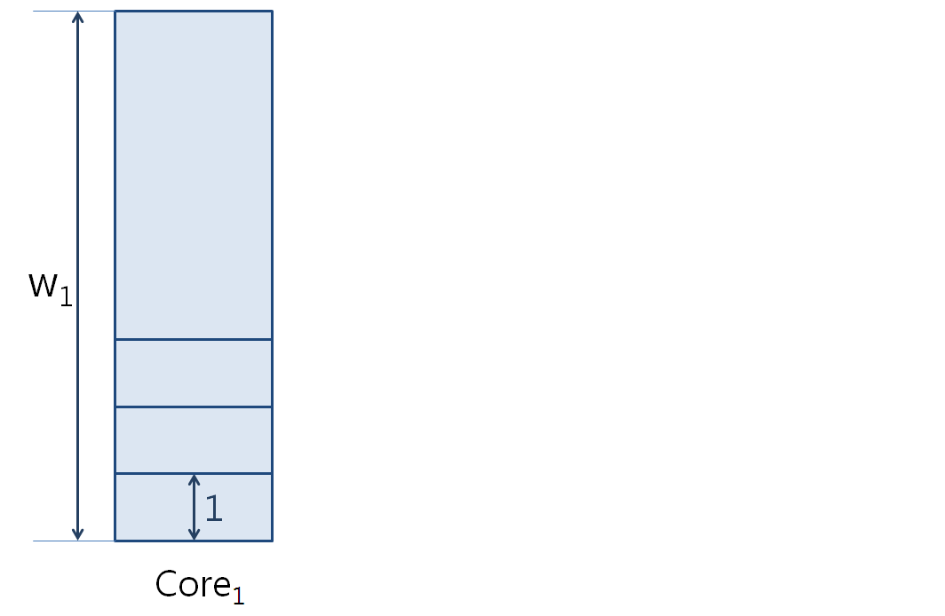
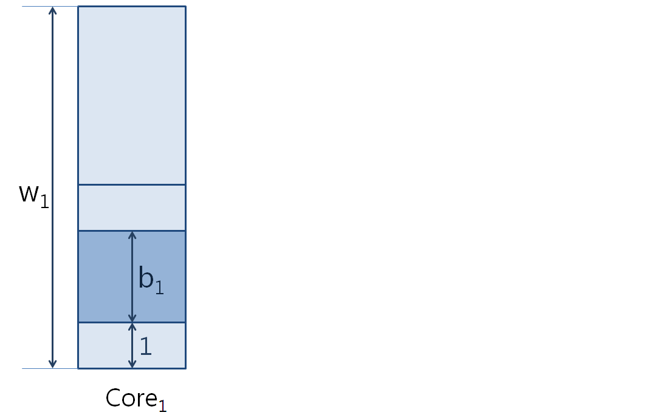
Modeling Workload Imbalance & Boosting

Slide 9
Boosting Assignment
Data parallel programs
Pipeline parallel programs
Worker
Worker
Worker
Worker
Worker
Stage1
Stage2
Stage3
Stage4

Slide 10
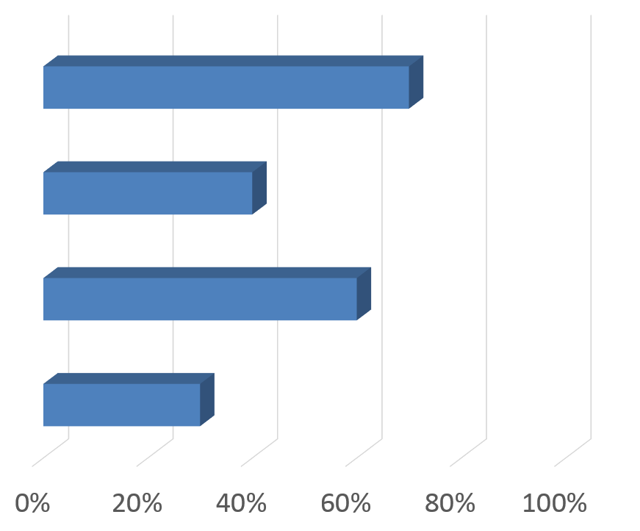
Boosting Data Parallel Programs
Greedy scheduling

Slide 11
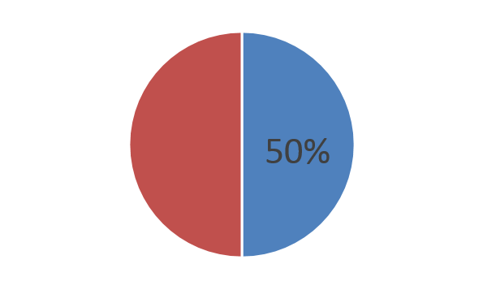
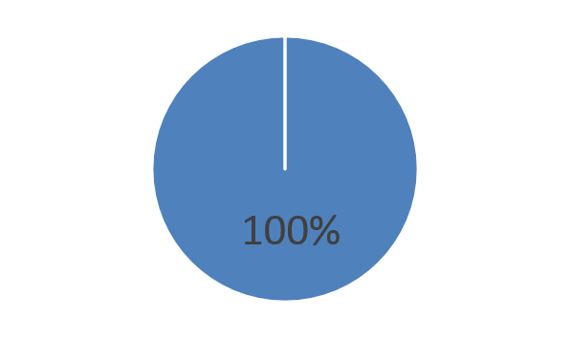
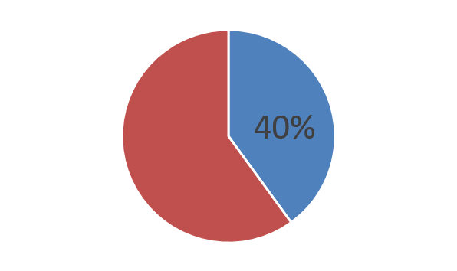
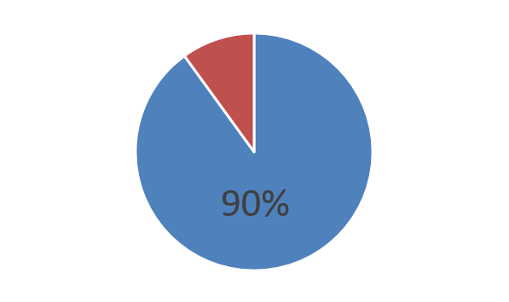
Boosting Pipeline Parallel Programs
Epoch-based scheduling
Monitors CPU utilization with H/W performance counter
Assigns boosting budget at the end of epoch

Slide 12
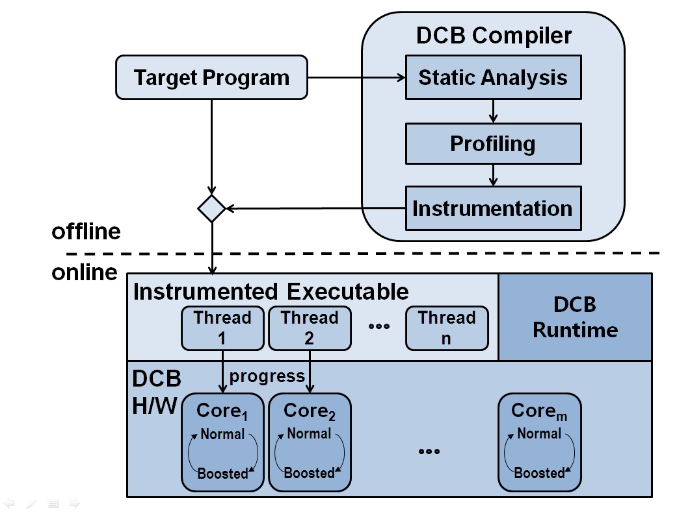
Dynamic Core Boosting

Slide 13
Progress Monitoring Example
…
pthread_barrier_wait(barrier);
period = calc_period_LID_007(start, end);
for ( i = start ; i < end ; i++ ) {
…
compute(…);
if ( side_exit ) {
SET_PROGRESS_TO(MAX_PROGRESS_007);
break;
}
if ( ( ( end – i ) % period ) == 0 )
PROGRESS_STEP_FORWARD;
}
pthread_barrier_wait(barrier);
…

Slide 14
Evaluation Methodology
Asymmetry emulation with Dynamic Binary Translation
Slow down proportionally instead of accelerating
8 cores with frequency variation
1 core boosted, boosting rate = 1.5x
Compares
Heterogeneous
Reactive
DCB

Slide 15
Performance Improvement

Slide 16
Synchronization Overheads

Slide 17
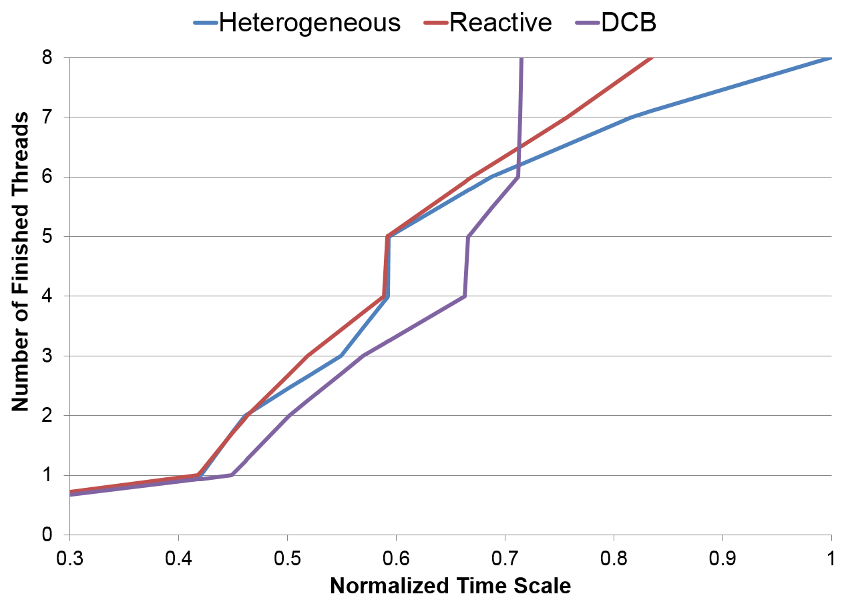
Thread Arrival Time

Slide 18
Conclusion
DCB mitigates workload imbalance in performance asymmetric CMPs
Accelerating critical threads
Coordinating compiler, runtime, and architecture for near-optimal assignment
Overall, improves performance by 33%, outperforming a reactive boosting scheme by 10%

Slide 19
Thank you!

Slide 20
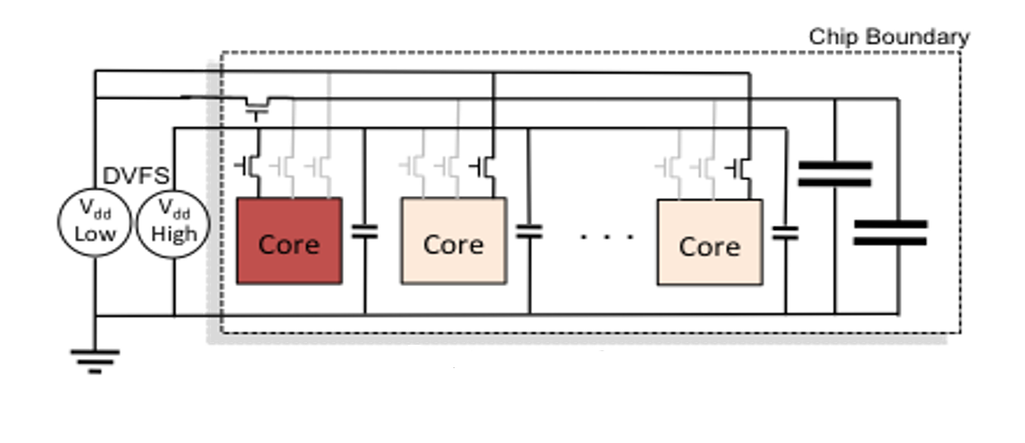
Core Boosting with Frequency Scaling
Transition time < 10ns
[Dreslinski`12]

Slide 21
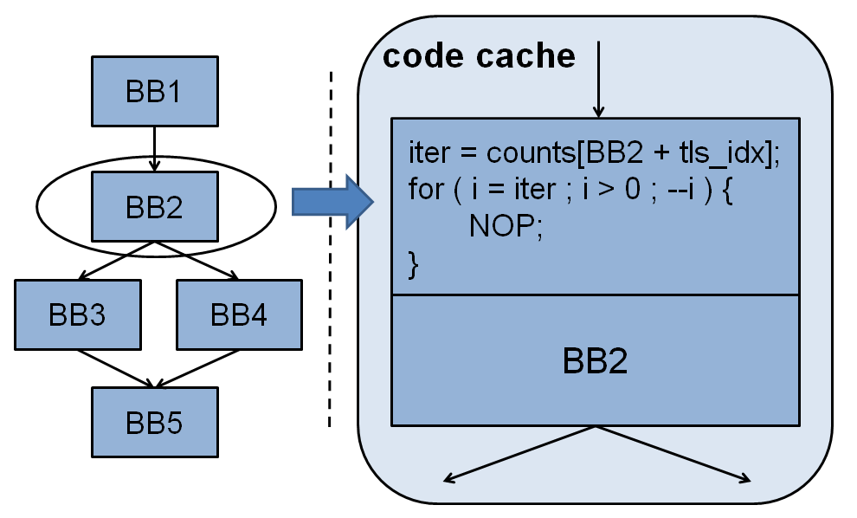
Asymmetry Emulation with DBT

Slide 22
Evaluation Platform Accuracy

